Slide 1
BE
English for Hotel 1: Taking reservations Aj. Sunattha Krudthong

Slide 2
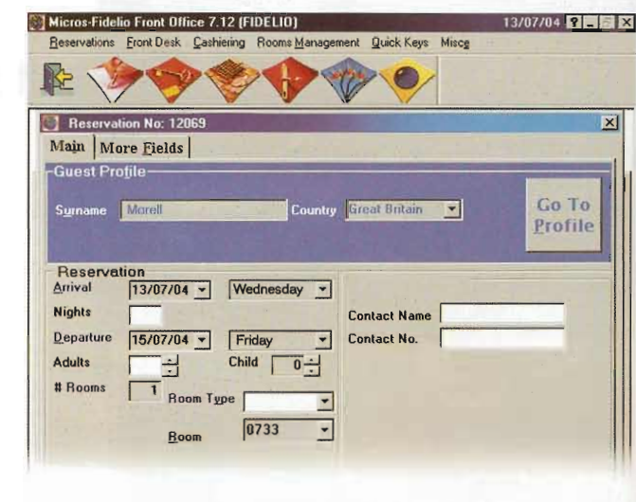
Fidelio Reservation System
Customer Profile
Name and Country
Arrival and Departure date
Number of night
Number of people
Number of room
Room type
Contact details
Payment details
Credit card details

Slide 3
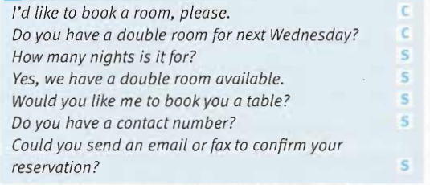
In this unit
Language study

Slide 4
Listening :
Taking a room reservation

Slide 5
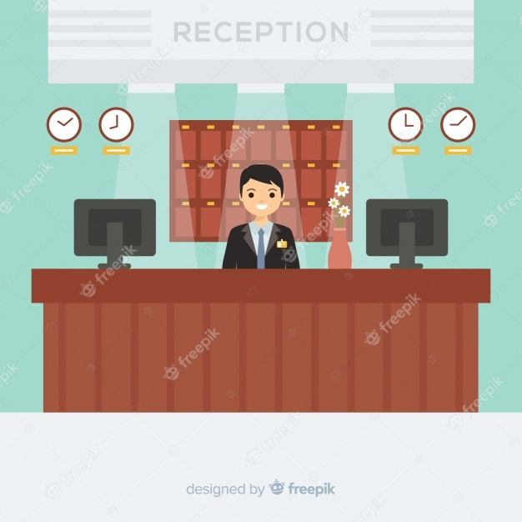
1. I’d like to……………………for a ……………of six.of six.

Slide 6
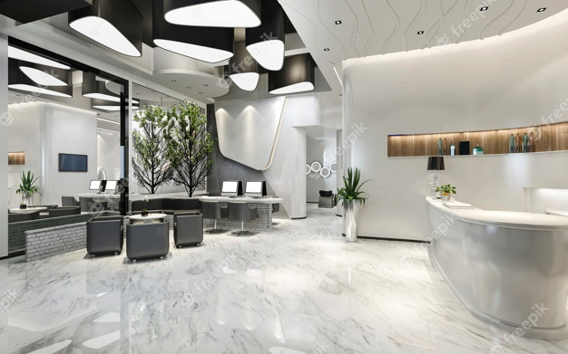
2. We…………………..on Sunday…………………10th……………………….May.

Slide 7
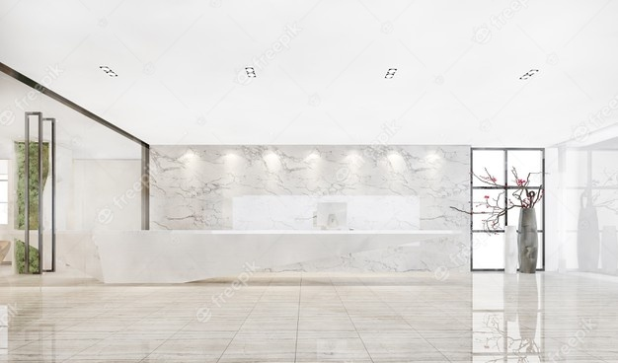
3. We……………..one double room, one twin room and……………………rooms.

Slide 8
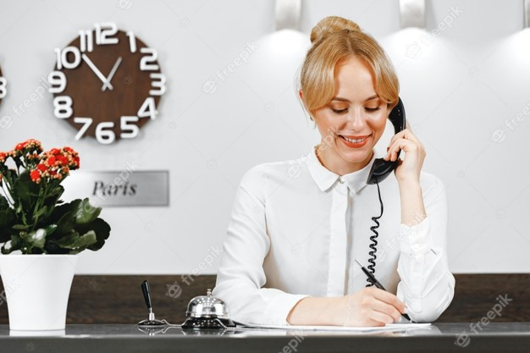
4. Let me…………………………..our reservations.

Slide 9
5. The double and twin room…………………is 200€, and……………..is 128€

Slide 10
6. We will………………………arrive………………..the evening,…………….about eleven o’clock.

Slide 11
7.And can you…………………the three security numbers……………………of the card, too,please?

Slide 12
8. We …………………..to………………….you……………………the 10th of May.

Slide 13
Use each word or phrase once to complete the text. running late switchboard connects put calls through makes a note hold the line hold their rooms arrange
Jessica works on the hotel …………. at the Como hotel in Milan. Most of the time, she can…………. to the different hotel departments or the guests’ rooms. She just asks the callers to……….. While she………..the calls. Sometimes, guests call to ask for a child’s bed in their room. Jessica asks housekeeping to……………..this. Guests who are ……………often call to inform reception. Jessica asks reception to………… If there’s a call for the manager and he’s not in his office, she……………….. of any message and leaves it on his desk.

Slide 14
Vocabulary
attendant overbooked
flat overcooked
Important short-staffed
next door straightaway
Nobody undercooked
Mistake complaints

Slide 15
Make questions and short answers
They arrived last night. (yes)
He reserved two double rooms. (no)
You heard what she said. (no)
Mr. Alimoglu called from Istanbul. (yes)
She ordered a cooked breakfast. (yes)
You booded a table for one o’clock. (no)
Past simple: Negative statements
Use didn’t to make negative statements in th4eh Past Simple.

Slide 16
Put the words in the correct order to make requests and offers
lemon/you/like/ice/Would/and/?
Smoke/ in/ Can/ here/ I/ ?
Reservation/ Shall/ check/ I/ your/?
Menu/ I/ a / have/ Could/?
Like/ more/ Would/some/you/?
Could/ the/ pool/ I/ swimming/ use/ ?

Slide 17
Complete the sentences with adverbs of frequency
always often sometimes rarely never
I ………………………..(50%) eat lunch at work.
The car park is …………………(75%) full.
She………………..(0%) works on Wednesday.
We………………….(25%) leave a tip.
The food is ………………..(75%) very good.
They …………(50%) visit Spain.
The manager…..(75%) speaks English.
He………….(100%) stays in the same hotel.

Slide 18
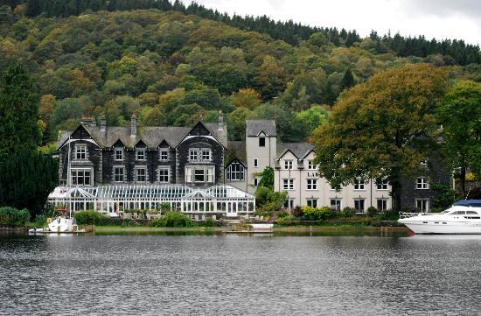
Lakeside HOTEL
INTERNAL CALLS
Reservations manager
Restaurant
Kitchen
Housekeeping
Reception
Room service
Rooms
Beauty salon
Security
Conference manager
Central bar
620
220
120
540
600
580
Room number
350
700
800
240
EXTERNAL CALLS
Dial 9 and wait for the dialling tone.
Then dial the number

Slide 19
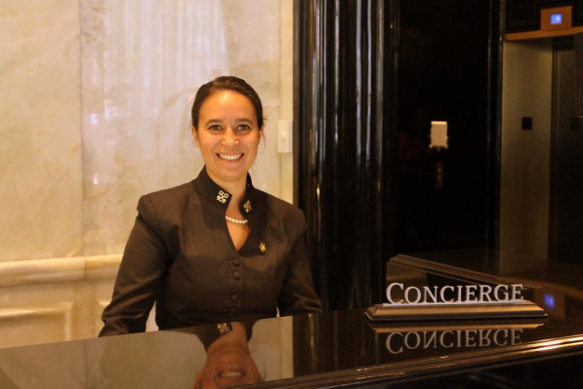
Match a word in each box to make a new noun.
business car
currency gift
hair internet
Shuttle taxi
Tourist airport
Bus parking
stop salon
access space
bus attractions
centre exchange
transfer shop
rental rank

