Slide 1
Tables, Charts and Graphs/
Describing trends
Business English
SSRU

Slide 2
Tables
A table displays content arranged in vertical columns and horizontal rows. This makes data comparison easy. Tables usually show exact numerical data. The aim of the table is to show data details or words in orderly manner and to understand them easily.

Slide 3
Charts
There are three types of charts including bar charts, pie charts and line charts
02
03
01

Slide 4
Bar charts
Bar charts are easy to interpret because they ask people to compare distance along a common scale. Bar charts are useful in a variety of situations:
To compare one item to another
To compare items over time, and
To show correlations

Slide 5
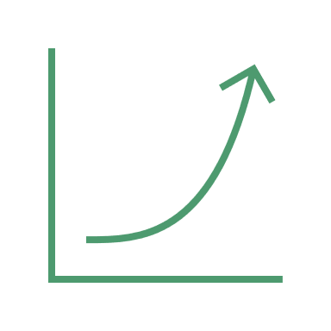
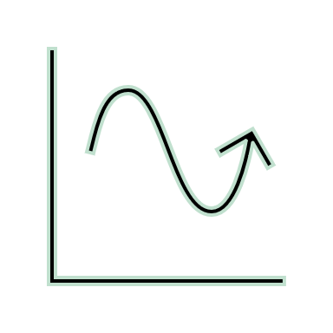
Line Charts
Line charts illustrate trends over time or plots the relationships of two variables. In line charts showing trends, the vertical, or y, axis shows the amount, and the horizontal, or x, axis shows the time.

Slide 6
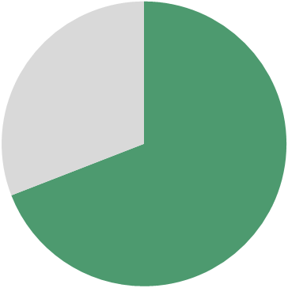
Pie Charts
A pie chart is used to show the distribution and relationships of the parts to a whole. The data in any pie chart can be put in a bar chart. Therefore, pie chart is utilized when you are comparing one segment to the whole.

Slide 7
Describing Trends
04
02
03
01
Verb | Noun | Trends
To increase | An increase
To rise | A rise
To climb | A climb
To decrease | A decrease
To decline | A decline
To reach a peak | A peak
To fluctuate | A fluctuate

