Slide 1
Unit 12 Airport departures
AJ. Sunattha Krudthong

Slide 2
Take off
1 How many airports have you been to?
2 What's your favorite airport? Why?
3 Where do you think would be the most interesting place to work in an airport? Where would be the most dangerous?

Slide 3
Where in the world?
1 Does the plan show the departures level or the arrivals level?
2 What happens when travellers depart from and arrive at an airport? Divide the following into departure and arrival procedures and put them in the order in which they occur.
a. passport control g. baggage reclaim
b. board the plane h. check-in desk
c. security check i. departure gate
d. immigration j. get off the plane (disembark)
e. departure lounge k. customs
f. arrivals hall

Slide 4
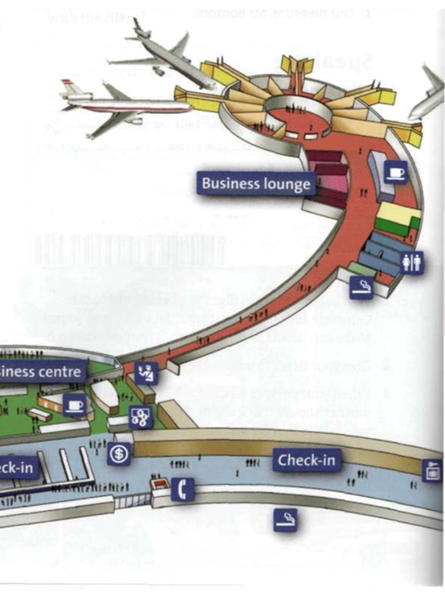
Is the airport similar to your local airport?

Slide 5
In this unit
• airport facilities, services, and procedures
• responding politely to questions and requests
• airport dialogues
• giving orders, stopping people doing something

Slide 6
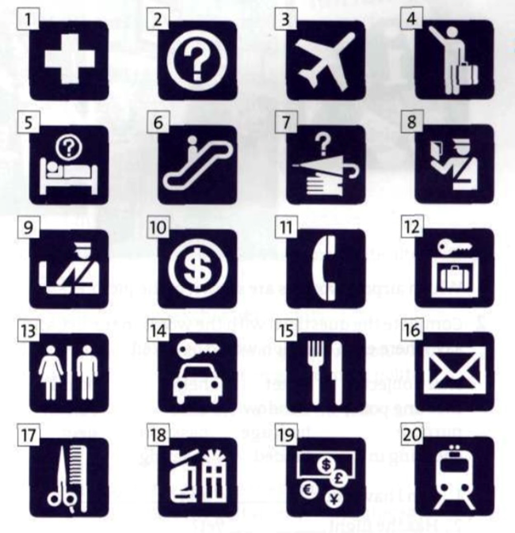
Vocabulary Airport facilities and services
1 What do the symbols of airport facilities represent?

Slide 7
2. Which symbol represents a place where
a you can store your baggage?
b you can get emergency medical treatment?
c you can rent a car?
d you may have your luggage searched?
e you might find something you have lost?

Slide 8
3. Match the words in the list with the symbols.
a note reservation j lost property r lifts
b immigration k smoking area s bar
c luggage trolleys 1 post office t first aid
d restaurant / café m information u customs
e bureau de change n hairdressers v toilets
f baggage store o escalator w telephones
g email and Internet p departures x arrivals
h railway station q shops y car rental
i cashier

Slide 9
Find out about your nearest airport and complete the fact file.

