Slide 1




Company Structure and
Organization Chart
Business English
SSRU

Slide 2


Company structure
Each company establishes an company structure that identifies responsibilities for each job position, communication, policies, authority and the relationship among those positions. A company structure consists of various departments that contribute to the company’s overall mission and goals.

Slide 3




Organization chart
A company’s organizational structure can be illustrated with an organization chart. Organization chart shows lines of authority among the various positions within an organization. This type of chart shows the relationship among departments and among personnel within the departments. The chart represents the entire organization or a selected portion of it. The senior position is placed at the top of the chart. Other positions are placed on the chart in descending order of authority.

Slide 4
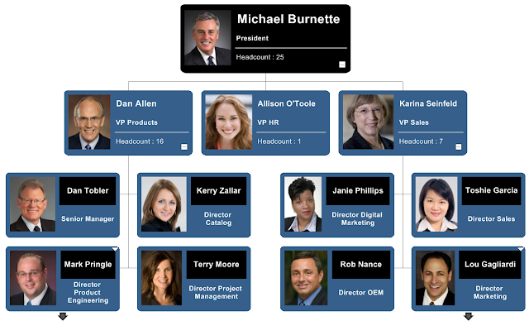
Example of organization chart

Slide 5

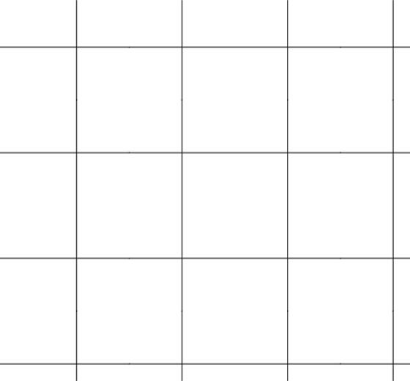

Layers of management
An organisational structure is how a business organises its staff to represent the different layers of management. This information can be displayed in the form of a chart. There are two main types of organisational structure used in businesses – hierarchical (or tall) and flat.
Different companies utilize different organizational structures. The specific organizational structure employed by the company may be influenced by the specific characteristics of its business.

Slide 6
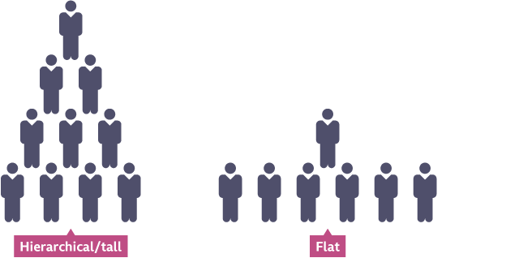
Tall vs. Flat organizational structures

Slide 7
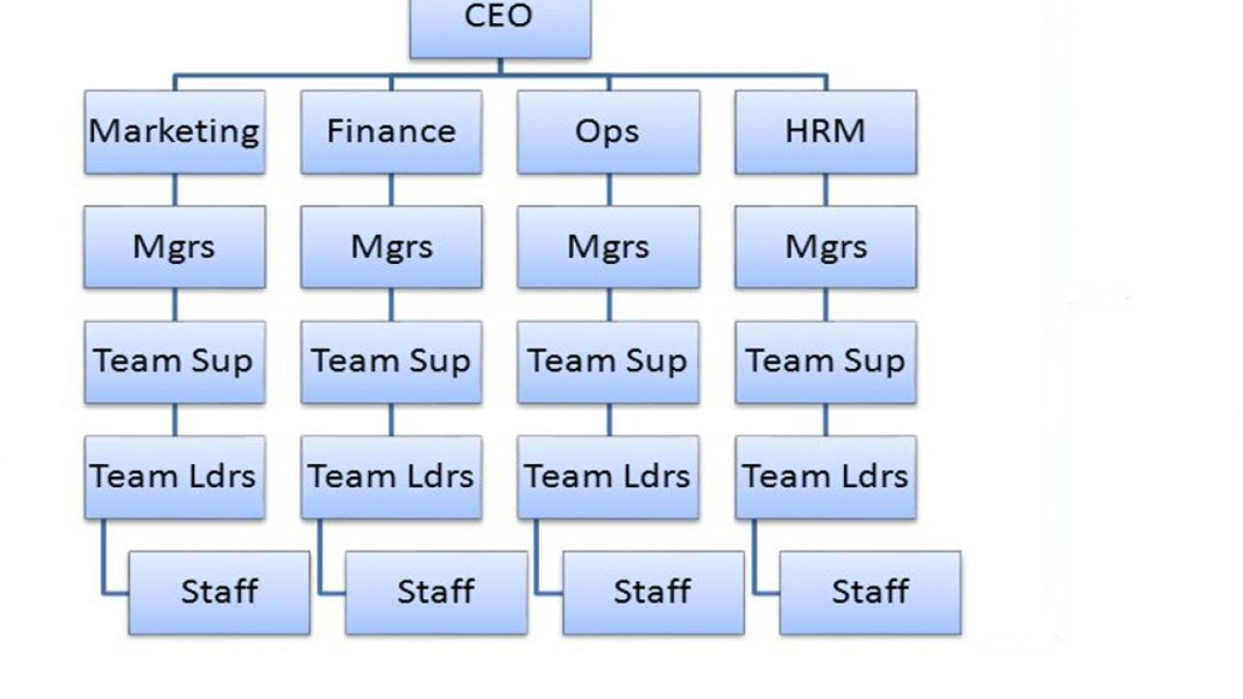
Hierarchical (Tall) organisational structure
A hierarchical structure is often also referred to as a ‘tall’ organisational structure. A hierarchical structure has many layers of management, and businesses with this structure often use a ‘top-down’ approach with a long chain of command. In a hierarchical structure, managers will have a narrow span of control and a relatively small number of subordinates (staff).
Large, complex organizations often require a taller hierarchy. Employees in tall organizations recognize defined levels of leadership within the organization; authority and levels of responsibility are obvious. The narrow span of control allows for close supervision of employees. Opportunities for promotion motivate employees to perform well.
A hierarchical organization follows the layout of a pyramid. Every employee in the organization, except one, usually the CEO, is subordinate to someone else within the organization.
Challenges begin when a structure gets too tall. Communication begins to take too long to travel through all the levels. These communication problems hamper decision-making and hinder progress.

Slide 8
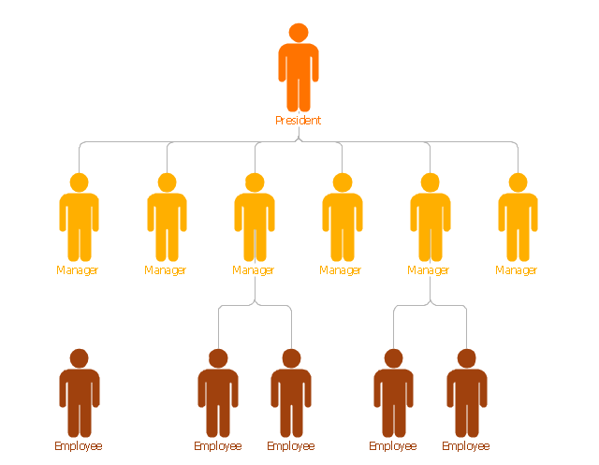
Flat organizational structure
Flat organizational structures differ in that there are fewer levels of management. A flat structure is an organisational structure with only a few layers of management. In a flat structure, managers have a wide span of control with more subordinates, and there is usually a short chain of command. Flat organisational structures are commonly used by smaller businesses or those adopting a more modern approach to management. The flat organization supervises employees less while promoting their increased involvement in the decision-making process. Employees often have more independence. It also improves the coordination and speed of communication between employees.

Slide 9
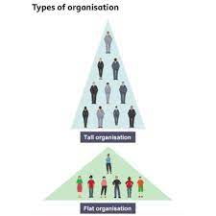

Key terms in organisation structure
span of control - the number of staff that a manager has responsibility for
chain of command - the route by which instructions and communications flow from the top to the bottom of a business, explaining who is answerable to whom
subordinates - members of staff below a manager in the chain of command

Slide 10









Levels of Management
There are three levels of management including
  top (high-level) management,
  middle management, and
  supervisory management.
In order to understand this clearly, it will be illustrated briefly.

Slide 11



Top management contains several positions such as president, chief executive officer, chief financial officer, and vice president.
Middle management refers to positions such as regional manager and plant manager. It is often responsible for the company’s short-term decisions.
Supervisory management including positions such as account manager and office manager is usually responsible for the employees who engage in the day-to day production process.
Top management
Middle Managers
Supervisory managers
Production/Operations staff
Levels of management

Slide 12



Levels of Management
Top Management
Set new plan to expand production and increase sales
Communicate those plans to all managers
Top
Management
Middle Managers
Middle Managers
Determine how many new employees to hire
Determine how to charge lower prices to increase sales
Determine how to increase advertising to increase sales
Determine how to obtain funds to finance the expansion
Supervisory Managers
Supervisory Managers
Provide job assignments to the new employees.
Set time schedules for new employees who are hired.
Employees/ Staff

Slide 13


Top
Management
Chief Executive Officer
CEO
Managing Director
MD
CEO/MD/President is the highest-ranking corporate officer or administrator in charge of total management of an organization. The responsibilities of an organization’s CEO or MD are
Developing strategy of the company
Developing annual plans with agreed strategies
Planning human resources to ensure that the company has the capabilities and resources required to achieve its plans
President/ Vice President
VP

Slide 14
Managers
The manager wears many hats. Not only is a team leader but he or she is also a planner, organizer, problem solver and decision maker
Planning
Organising
Leading
Coaching
Planning is the process of thinking and organizing the activities to achieve a desired goal.
Organising is to rearrange a team and materials according to plan.
Leading involves motivating, communicating, guiding and encouraging.
Training and developing existing employees.

Slide 15

Q&A

