Slide 1
Meeting agenda and minutes
Aj. Sunattha Krudthong
Business Reading

Slide 2
Meeting agenda structure
Title of the meeting : Human Resouces weekly meeting, Operation weekly meeting, Finance and Accounting monthly meeting
Date, Start, End time and attendees (ผู้เข้าร่วมประชุม) of the meeting
Venue of the meeting
Issues to be discussed in the meeting/ Points, topics, agenda

Slide 3
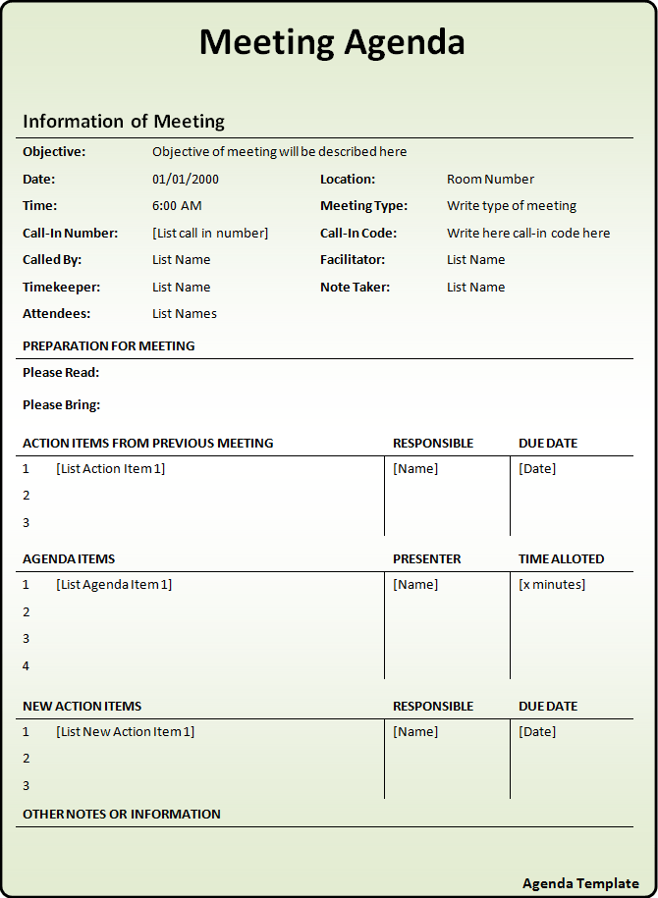
Vocabs
Objective
To discuss
To solve the problems
To review some issues
To revise some documents
2. Facilitator ประสานงาน
3. Recording secretary /Note taker
4. New items- task assignments
5. Due date - Time deadline
6. Time allocation – กำหนดเวลา

Slide 4
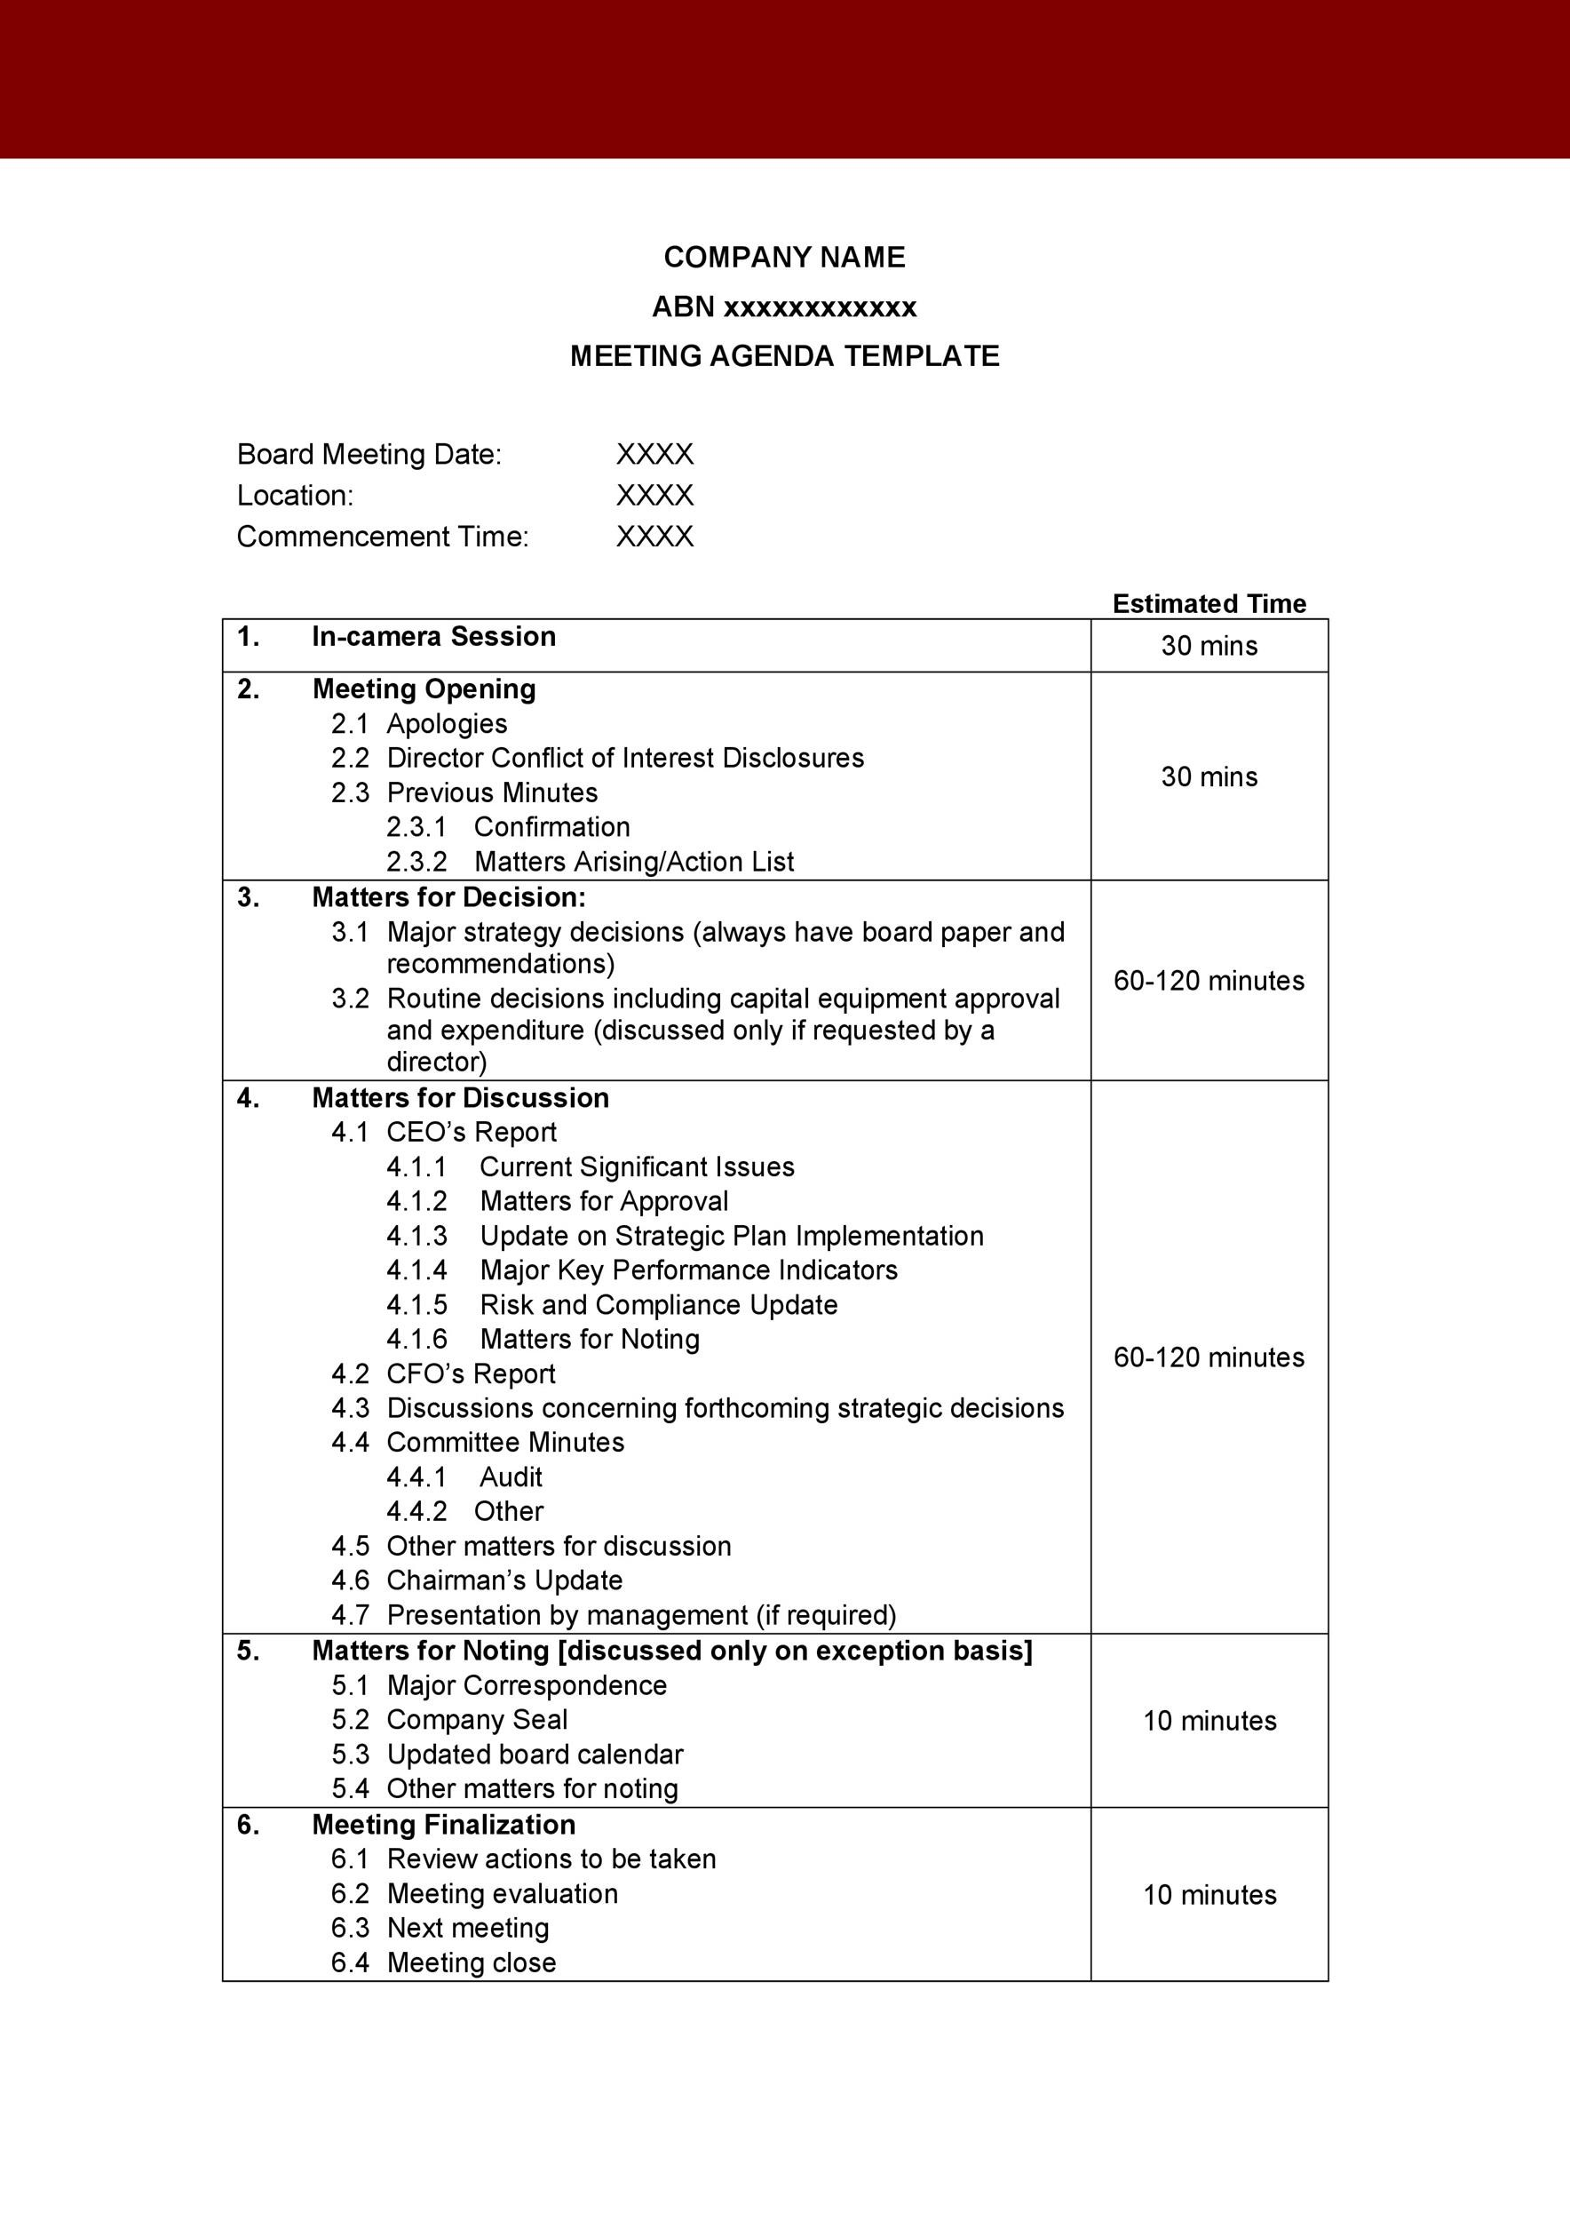
In-detailed agenda
Vocabs
1. Apologies คำขอโทษ – absent attendees
2. Matters – Happenings
3. Noting – note
4. Finalized, finalization สรุป
5. New items or next meeting
Agenda patterns
Noun e.g. apologies, confirmation,
Audit
Noun + noun e.g. committee minutes, company seal
Adj + noun e.g. previous minutes
Current issues

Slide 5
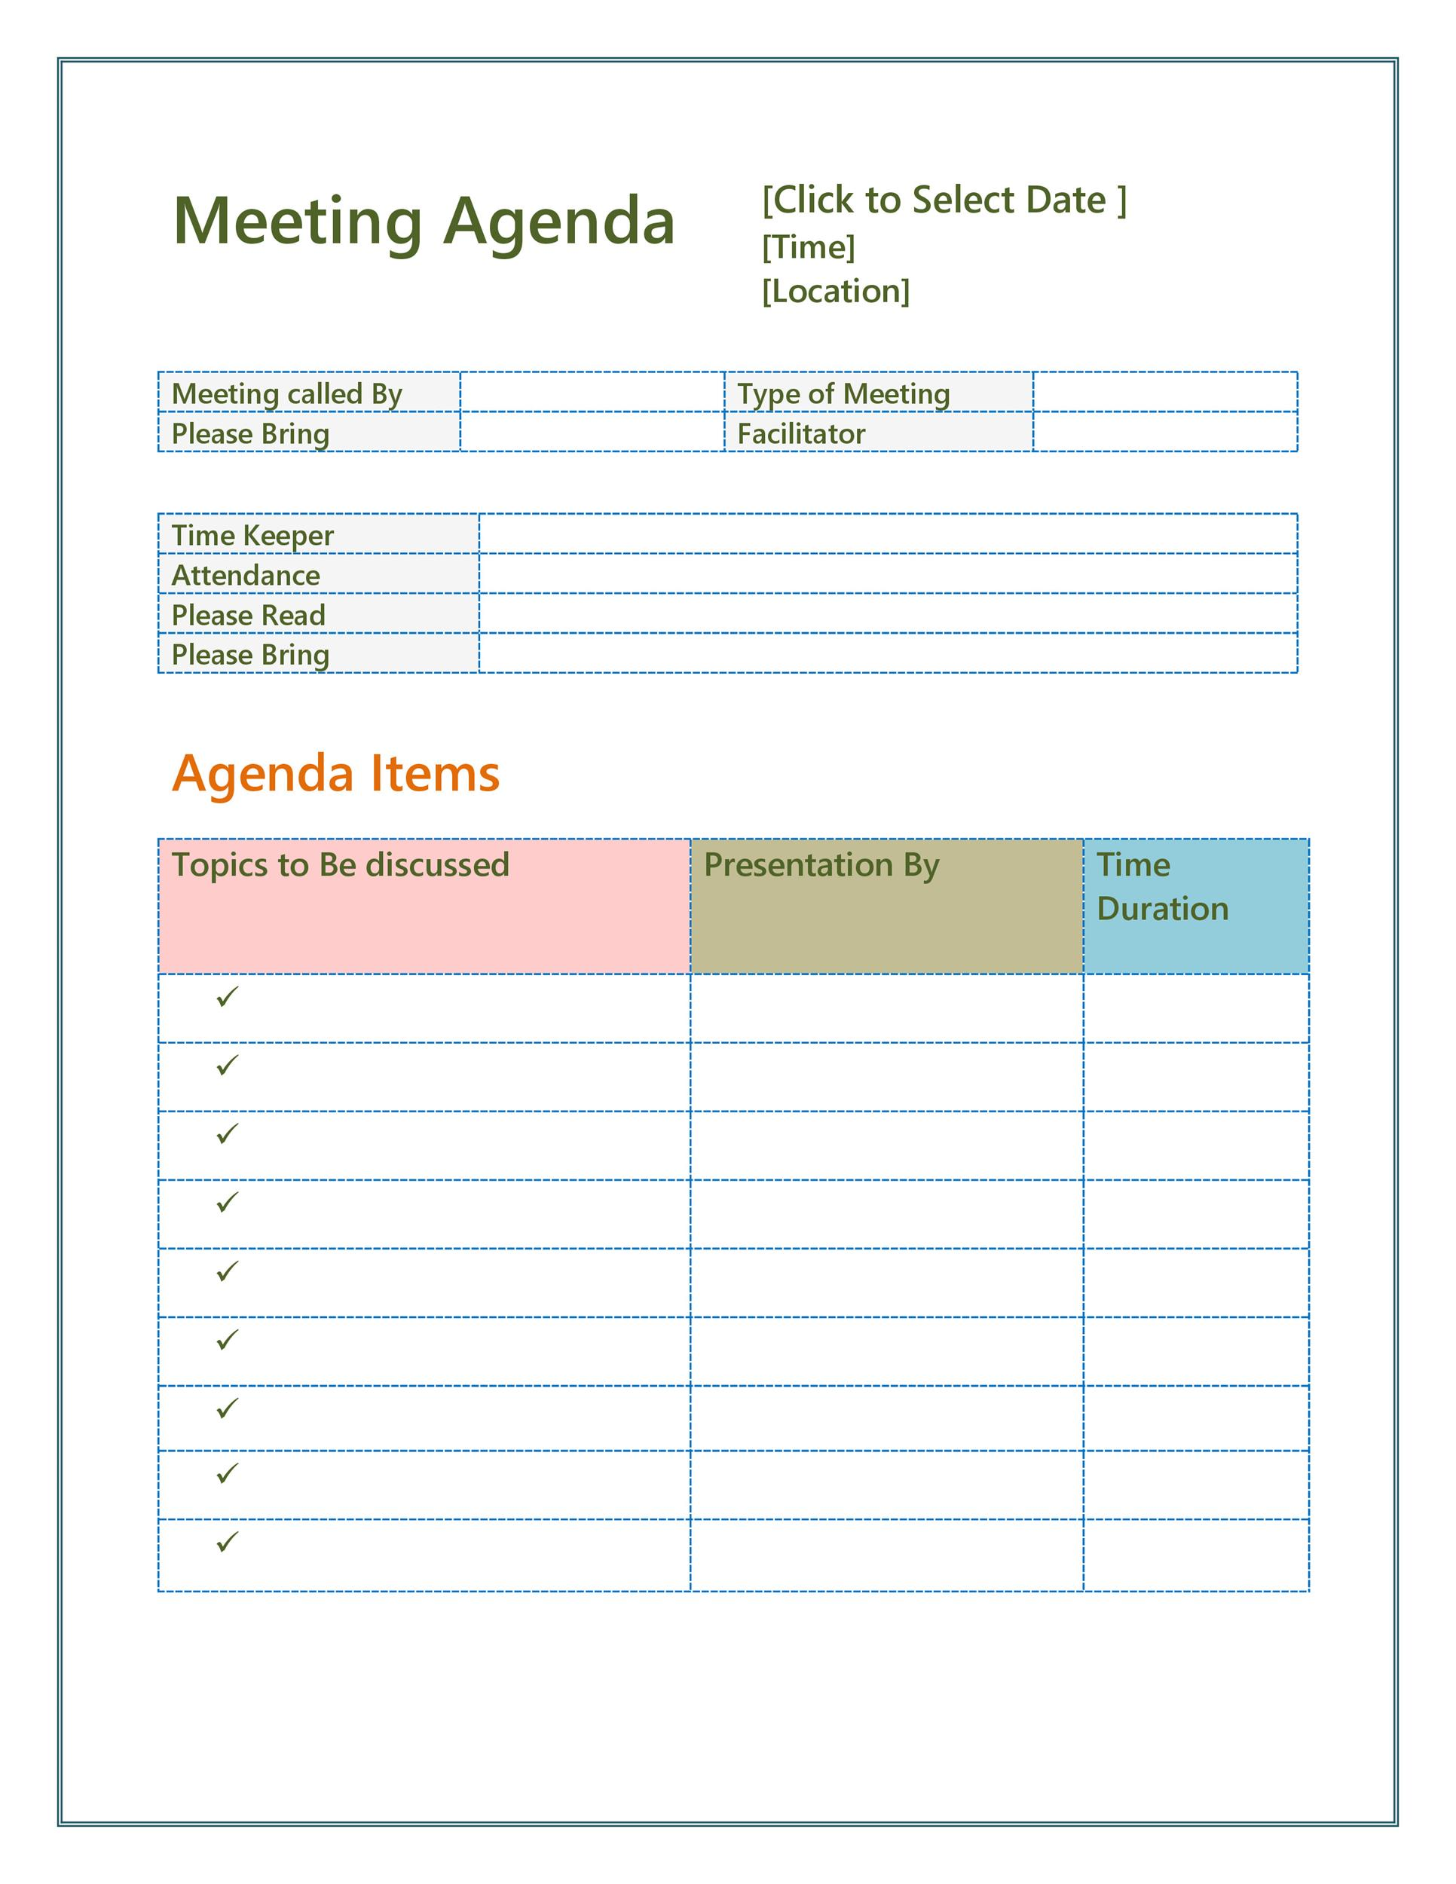
Fill in the missing parts of agenda structure
Date : 20 April 2022
Time : 13.00 hours
Location : Meeting room 2
Taylor Swift
Sales Department meeting
Kendall Jenner
March Sales report
Kendall Jenner
1.Title
2. Please bring
what to bring
3. Attendees
4. Please bring
5. Agenda to be
discussed
6. Attendees/Presenter
Russell Crow, Timothy Brawn, Frederic Dawn, Julian Dewal
New Sales incentives
March Sales report
Sales pipeline Russell Crow 20 mins
Operations problems Frederic Dawn 20 mins
New Sales incentives Taylor Swift 20 mins

Slide 6
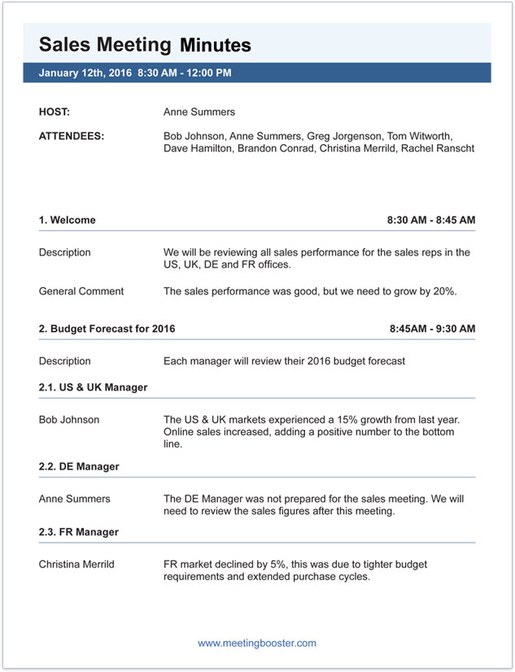
MoM (Minutes of meeting บันทึกการประชุม) Structure
1. Date Time Venue
2. Attendees
3. Called-by or Host
4. Information of discussion (complete sentence)
5.
Vocabs
1. FR = France, DE = Germany
2. Sales performance, Sales results
3. Growth, increase, positive
4. Declined ตกต่ำ
5. Sales figures = Sales numbers

