Slide 1
Sociocultural Forces
Krittametha Getglum

Slide 2
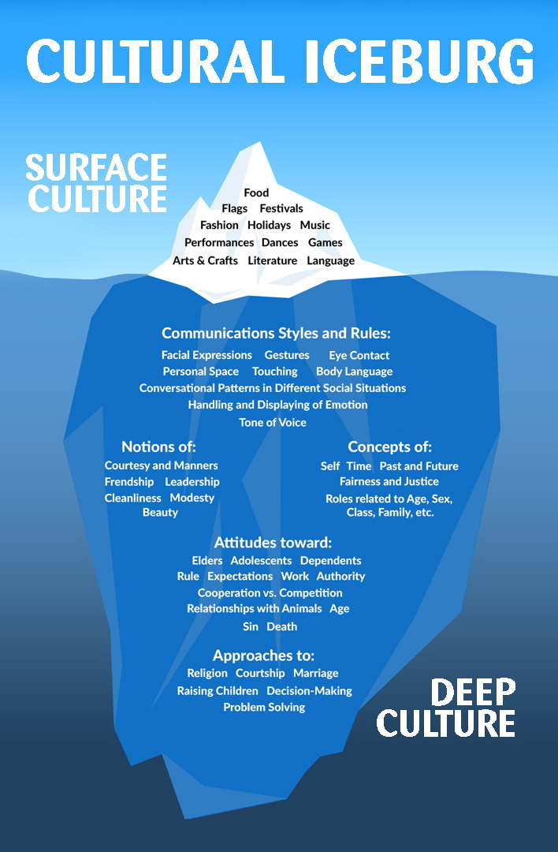

Slide 3
Cultural Diversity
Multiculturalism
Cultural Pluralism

Slide 4
Six Rules of Thumb for doing business across cultures
Be prepared
Slow down
Establish trust
Understand the importance of language
Respect the culture
Understand components of culture

Slide 5
What is culture?
Most anthropologists agree that:
Culture is learned, not innate.
The various aspects of culture are interrelated.
Culture is shared.
Culture defines the boundaries of different groups.

Slide 6
What is culture?
Culture is the sum total of the beliefs, rules, techniques,
institutions, and artifacts that characterize human populations.
Sociocultural → Society + Culture
Society : Sociology → Society ( สังคมวิทยา )
Culture : Anthropology→ Culture ( มานุษยวิทยา )
Sociocultural is the variables that businesspeople are interested in
both social and cultural.

Slide 7
Ethnocentricity
Belief in the superiority of one’s own ethnic group.

Slide 8
Culture
E.T. Hall (Anthropologist) claims that:
Spend a lifetime in a country.
Undergo an extensive, highly sophisticated training program that covers the main characteristics of a culture, including the language.

Slide 9
Sociocultural components
Aesthetics
Attitudes and beliefs
Religion
Material culture
Language
Societal organization

Slide 10
Aesthetics
Aesthetics pertains to a culture’s sense of beauty and taste and is expressed in its art, drama, music, folklore, and dances.

Slide 11
ART
Particular interest to international businesspeople are the formal aspects of art, color, and form because of the symbolic meanings they convey.

Slide 12
Aesthetics
Colors can be deceptive because they mean different things to different cultures.
Symbols must be careful: number and using a nation’s flag or any symbols connected with religion.
Forms could affect the design of products, packaging, or the building in which the firm is located.

Slide 13
Feng Shui
Feng Shui. In Asia, it is often believed that if buildings, furniture, roads, and other human made objects are placed in harmony with nature, they can bring good fortune. If they are not, they will cause a disaster.

Slide 14
Attitudes and beliefs
Every culture has a set of attitudes and beliefs that influence nearly all aspects of human behavior and help bring order to a society and its individuals.

Slide 15
Attitudes Toward Time
The attitudes-toward-time culture characteristic may present more adaptation problems for businessperson.
1. Directness
2. Deadlines
3. High - Context Culture
4. Low - Context Culture

Slide 16
Attitudes and beliefs
Attitudes Toward Achievement and Work
▪ The demonstration effect
▪ Job prestige

Slide 17
religions
Work Ethics
Protestant work ethic : Expressed by Luther and Calvin who believed it was one’s duty to glorify God by hard work and the practice of thrift in Europe and America.
Confucian work ethic : Drive toward hard work and thrift ; similar to Protestant work ethic.

Slide 18
religions
In the religions of India : Birth, death, and reincarnation.
The goal of salvation is to escape from the cycle and move into a state of eternal bliss (nirvana).
The notion of karma (moral retribution) holds that evil committed in one lifetime will be punished in the next.

Slide 19
Hinduism
They believe one can be liberated from the samsura cycle and achieve eternal bliss through 1. yoga (purification of mind and body) 2. devout worship of the gods 3. good works and obedience to the laws and customs of the one’s caste.
• Caste system : An aspect of Hinduism by which the entire society is divided into 4 groups and each is assigned a certain class of work.

Slide 20
Buddhism
- Buddhism : As a reform of Hinduism.
How to break the laws of karma and the cycle of rebirth.
- Jainism : The Jain religion was founded by Mahavira. Jain doctrine teaches that there is no creator, no god, and no absolute principle.

Slide 21
Jainism
The Jain religion was founded by Mahavira. Jain doctrine teaches that there is no creator, no god, and no absolute principle.

Slide 22
Sikhism
The religion of an Indian ethic group, a military brotherhood and a political movement that was founded by Nanak who sought a bridge between Hinduism and Islam.

Slide 23
Confucianism
The name of Confucius is inseparable from Chinese culture and civilization which were already well developed when he set out to transform ancient traditions into a system capable of guiding personal and social behavior.

Slide 24
Taoism
It is a mystical philosophy founded by Lao-tzu. It holds that each of us mirrors the male and female energies (yin and yang) that govern the cosmos. The aim of Taoist meditation and rituals is to free the self from distractions and become empty to allow the cosmic forces to act.

Slide 25
Shintoism
It is the indigenous religion of Japan. Shinto legends define the founding of the Japanese empire as a cosmic act, and the emperor was believed to have divine status. There is no elaborate theology or weekly worship.

Slide 26
Christianity
Christianity is a monotheistic Abrahamic religion centered around the life, teaching, death, and resurrection of Jesus Christ as presented in the New Testament of the Bible. Denominations of Christianity
1. Catholicism
2. Protestantism
3. Orthodoxy

Slide 27
Islam
• It is the second largest after Christianity. Islam accepts as God’s eternal word the Koran, a collection of Allah’s revelations to Muhammad.

Slide 28
animism
A kind of spirit worship that includes magic and witchcraft. Animism is one of humanity’s oldest beliefs. Animism is the belief that everything in nature has its own spirit or divinity.

Slide 29
Material culture
Material Culture refers to all human-made objects and is concerned with how people make things (technology) and who makes what and why (economics).

Slide 30
Technology
The technology of a society is the mix of the usable knowledge that the society applies and directs toward the attainment of cultural and economic objectives.

Slide 31
Cultural Aspects of Technology
Technology’s cultural aspects are certainly important to international managers because new production methods and new products often require that people change their belief and way of living.

Slide 32
Technological Dualism
Technology dualism is a prominent feature of many developing nations. In the same country, one industry sector may be technologically advanced, with high productivity, while the production techniques of another sector may be old and labor-intensive.

Slide 33
Appropriate Technology
The technology which can be labor-intensive, intermediate, or capital-intensive. The idea is to choose the technology that most closely fits the society using it.

Slide 34
Boomerang Effect
One reason firms sometimes fear to sell their technology abroad. It is the situation in which technology sold to companies in another nation is used to produce goods to compete with those of the seller of the technology.

Slide 35
The Information Technology Era
The information technology industry is changing at the pace that is bewildering to many business executives. Managing the flood of data available electronically is a challenge.

Slide 36
Material Culture and Consumption
One of the unique expression of Japanese material culture is the wide use of automation- not only in robots for manufacturing but in vending machines for a variety of items, including hot meals and alcohol.

Slide 37
language
Language is the most apparent cultural distinction that the newcomer to international business perceives is in the means of communication. Differences in the spoken language are readily discernible, and after the short period in the new culture it becomes apparent that there are variations in the unspoken language.

Slide 38
Spoken Language
Language is the key to culture.
Language Delineate Cultures: The spoken language is for distinguishing one culture from another. If two languages are spoken in a country, there will be two separate cultures.

Slide 39
Lingua franca
Lingua Franca is a foreign language used to communicate among a nation’s diverse cultures that have diverse languages.

Slide 40
english
English, the Link Language of Business: English as a business lingua franca has spread so rapidly in the world.
Must Speak the Local Language: Moreover, knowing the language of the area indicates respect for its culture and people.

Slide 41
translation
Translation: The ability to speak the language well does not eliminate the need for translators.
Back Translations: To avoid translation errors, the experienced marketer will prefer what are really two translations. The first will be made by a bilingual native, whose work will then be translated back by a bilingual foreigner to see how it compares with the original.

Slide 42
Technical Words
Technical Words: Translators have difficulty with technical terms that do not exist in the language and with common words that have a special meaning for a certain industry.

Slide 43
No Unpleasantness
One aspect of the spoken language worthy of mention is the reluctance in many areas to say anything disagreeable to the listener.

Slide 44
Unspoken Language
Unspoken Language or nonverbal communication can often tell businesspeople something that the spoken language does not.

Slide 45
Gesture
Although gestures are a common form of cross-cultural communication, gestures vary from one region to another.

Slide 46
Close doors, office size, conversational distance
- Closed Doors: It has different meaning upon each region.
- Office Size: Although office size is an indicator of a person’s importance, it means different things in different cultures.
- Conversational Distance: Conversational distance are smaller in the Middle East, larger in Asia than the Western average.

Slide 47
Gift Giving
The language of Gift Giving: It is important aspect of every business people's life. Entertainment outside office hours and the exchange of gifts are part of the process of getting better acquaintance.
Acceptable gifts : Dependent on each culture.
Gifts or Bribes: Bribes are gifts or payments to induce the receiver to do something illegal for the giver.

Slide 48
extortion
- Extortion is the demand for payment to keep the receiver from causing harm to the payer.
- Questionable Payments: These come in all forms and sizes, from the small expediting payments necessary to get poorly paid government officials to do their normal duties to huge sums to win large orders.
TI: Transparency International
CPI: Corruption Perception Index

Slide 49
Societal organization
Every society has a structure or an organization that is the patterned arrangement of relationships defining and regulating the manner by which its members interface with one another.

Slide 50
kinship
The family is the basic unit of institutions based on kinship.
Extended Family is a source of employees and business connections.
Member’s responsibility: Although the extended family is large, each member’s feeling of responsibility to it is strong.

Slide 51
association
Associations is a social unit s based on age, gender, or common interest, not on kinship.
- Free Association: Groups are composed of people jointed together by a common bond, which can be political, occupational, recreational, and religious.

Slide 52
Understanding National Cultures
- Geert Hofstede, a Dutch social psychologist analyzed on six value dimensions.

Slide 53
Hofstede’s cultural dimensions theory
Power distance (PDI)
Individualism versus collectivism (IDV)
Uncertainty avoidance (UAI)
Motivation towards achievement and success (MAS)
Long-term orientation versus short-term orientation (LTO)
Indulgence versus restraint (IND)

Slide 54
Nonverbal Communication
1. Paralanguage 2. Emblems 3. Chronemics 4. Proxemics 5. Haptics 6. Olfactics
7. Gustics 8. Acoustics
9. Silence 10. Kinesics
11. Artifacts

Slide 55
Assignments
1. Mind-Mapping – Presentation within 5 minutes (2 Tasks)
2. Presentation of Nonverbal Communication (10 Minutes)
- Definition
- Importance
- Example
3. Organizational Analysis Based on Hofstede and Organization’s Information (Presentation with E-Report)

