Slide 1
Business translation (Enb4202)
Review of grammar terms

Slide 2
Grammar terms
Definitions/function
Examples
Action verb : Also see the entries for Linking verb and Verb | a verb that express an action such as hit, live, lose, speak, go, or come | I lost my keys. He lives in Rome now.
Adjective | a word that describes a noun or pronoun | I have a new neighbor named Eva. Eva has a nice smile. She is friendly.
Adverb | a word that describes a verb, an adjective, another adverb, or a complete sentence, often to tell how, when, or where | The actors talked fast. It was really difficult to understand them. I listened very carefully. I’m going to watch the same movie tomorrow. Meet me here at 9:00.
Article | the word a, an, or the, used to introduce a noun | There is a café on Green Street. The café is called Java’s. It is an interesting place.
Clause | a group of related words that has a subject and verb | This is my book. (independent clause) ….because it was late. (dependent clause)
Coordinating conjunction | a word that connects equal elements in a sentence (for, and, nor, but, or, yet, and so) | It is my birthday, so I want to celebrate. I know I’m on a diet, but let’s have cake and ice cream.

Slide 3
Definitions/function
Examples
Dependent clause | a clause that cannot be a complete sentence | After I got up… because it was late.
Gerund | a verb ending in –ing that is used as a noun | Playing is fun. I am sad about leaving.
Independent clause | a clause that is, or could be, a complete sentence | I took a shower. After I got up, I took a shower.
Linking verb: Also see the entries for Action Verb and Verb | a verb that connects the subject to information about the subject | She is in a band. I am his boss.
Noun | a word that names a person, place, or thing and that can be used as a subject or an object | I have a roommate at school. His name is Mark. He is from Hong Kong. Mark and I like the same music.
Noun phrase | a group of words ending with a noun that belong together in meaning | He lives in that old house on the corner. I’m reading a really good book.
Object | a noun, noun phrase, object pronoun, or possessive pronoun that receives the action of certain verbs | Mark is always losing things. Today he lost his keys. His girlfriends found them. I saw mine on the table.
Grammar terms

Slide 4
Definitions/function
Examples
Phrase | a group of related words that does not have both a subject and a verb | I had a frightening experience. It happened a few days ago.
Preposition | a word that shows direction, location, ownership, and so on. | I went into my room and looked under the bed. Juan is from Guadalupe in Mexico.
Prepositional phrase | a preposition plus a noun, pronoun, or gerund | The train left at noon. Hundreds of people were on it.
Pronoun | a word that replaces a noun | Ed knew where the pen was. He had hidden it.
Subject | a noun, noun phrase, or subject pronoun that tells who or what the sentence is about | Mark rarely loses his keys. His sister lives in Boston. She has a nice house.
Subordinating conjunction (“subordinator”) | a word or phrase that introduces a dependent clause | When it’s hot, we go to the beach. He couldn’t find the file because he lost it.
Verb | a word or a group of words that expresses an action, feeling, or state | Davina plays the guitar and sings. He feels happy today. She enjoyed the opera.
Grammar terms

Slide 5
Business translation (Enb4202)
Recognizing sentences or non-sentences

Slide 6
Read each group of words and write S (sentence) or NS (non-sentence)
NS
______1. Is very hot today.
S
______2. It is raining today.
NS
______3. My new classmate from Brazil.
S
______4. He speaks three languages fluently.
NS
______5. Is very competitive.
S
______6. Hurry up, please.
S
______7. He wants to start his own business.
S
______8. He isn’t married.

Slide 7
Read each group of words and write S (sentence) or NS (non-sentence)
NS
______9. Enjoys music, especially jazz.
S
______10. Don’t send text messages in class.
NS
______11. The books expensive.
S
______12. Go to the course website.
NS
______13. When I finish my education.
S
______14. He looks mad.
S
______15. Who’s there?
S
______16. I will work for my uncle, when I finish my education.

Slide 8
Correct the NSs (non-sentences)
NS
______1. Is very hot today.
NS
______3. My new classmate from Brazil.
NS
______5. Is very competitive.
NS
______9. Enjoys music, especially jazz.
NS
______11. The books expensive.
NS
______13. When I finish my education.

Slide 9
Correct the NSs (non-sentences)
NS 1. Is very hot today.
1. It is very hot today.
NS 3. My new classmate from Brazil.
3. My new classmate is from Brazil.
NS 5. Is very competitive.
5. The price is very competitive.
NS 9. Enjoys music, especially jazz.
9. She enjoys music, especially jazz.
NS 11. The books expensive.
11. The books are expensive.
NS 13. When I finish my education.
13. When I finish my education, I will find a job.

Slide 10
Business translation (Enb4202)
Identifying subjects, verbs, objects, complement, and adverbial (svoca)

Slide 11
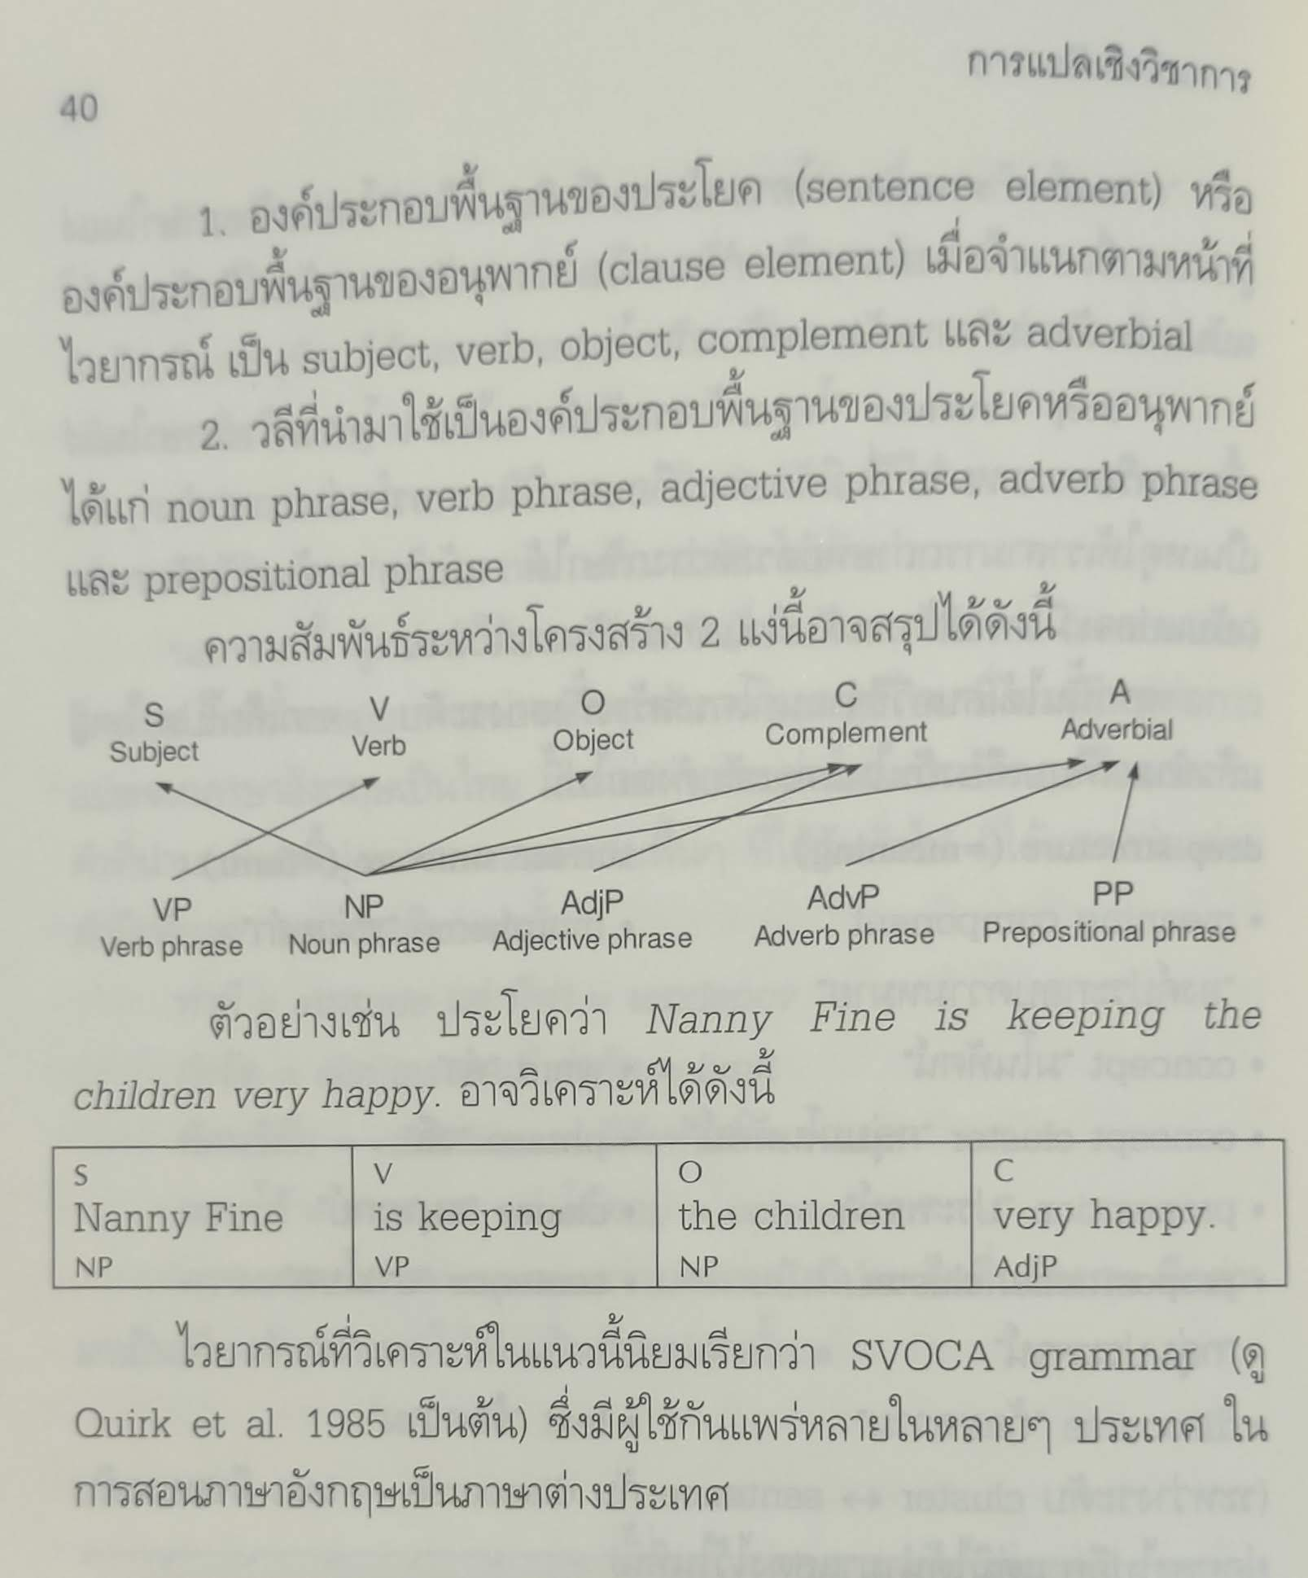
Svoca
Nanny Fine
is keeping
the children
very happy.
Identify form of each phrase
Nanny Fine
is keeping
the children
very happy.
Noun phrase (np)
Verb phrase (vp)
Noun phrase (np)
Adjective phrase (adj p)
Identify function of each phrase (s, v, o, c, a)
Nanny Fine
is keeping
the children
very happy.
Subject (s)
Verb
(v)
Object (o)
Complement (c)
Dhamma Bilingualized Bhikkhu P. A. Payutto 2013

Slide 12
Svoca EXERCISE
Identify form and function of each phrase of the following sentences
(Pron/np)
(vp)
(np)
(adverb phrase)
1. He
speaks
three languages
very fluently.
Subject (s)
Verb
(v)
Object (o)
Adverbial
(a)
(np)
(vp)
(prepositional phrase)
2. My new classmate is from Brazil.
Subject (s)
Verb
(v)
Adverbial
(a)
(np)
(vp)
(adjective phrase)
3. The price is very competitive.
Subject (s)
Verb
(v)
Complement
(c)

Slide 13
Svoca EXERCISE
Identify form and function of each phrase of the following sentences
(np)
(vp)
(adjective phrase)
(vp)
(adverb phrase)
4. His job
is
easy
and
pays
well.
Subject (s)
Verb
(v)
Complement
(c)
Verb
(v)
Adverbial
(a)
(Pron/np)
(vp)
(np)
(prepositional phrase)
5. He became a computer programmer at the age of 16.
Subject (s)
Verb
(v)
Object
(o)
Adverbial
(a)
(prepositional phrase)
(np)
(vp)
(np)
(prepositional phrase)
6. On weekends, he plays soccer with his friends.
Adverbial
(a)
Subject (s)
Verb
(v)
Object
(o)
Adverbial
(a)

Slide 14
Svoca EXERCISE
Identify form and function of each phrase of the following sentences
(Pron/np)
(vp)
(adj.phr.)
(prep. phrase)
7. She
was
important
to me.
Subject (s)
Verb
(v)
Complement (c)
Adverbial
(a)
(np)
(vp)
(pron/ np)
(np)
8. My teacher taught me a valuable lesson.
Subject (s)
Verb
(v)
Object
(o)
Object
(o)
(np)
(vp)
(adj.phr.)
(np)
9. My grandfather seemed unhappy that day.
Subject (s)
Verb
(v)
Complement
(c)
Adverbial
(a)

