Slide 1
Modals: Advice, Suggestion
Start!

Slide 2
EXERCISE
1
2
3
4

Slide 3
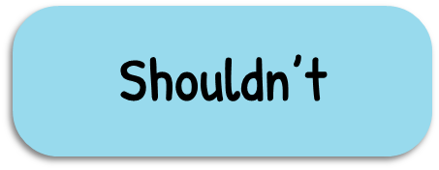
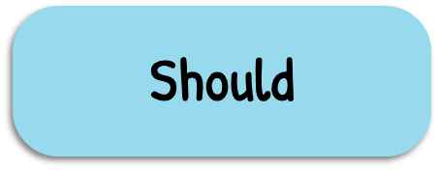
Exercise 1 Complete the sentences, using should or shouldn’t.
1. You ____________work too hard. You need to relax. Have a holiday.

Slide 4
Exercise 1 Complete the sentences, using should or shouldn’t.
2. You ____________ eat too much chocolate. It’s not good for your health.

Slide 5
Exercise 1 Complete the sentences, using should or shouldn’t.
3. I enjoyed taking the trip with you. We ______travel together more often.

Slide 6
Exercise 1 Complete the sentences, using should or shouldn’t.
4. ____________ he pay for this meal?

Slide 7
Exercise 1 Complete the sentences, using should or shouldn’t.
5. What ____________I cook for the family party this Friday?

Slide 8
Exercise 2 Complete the sentences, using ought to or ought not to.
1. You ______ smoke. It’s terrible for your own health as well as others’.

Slide 9
Exercise 2 Complete the sentences, using ought to or ought not to.
2. Traveler ____________ arrive at the airport at least two hours earlier.

Slide 10
Exercise 2 Complete the sentences, using ought to or ought not to.
3. This restaurant is terrible. We ____________ complain.

Slide 11
Exercise 2 Complete the sentences, using ought to or ought not to.
4. You ____________park here. It’s not allowed.

Slide 12
Exercise 2 Complete the sentences, using ought to or ought not to.
5. We ____________ sit in the sun for too long.

Slide 13
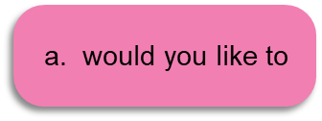
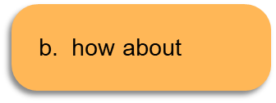
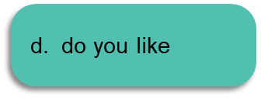
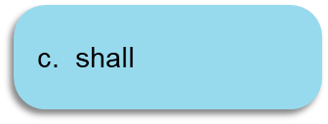
Exercise 3 Choose the best option for each sentence.
1. Hey Rob, _________________ go to the cinema with us?

Slide 14
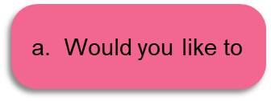
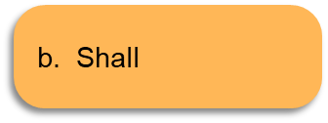
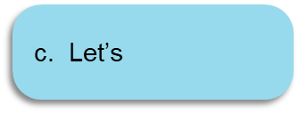
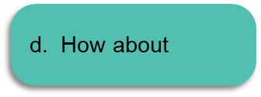
Exercise 3 Choose the best option for each sentence.
2. So, we all want Japanese, right? ______ that restaurant near the mall?

Slide 15
Exercise 3 Choose the best option for each sentence.
3. What can we do after class? _________________ we watch the game in a bar?

Slide 16
Exercise 3 Choose the best option for each sentence.
4. A: It's getting so hot in here!
B: _________________ get out of here and go to park by the bay!

Slide 17
Exercise 3 Choose the best option for each sentence.
5. My best friend, Sabrina, called and said she's going shopping. ____ going with her?

