Slide 1

How to write a research article

Slide 2

Principles of Writing
Clear & concise
Unity & coherence
Support with evidence
Effective paragraphs
The matter of word choice

Slide 3

Unity & Coherence
paragraph level
paper level
Unify and logically connect all of the sentences in one paragraph.
Illustrate, clarify, and explain, while also unify and logically connect all of the paragraphs
to express the main idea of the paper.

Slide 4
Effective Paragraphs
1. A topic sentence
A main idea is expressed, often as a generalisation.
2. An explanatory sentence
The meaning of the generalisation is elaborated on and
explained.
3. An illustration
The application of the generalisation is shown by
example.
4. A conclusion
This recap the main points made in the paragraph and
lead into the following paragraph.

Slide 5

The Matter of Word Choice
Hedging
Simplifying
Showing variety

Slide 6
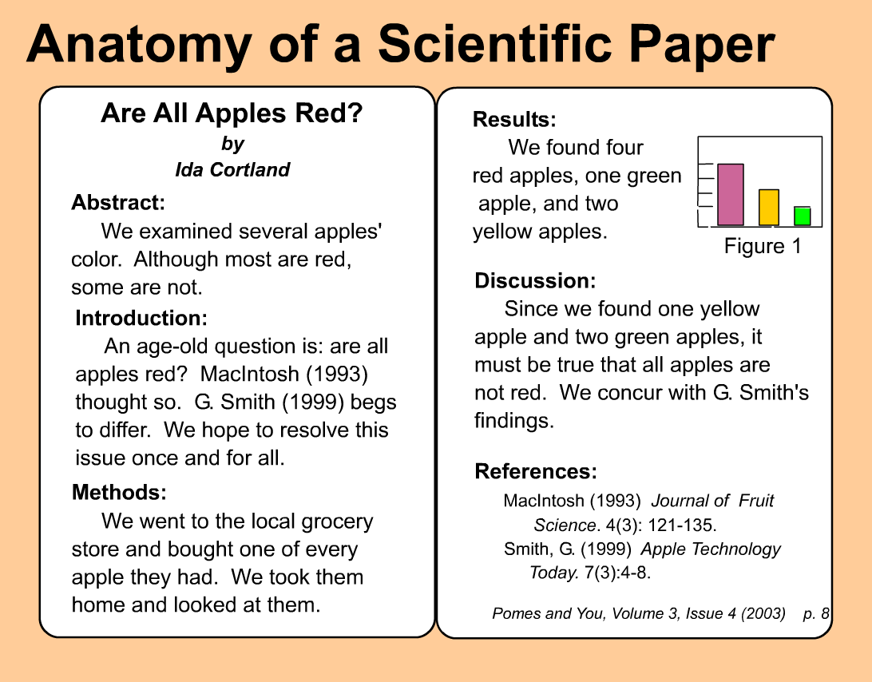
Structure of RA
https://library.wcc.hawaii.edu/chemistry/reading_articles

Slide 7
IMRD
Abstract: a one-to-four-paragraph summary of the paper.
Introduction: describes the background for the research
Methods: provides specific details
Results: describes the outcome
Discussion: describes implications of the research
Conclusion: places the research in context and describes avenues for further exploration.

Slide 8
Components of a Paper

Slide 9
Title
Describes the paper’s content clearly and precisely including keywords since they use the keywords to identify relevant articles
Uses keywords that researchers in a particular field will recognize
Avoid long title and abbreviations

Slide 10
Abstract
Summarize and state the problem, the main objective, the method, the results, and the conclusions so that the reader can decide whether or not to read the whole article
Avoid acronyms and mathematical symbols
Critical part of paper!

Slide 11
Abstract
Functions:
Tell the reader what to expect
Summarize important contribution
Attract the reader to look further

Slide 12
Introduction
Function of this section is to show:
importance/necessity of study.
This section should:
Clearly state the:
  Problem being investigated
  Background that explains the problem
  Reasons for conducting the research
Summarize relevant research to provide context
State how your work differs from published work
Explain what other findings, if any, you are challenging or extending
Identify the questions you are answering/ a statement of the purpose

Slide 13
Statement of purpose
e.g.:
  This study investigates the relationship between tree density and fruit size.
  The purpose of this study is to determine the effect of enzyme concentration on the reaction rate of ....

Slide 14
Evaluating Introductions
  Clarity of problem
  Sufficient rationale
  Contribution to existing knowledge
  Link to theoretical framework and literature review
  Assumptions explicit
  Operational definition of terms

Slide 15
Evaluating Literature Review in Introductions
Literature review: to place current study in context of what is known/not known
  Rationale/need for study
  Theoretical framework
  Link of framework to research questions
  Sufficiency of information
  Usefulness of review

Slide 16
Introduction & Discussion

Slide 17
Methodology
Participants (sample) - who the subjects are, how obtained/selected
Materials (equipment, measuring instruments) - what was used, quality of measuring instruments
Procedures - how study was conducted; what subjects did or what was done to them

Slide 18
Methods
Provide the reader enough details so they can understand and replicate your research
Explain how you studied the problem, identify the procedures you followed, and order these chronologically where possible
Be precise in describing measurements and include errors of measurement or research design limits
Explain what was analyzed, how it was analyzed and why each procedure was done

Slide 19
Methods
Examples
Difficult to understand:
First, I removed the frog muscle and then I poured ringer’s solution on it. Next, I attached it to the kymograph.
Improved:
I removed the frog muscle and poured Ringer’s solution on it to prevent it from drying out. I then attached the muscle to the kymograph in order to determine the minimum voltage required for contraction.

Slide 20
Evaluating Methodology
Sufficient detail of procedures (treatment), design and instruments
Full description of population
Full description of sampling method
Quality of measures used
Obvious weaknesses in design

Slide 21
Results
A summary of the statistical analyses used
Findings:
- in a form of text
- in a form of tables
- in a form of figures

Slide 22
Results
Objectively present your findings, and explain what was found
Show that your new results are contributing to others
Follow a logical sequence based on the tables and figures presenting the findings to answer the question or hypothesis
Figures should have a brief description, providing the reader sufficient information to know how the data were produced

Slide 23
Evaluating Results
Appropriateness of statistical techniques used
Clarity of presentation of results
Adequacy of presentation of results

Slide 24
Tables and Figures
Straight forward and concise
Do not include the same data in both a table and a figure
Present the data in a table unless there is visual information that can be gained by using a figure.
A figure is useful for reporting:
  a regression analysis (line graph),
  comparing the several treatment levels (bar graph with error bars).
Avoid using figures that show too many variables or trends at once.

Slide 25
Discussion/Conclusion
Summarize the findings
Interpret the findings by linking results to original purposes
Explain why the findings turned out the way they did
Describe what your findings mean in context of what was already known about the subject
Indicate how the results relate to expectations and to the literature previously cited
Identify the study’s limitations
Suggest steps for further research

