Slide 1
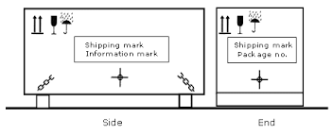
Pictorial Markings

Slide 2



Fragile
(Handle with care)
To indicate that the contents of the package are fragile and must therefore be handled with care.

Slide 3

Keep Dry
To indicate that the package must be kept in a dry environment.

Slide 4

This way up
To indicate the correct upright position of the package.

Slide 5

Use
no hooks
To indicate that hooks are prohibited for lifting the package.

Slide 6

Do not roll
To indicate that the package must not be rolled.

Slide 7

No hand truck here
To indicate where hand trucks should not be placed on this side when handling the package.

Slide 8

Do not use
forklift
truck here
To indicate that the package must not be handled by forklift trucks.

Slide 9

Sling here
To indicate where the slings should be placed for lifting the package.

Slide 10

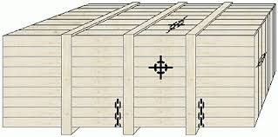
Center of gravity
This indicates the center of gravity of a package and should be handled as a single unit.

Slide 11

Top heavy
This indicates that the package is top heavy and may tip over easily.

Slide 12
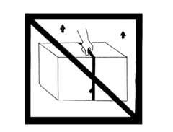
Do not use
strapping to move
(lift or pull) packages
To indicate that strapping should not be used to move (lift or pull) on package.

Slide 13

Clamp here
To indicate that clamps must be used for handling package.

Slide 14


Do not
clamp here
To indicate where clamps must not be applied to the sides for handling the package.

Slide 15

Do not stack
To indicate that stacking of the packages is not permitted and loads should not be placed on the package.

Slide 16

Stacking weight limitation
This indicates the maximum stacking load for packages or the limited stacking possibilities of the package when unlike packages are placed on top.

Slide 17

Stacking limitation
by number
N
This indicates maximum number of packages that may be stacked, where ‘n’ stands for the number of permitted packages.

Slide 18

Temperature limits
This indicates the temperature range within which the package must be stored and handled.

Slide 19

Keep away from heat (direct sunlight)
To indicate that the package should be protected from heat.

Slide 20

Protect from radioactive
sources
To indicate that the contents of the package can be degraded as a result of radioactivity.

Slide 21

Keep away
from cold
To indicate that the package should be kept away from cold

Slide 22

Magnetically sensitive
To indicate that the contents are magnetically sensitive and should not be placed near anything which is magnetic.

Slide 23




Slide 24



Slide 25
Activity: Role play
Select 3 pictorial markings
Introduce the meaning of the symbols and their functions in a role play (conversation)

Slide 26
Sample I
A: Do you know this symbol?
B: Of course, it means “Keep dry”. It is usually used to inform that the packages should be kept in a dry environment.
A: What about this one?
B: It means “Keep away from cold”. It indicates that the contents in the packages need to be protected from cold.

Slide 27
Sample II
A: What are you doing? Don’t you see the pictorial marking?
B: What does it mean?
A: It means you must not roll the package because the contents could be damaged.

Slide 28
Resources
http://freightfilter.com/shipping-mark-guide
http://www.tis-gdv.de/tis_e/verpack/verpackungshandbuch/35verpackungshandbuch_11.htm

