Slide 1
Perishable goods

Slide 2
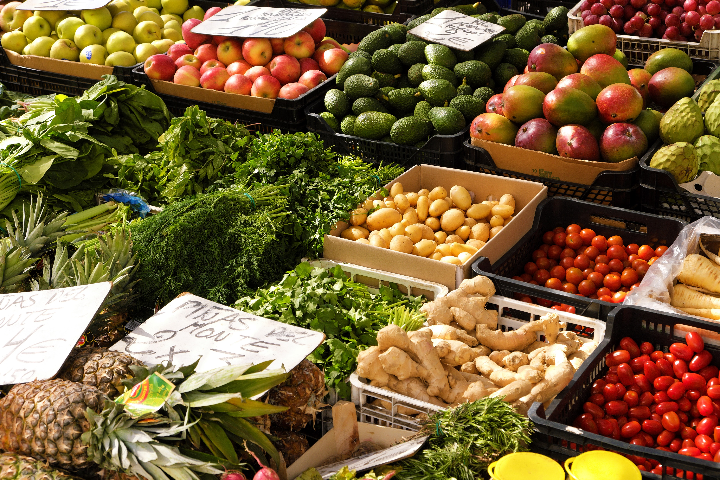
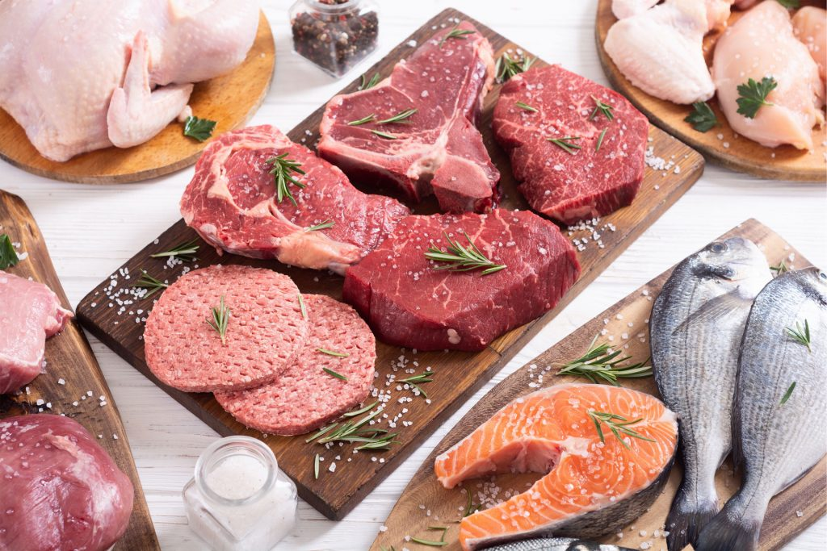
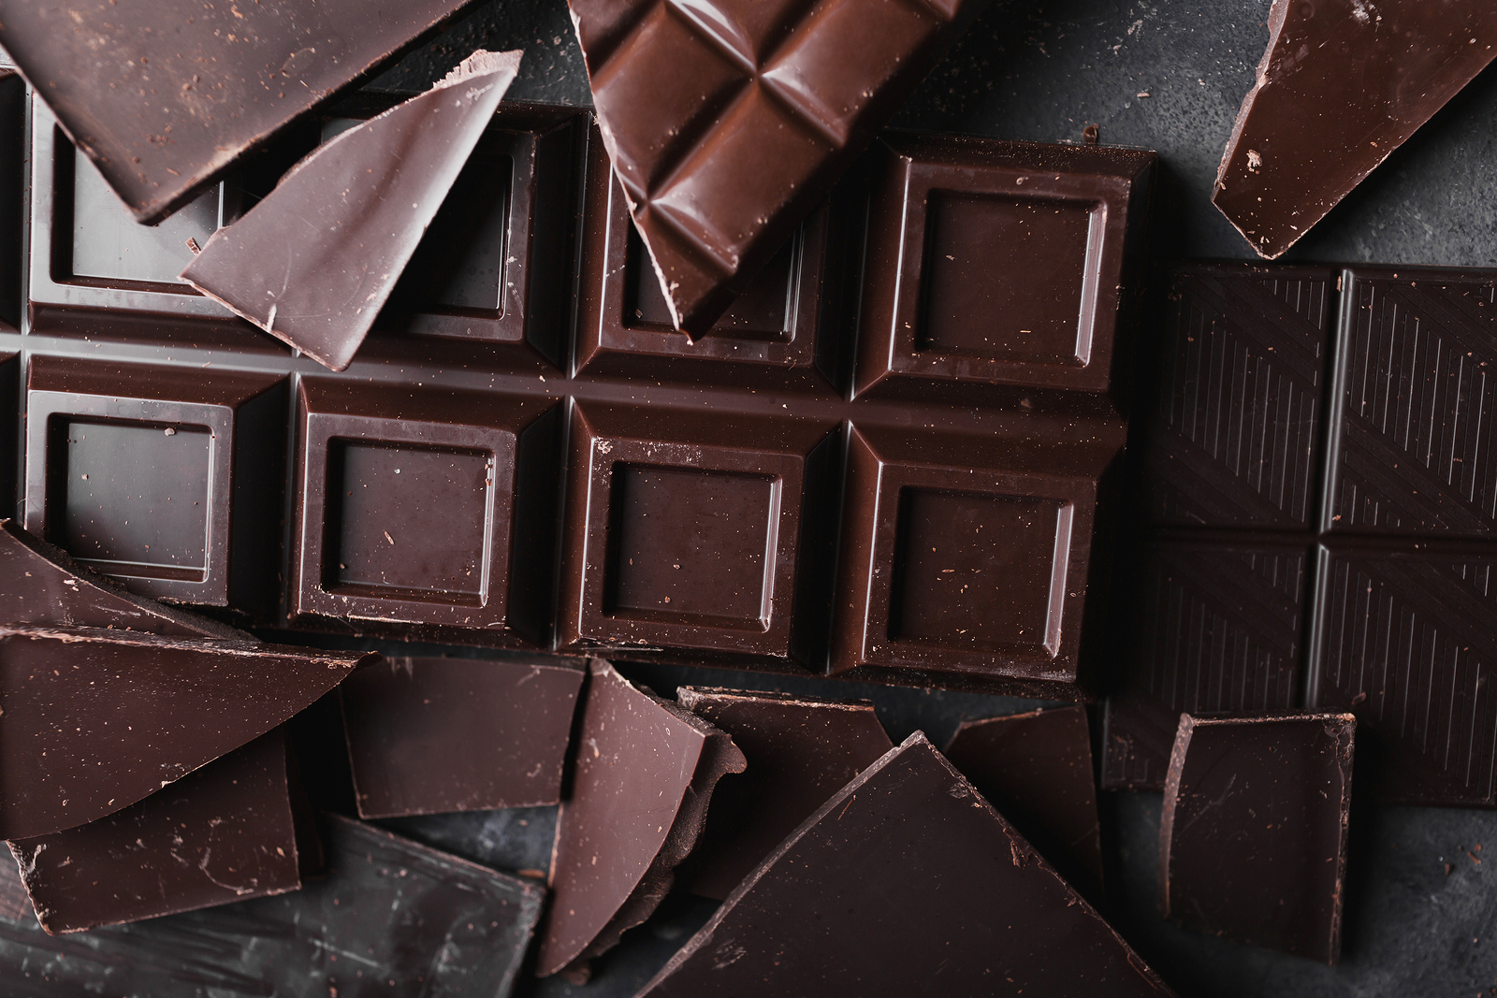
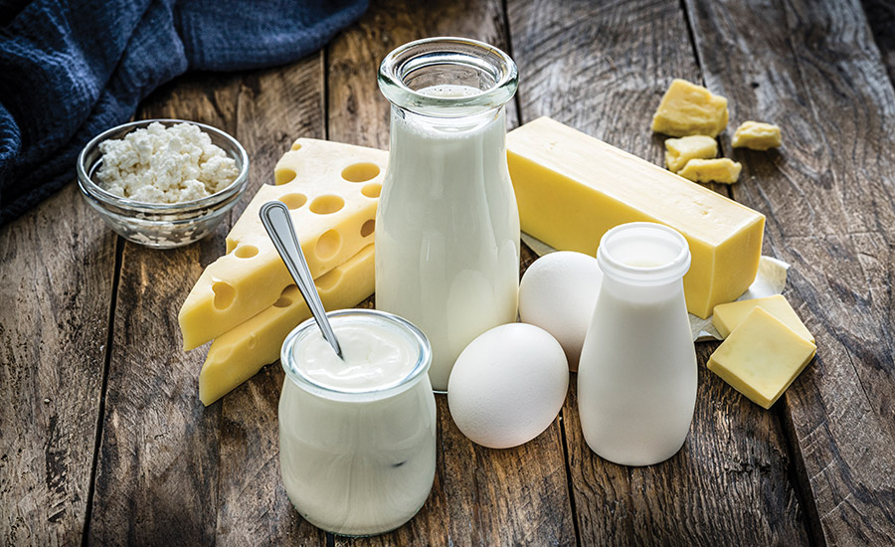
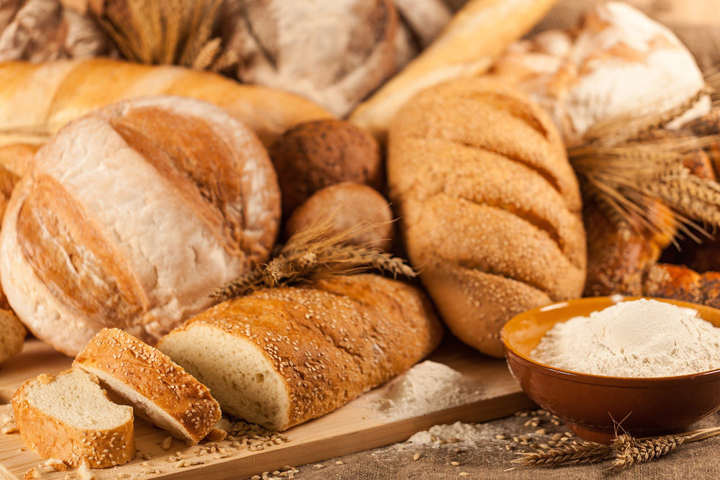
Fresh fruit and vegetables
Fresh meat and fish
Chocolate
Dairy products
Bread
Frosting

Slide 3
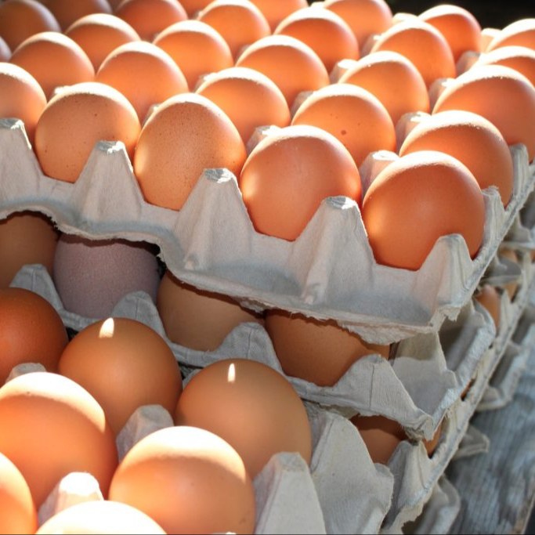
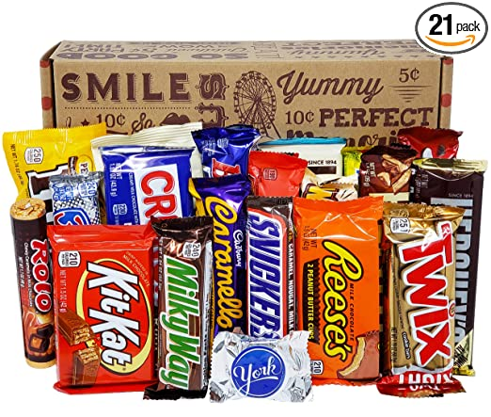
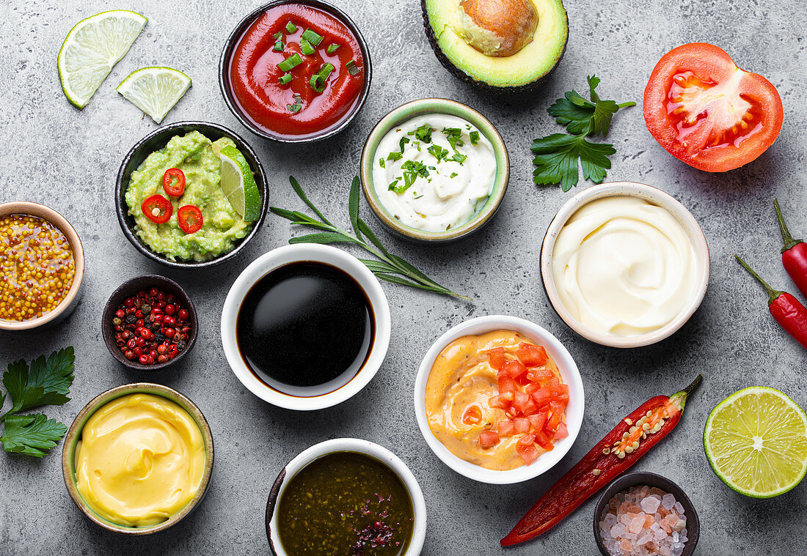
Cottage cheese
Fresh poultry egg
Candy bars and snack foods
Cooked food
Sauces
Custard

Slide 4
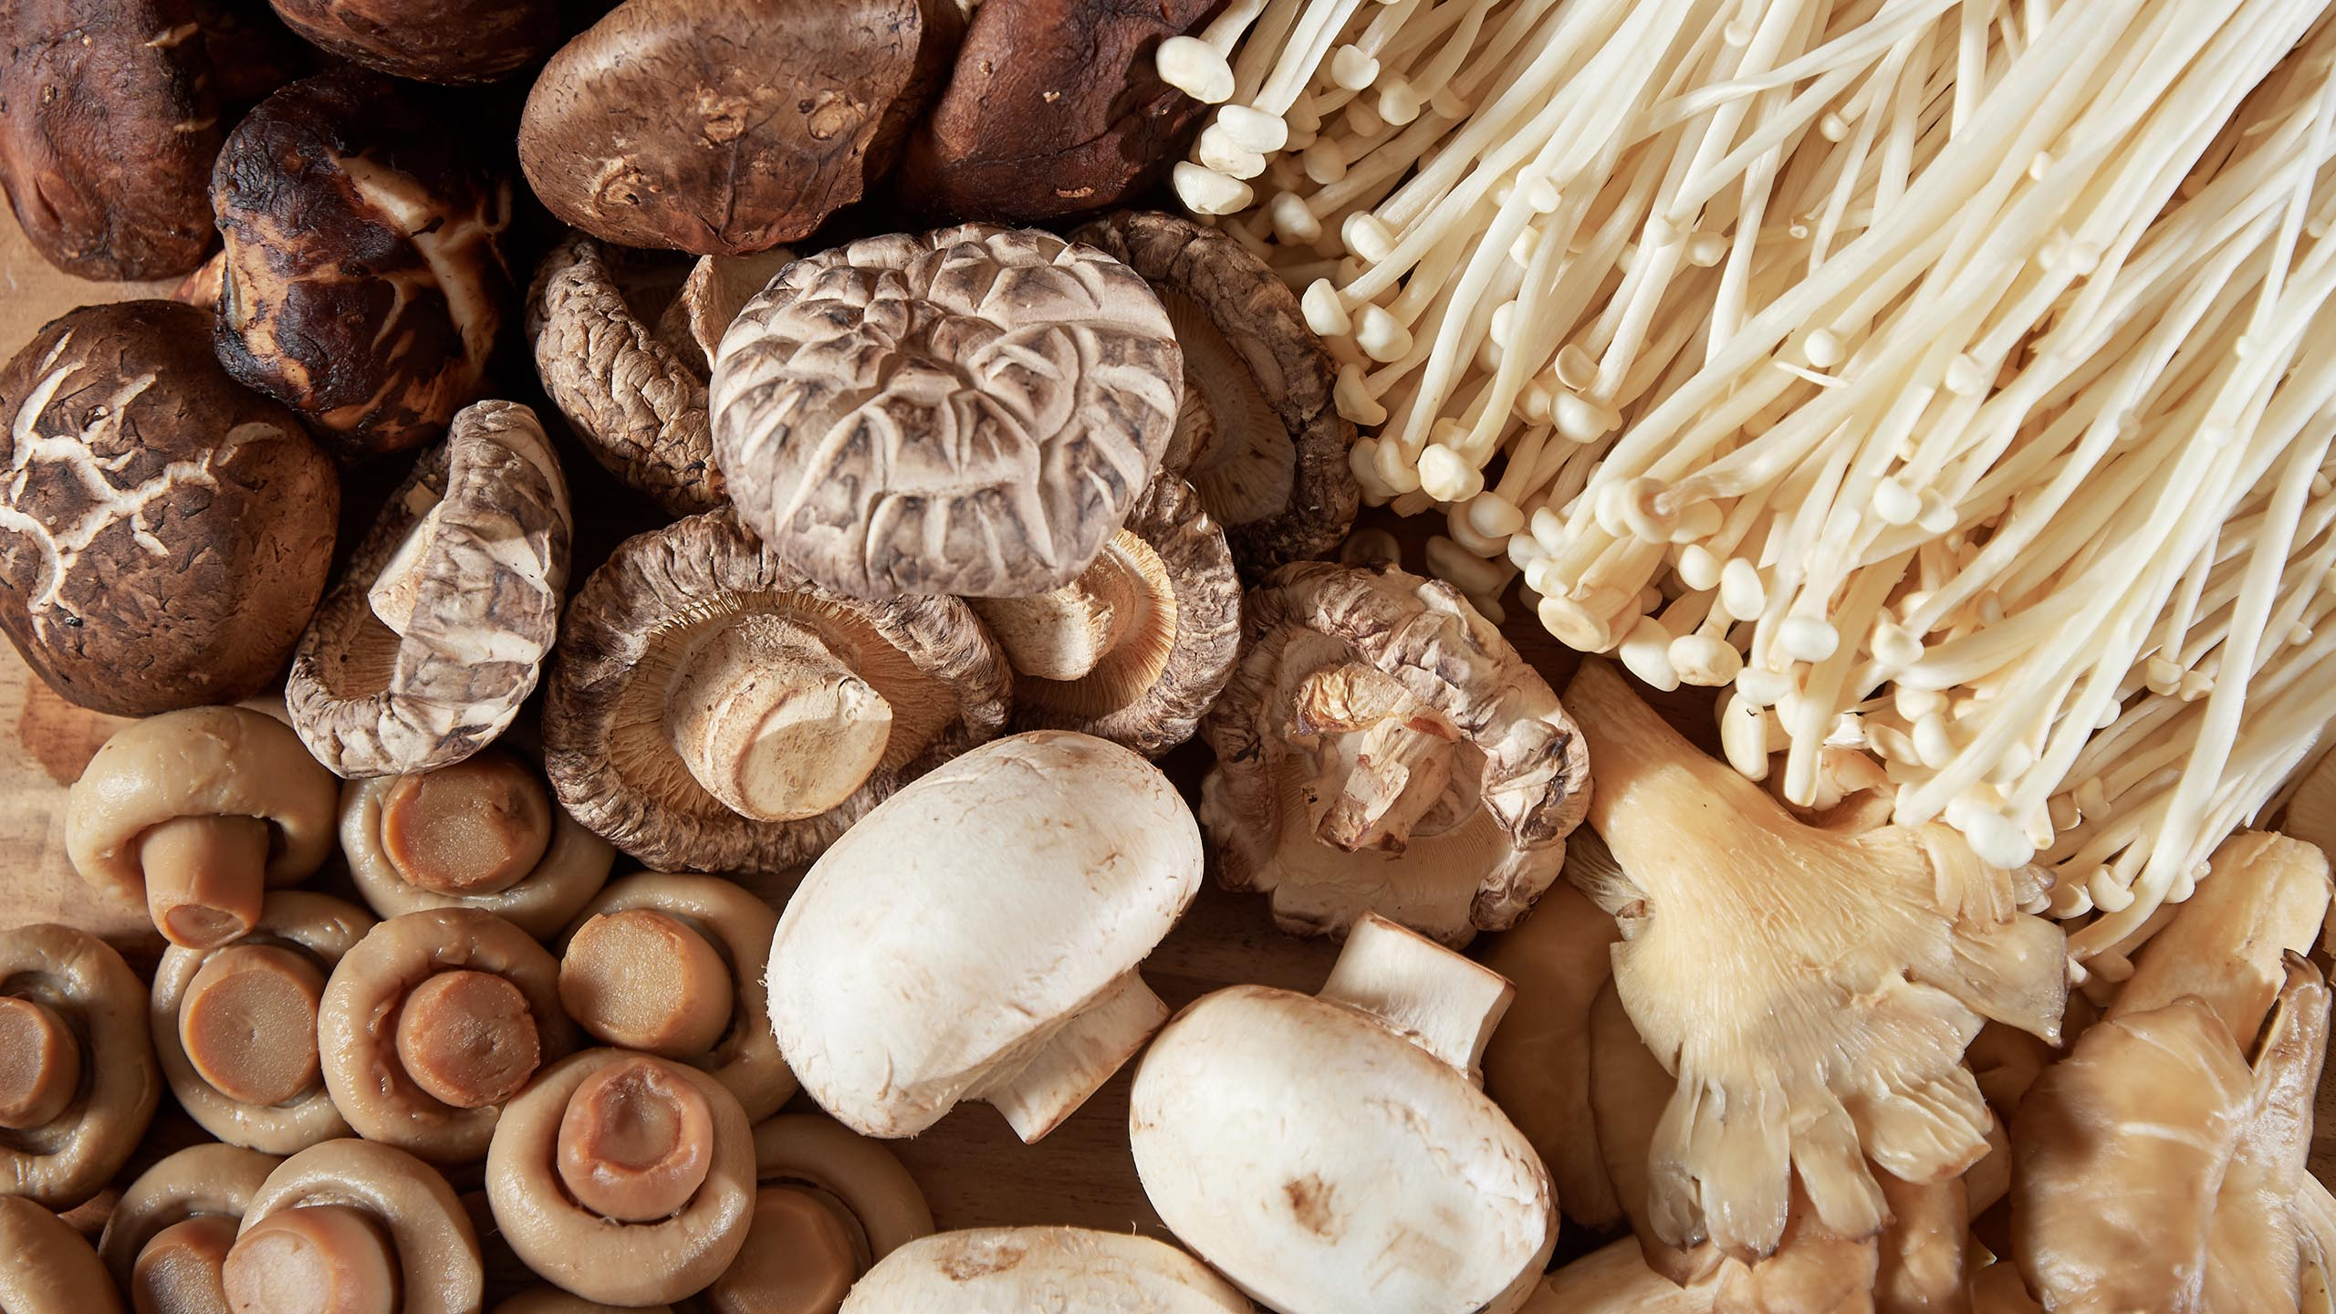
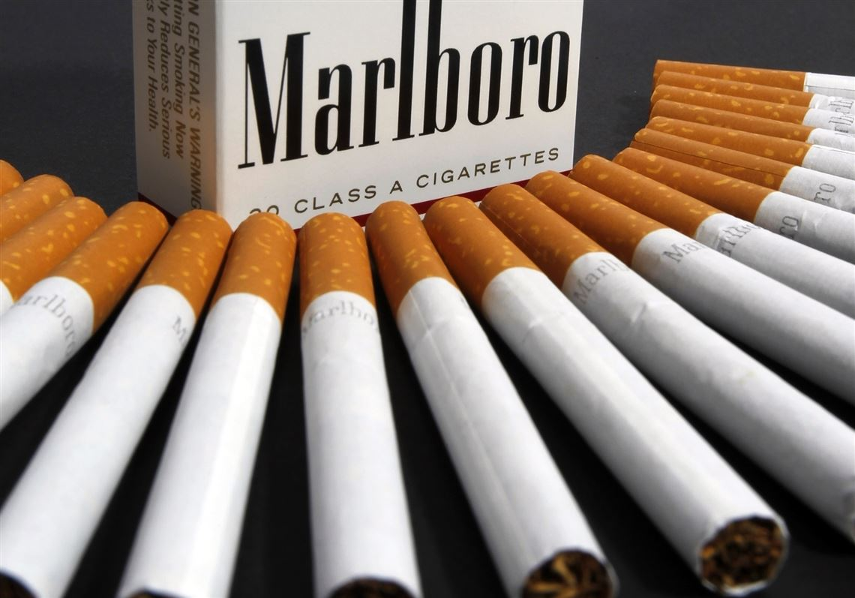
Fresh mushroom
Cigarette / Tobacco
Flower
Candle

Slide 5
Non-Perishable goods

Slide 6
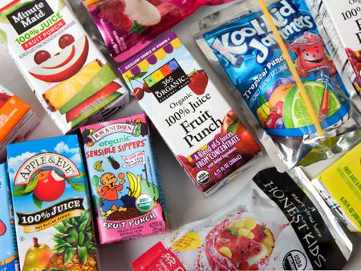
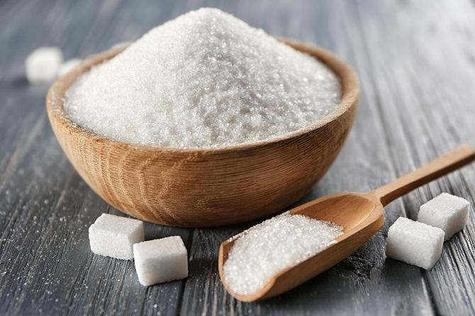
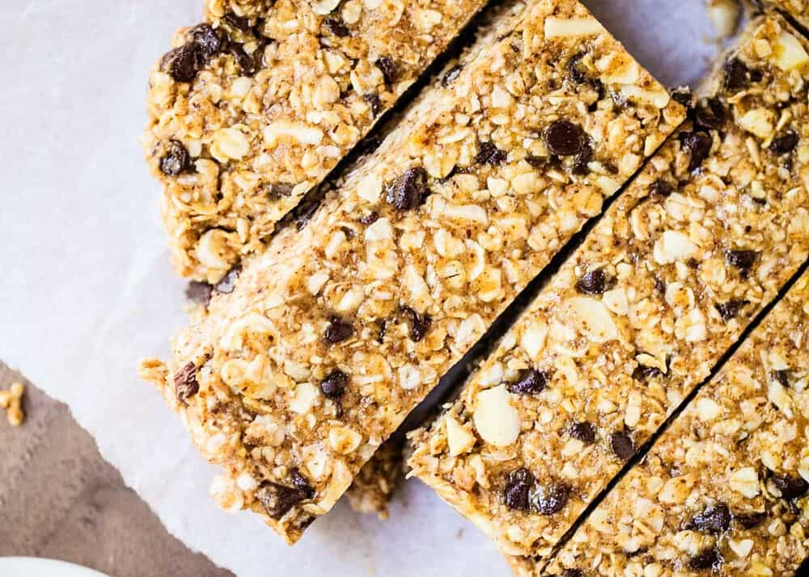
Juice boxes
Granulated Sugar
Powdered Milk
Alcohol
Peanut butter
Granola Bars

Slide 7
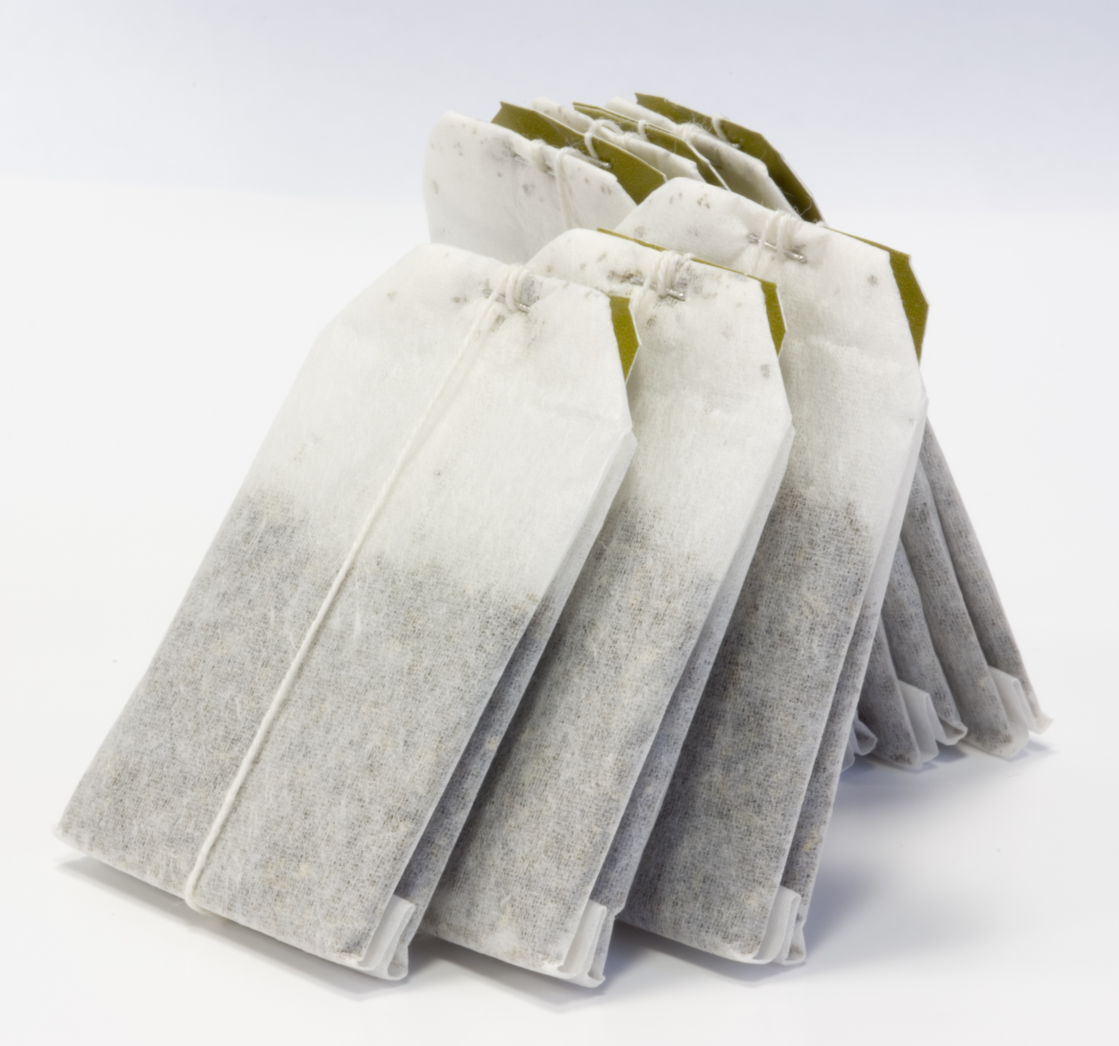
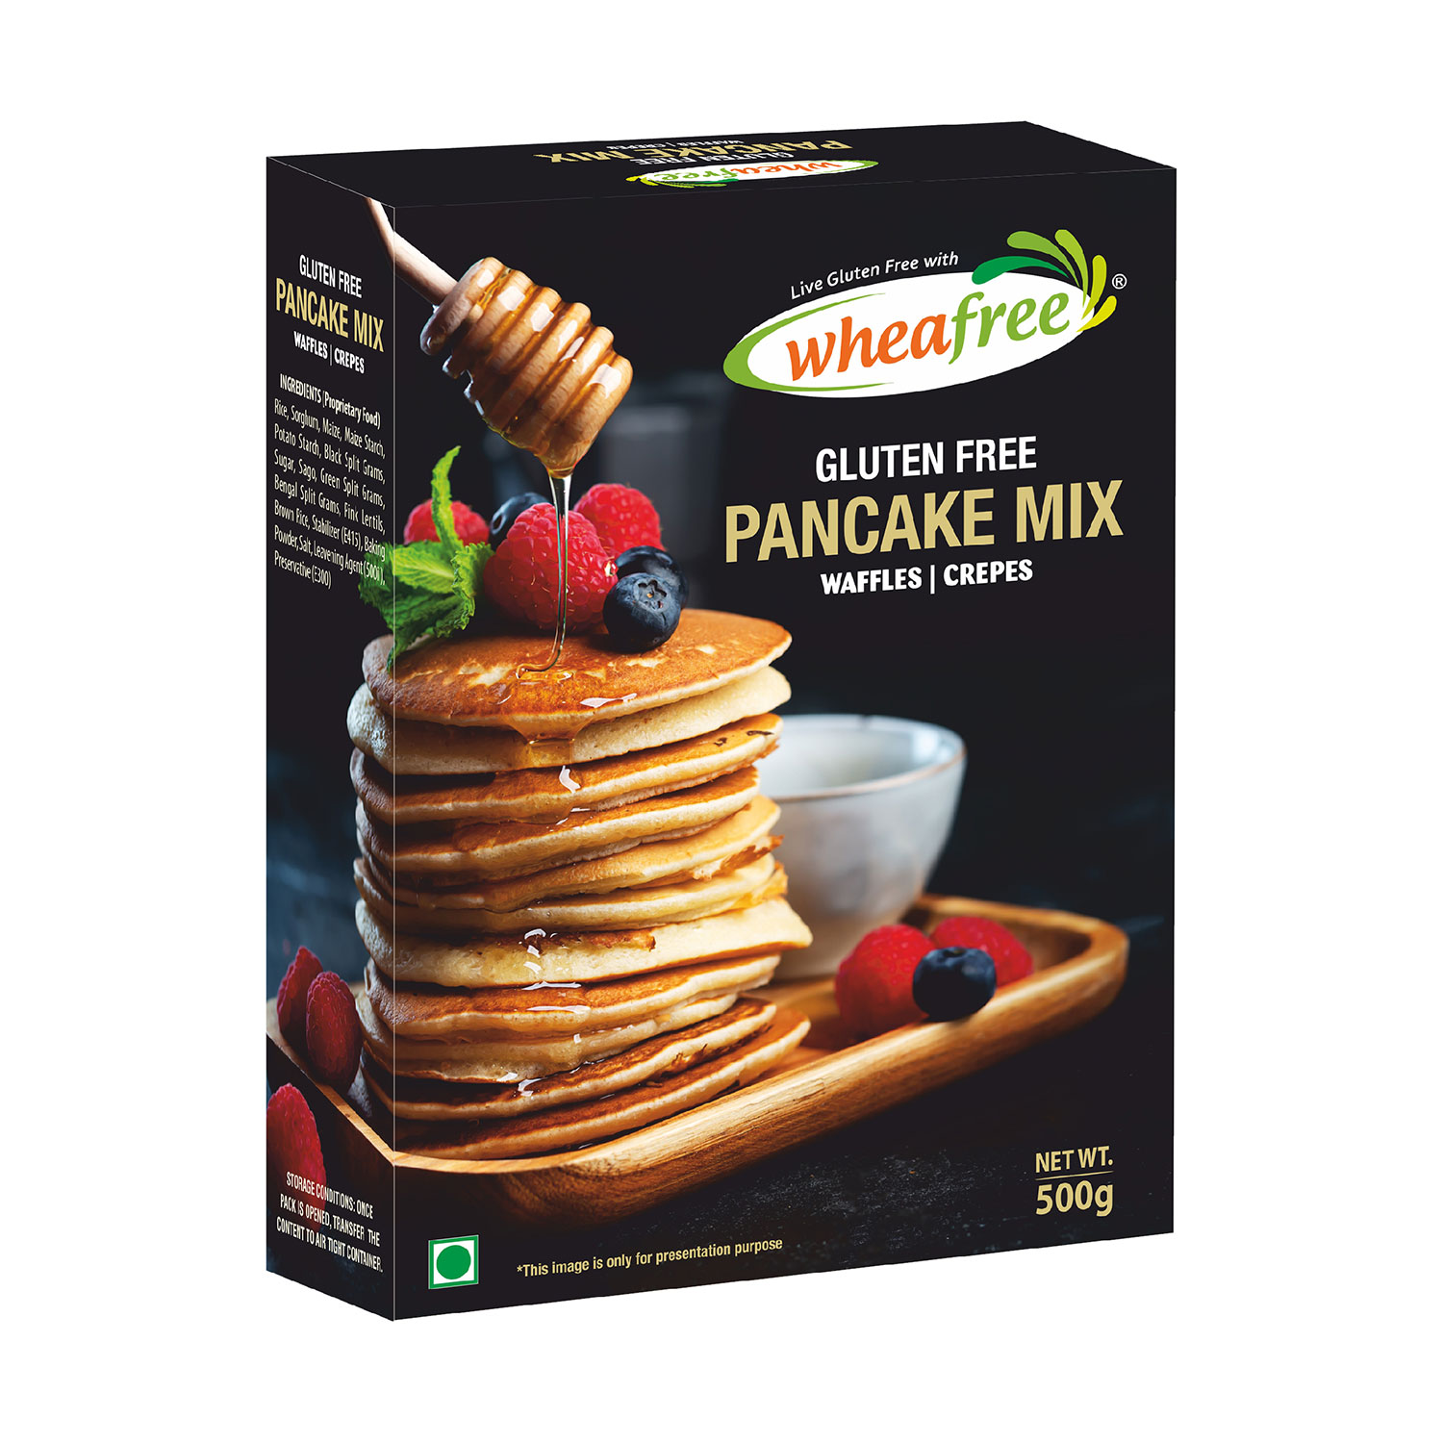
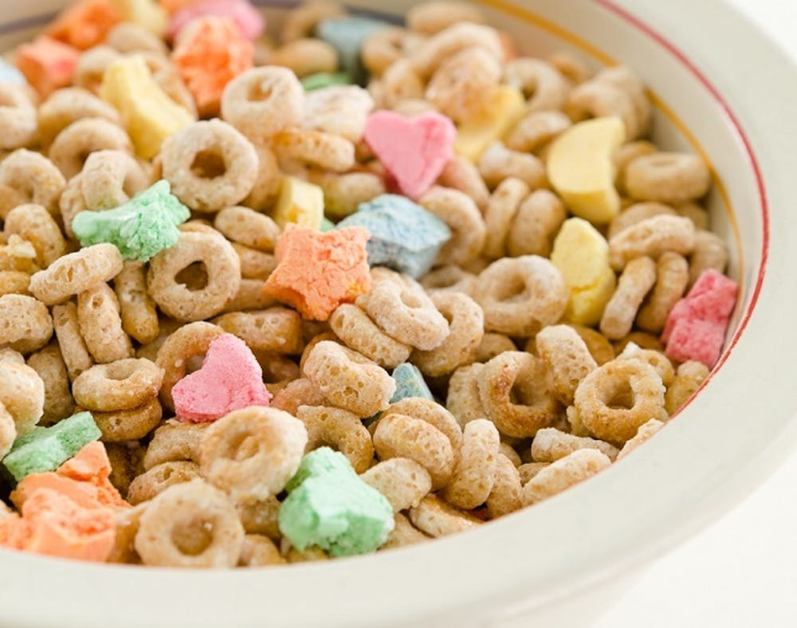
Ground coffee
Tea bags
Syrup
Pancake mix
Sauces
Cereals

Slide 8
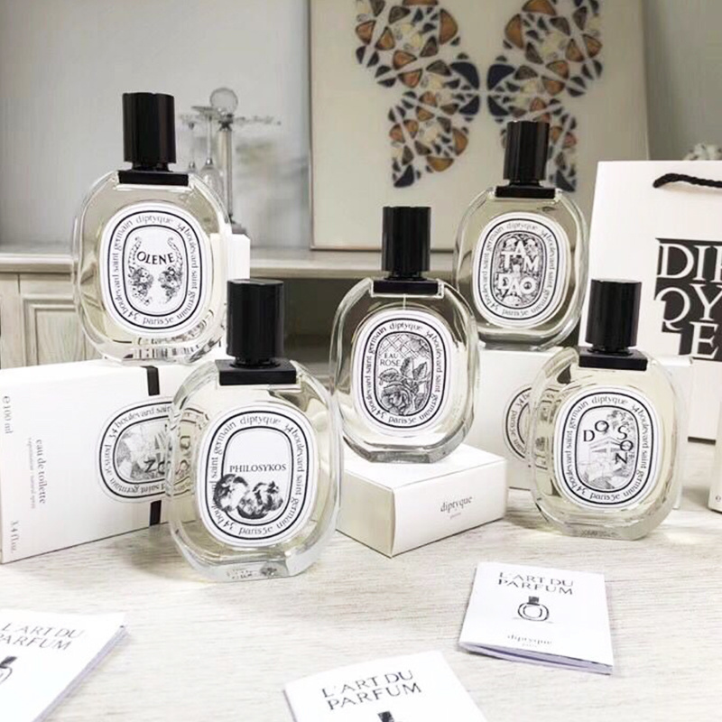
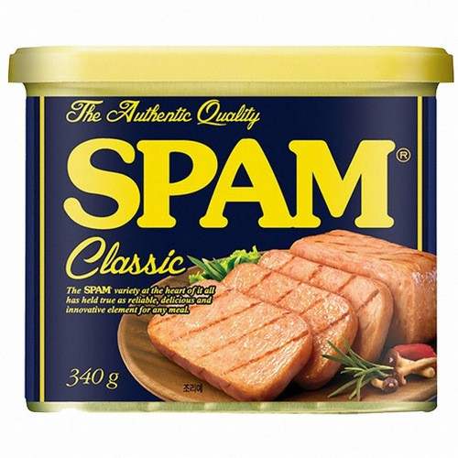
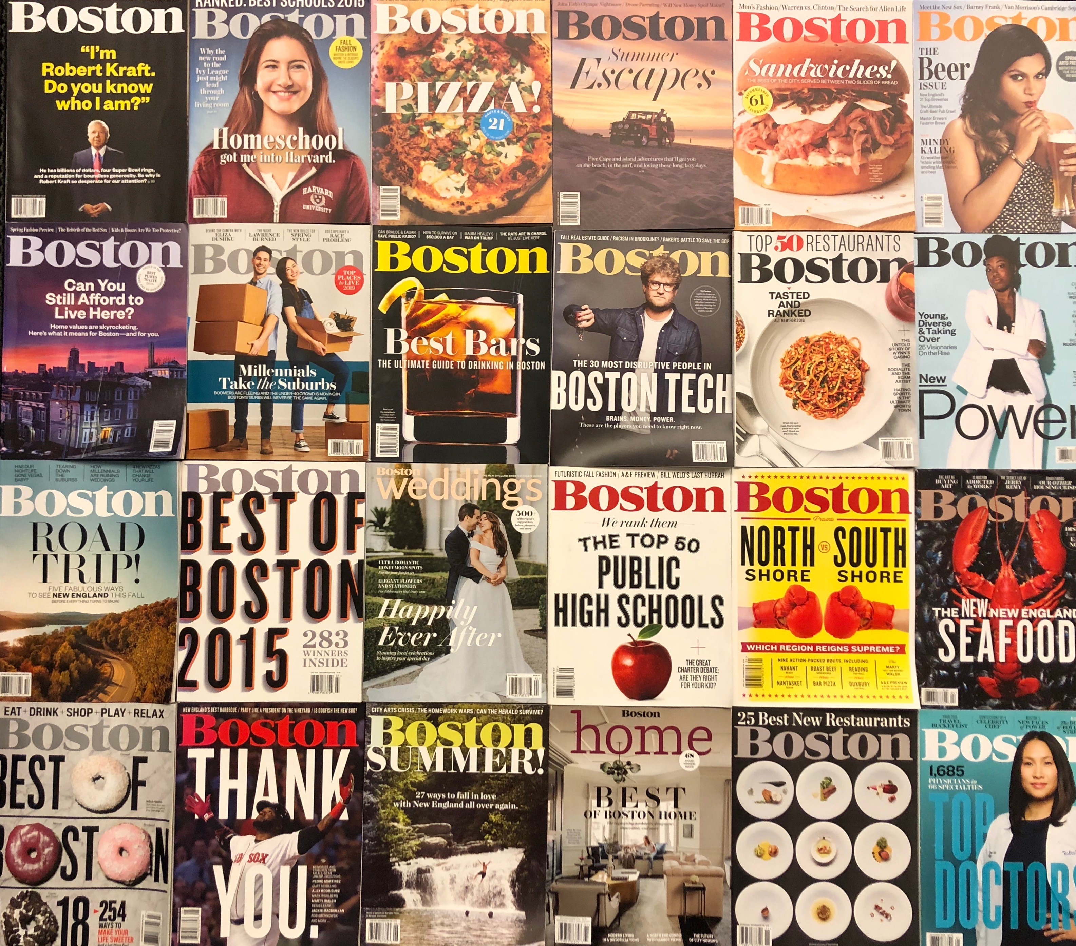
Watches
Perfume
Jewelry
Spam
Luggage
Magazines

Slide 9
Sport equipment
Smartphone
Electronic devices
Camping equipment
Clothing
Furniture

Slide 10
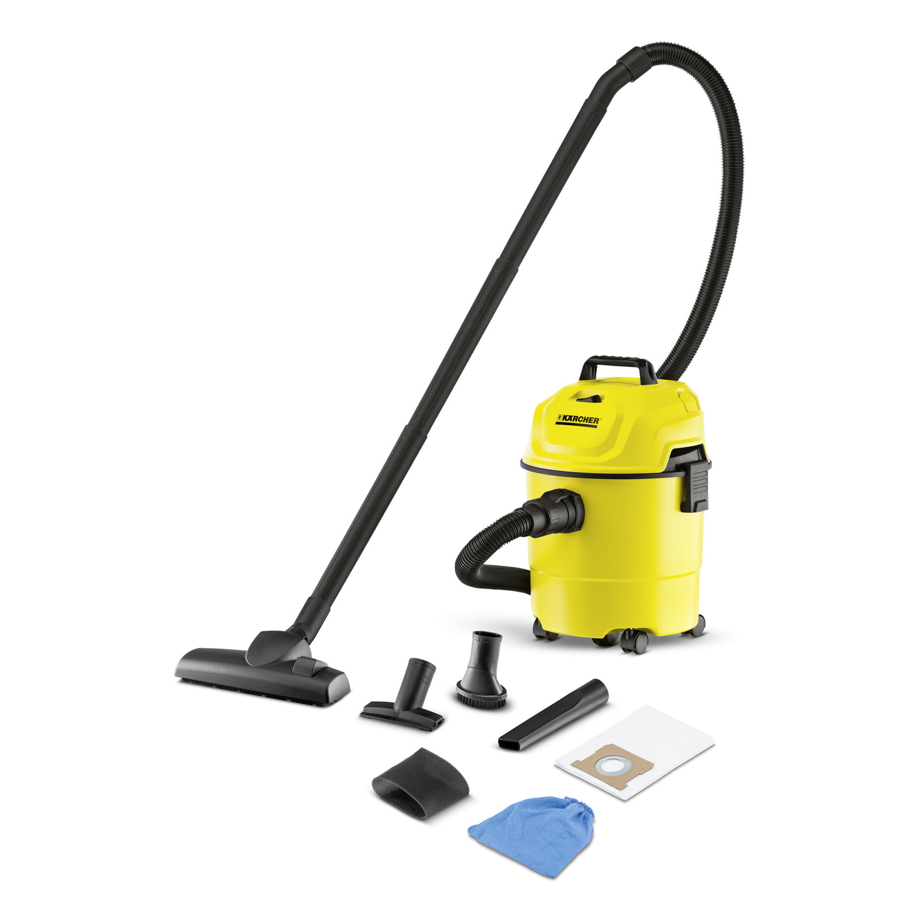
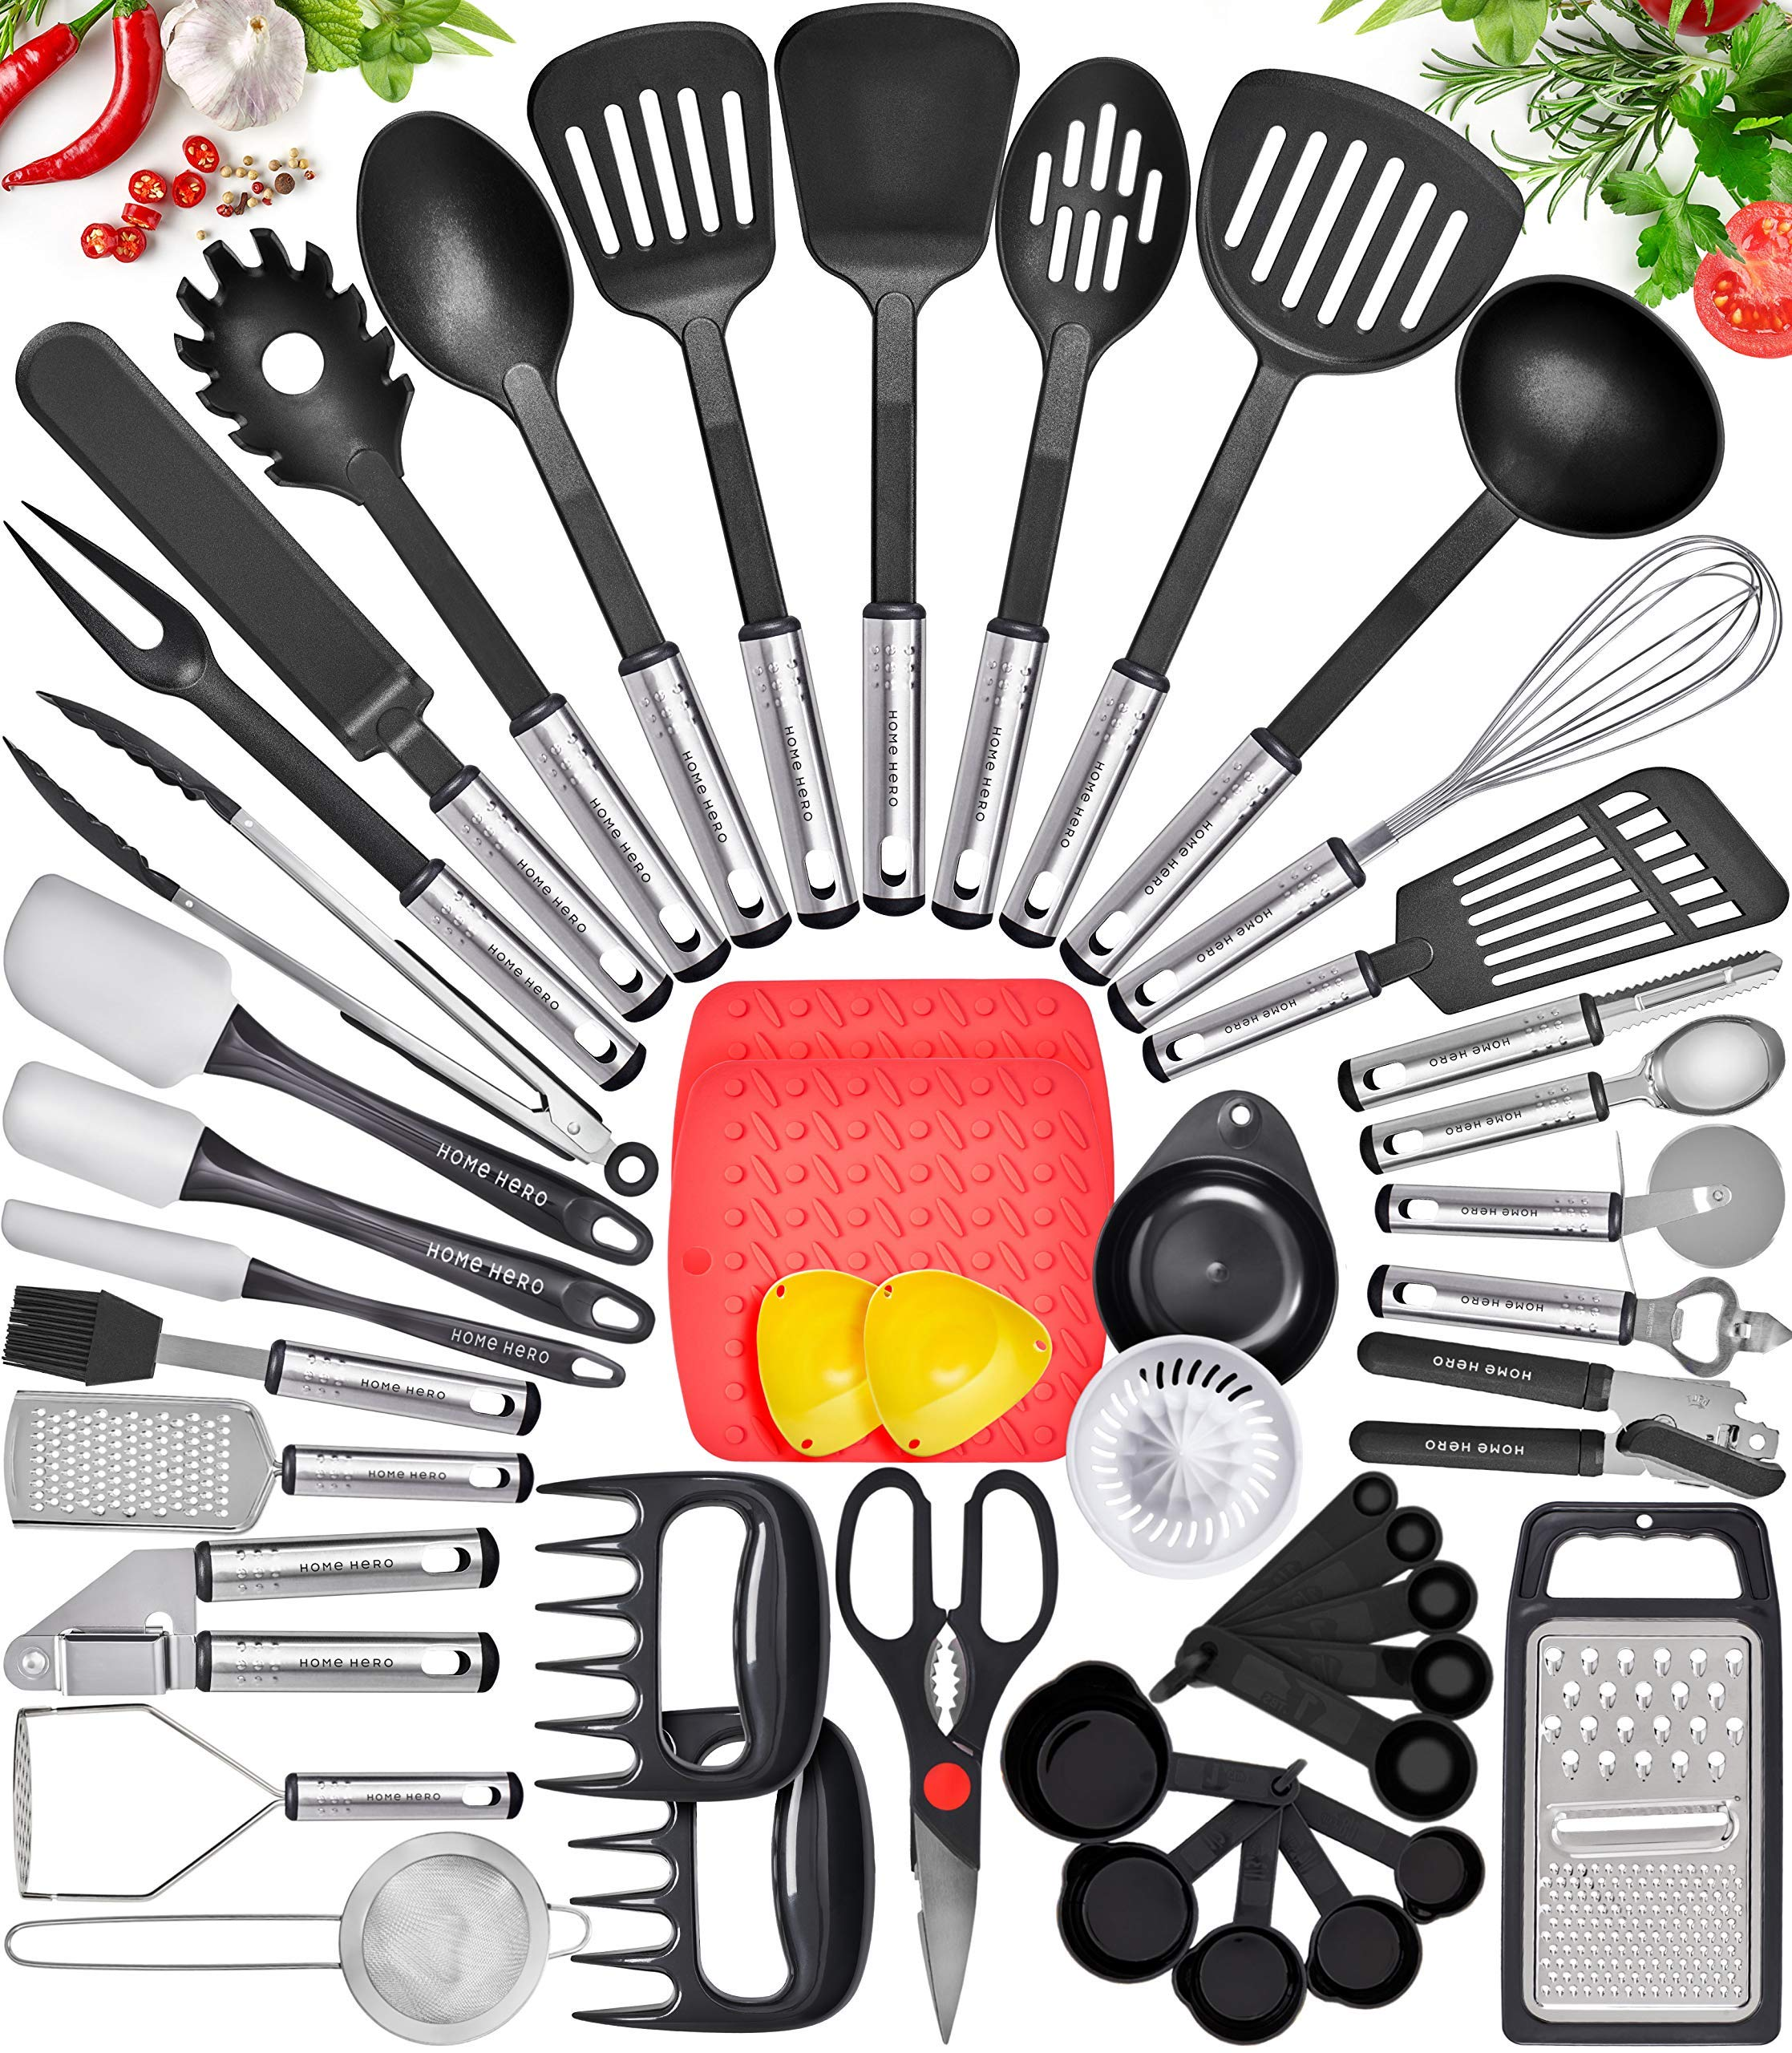
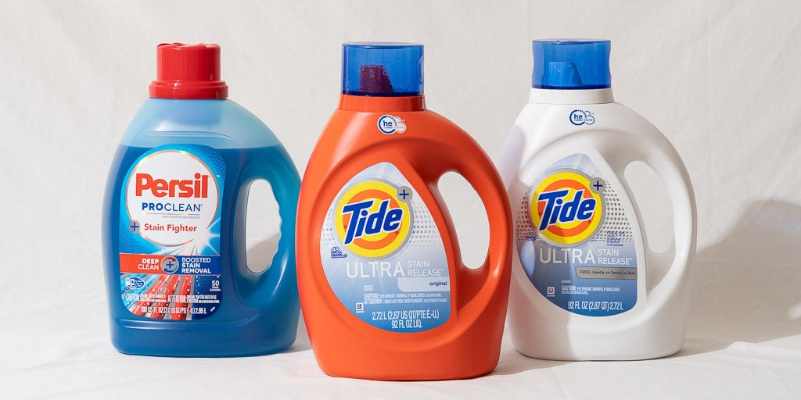
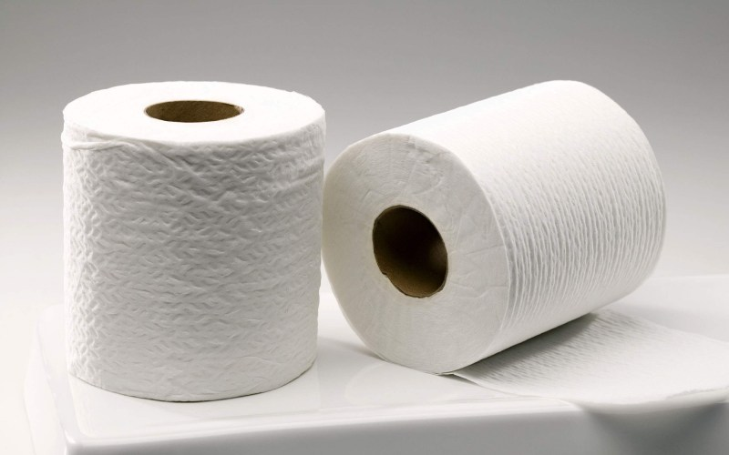
Vacuum cleaners
Toothpaste
Cleaning supplies
Kitchen utensils
Laundry detergent
Tissue

Slide 11
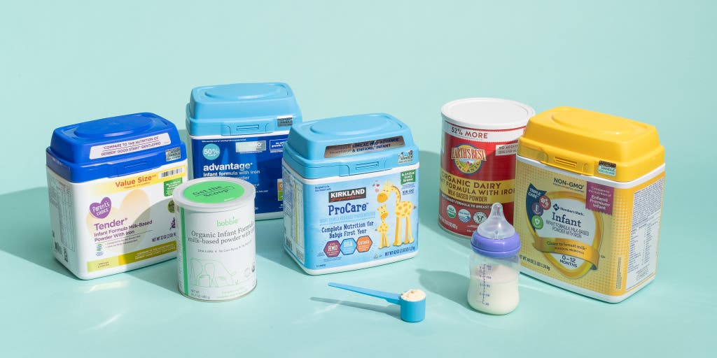
Baby Formula
Vehicles

