Slide 1
Questionnaire Design

Slide 2
What is a questionnaire?
A set of written questions as a research tool designed to generate the statistical information needed to accomplish the research objectives

Slide 3
Advantages of questionnaires
Can reach a large number of people relatively easily and economically
Provide quantifiable answers
Relatively easy to analyse
A well designed questionnaire:
- Will give appropriate data which allow to answer your research question
- Will minimise potential sources of bias, thus increasing the validity of the questionnaire
- Will much more likely be completed

Slide 4
Disadvantages of questionnaires
Provides only limited insight into problem
Limited response allowed by questions
Maybe not the right questions are asked
Varying response
Misunderstanding/misinterpretation
Need to get it right first time
Hard to chase after missing data

Slide 5
Questionnaires
The validity of the results depends on the quality of a questionnaire.
Good questionnaires are difficult to construct; bad questionnaires are difficult to analyze.
Difficult to design for several reasons:
Each question must provide a valid and reliable measure.
The questions must clearly communicate the research intention to the survey respondent.
The questions must be assembled into a logical, clear instrument that flows naturally and will keep the respondent sufficiently interested to continue to cooperate.

Slide 6
What do you prefer?

Slide 7
What makes a well designed questionnaire?
Good appearance
easy on the eye
Short and simple
Relevant and logical
⇒ High response rate
⇒ Easy data summarisation and analysis

Slide 8
Basic Rules
On first page
Return address
Study title in bold
On all pages
Identifying mark/ unique identifier
Numbered items
Page numbers
Directions in bold
Self-addressed envelope!!

Slide 9
Good Questionnaire
Valid: measures what is supposed to be measured
Reliable: measures consistently
Unbiased: measures in a way that does not systematically under- or overestimate the true value
Discriminating: can distinguish adequately between respondents for whom the underlying level of the quantity or concept is different

Slide 10
Steps to Design a Questionnaire:
Write out the primary and secondary aims of your study.
Write out concepts/information to be collected that relates to these aims.
Review the current literature to identify already validated questionnaires that measure your specific area of interest.
Compose a draft of your questionnaire.
Revise the draft.
Assemble the final questionnaire.

Slide 11
Step 1: Define the aims of the study
Write out the problem and primary and secondary aims using one sentence per aim. Formulate a plan for the statistical analysis of each aim.
Make sure to define the target population in your aim(s).

Slide 12
Step 2: Define the variables to be collected
Write a detailed list of the information to be collected and the concepts to be measured in the study. Are you trying to identify:
Attitudes
Needs
Behavior
Some combination of these concepts
Translate these concepts into variables that can be measured.

Slide 13
Step 3: Review the literature
Review current literature to identify related surveys and data collection instruments that have measured concepts similar to those related to your study’s aims.
This helps save development time and allow for comparison with other studies if used appropriately but proceed with caution if using only a subset of an existing questionnaire as this may change the meaning of the scores.

Slide 14
Step 4: Compose a draft [1]:
Determine the mode of survey administration: face-to-face interviews, telephone interviews, self-completed questionnaires, computer-assisted approaches.
Write more questions than will be included in the final draft.
Format the draft. Remember: longer questionnaires reduce the response rate.
Place the most important items in the first half of the questionnaire to increase response on the important measures even in partially completed surveys.
Make sure questions flow naturally from one to another.

Slide 15
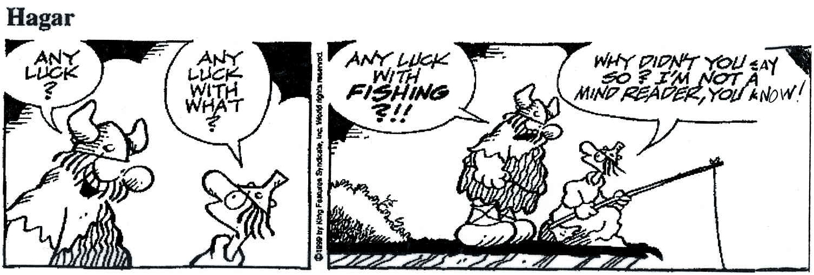
Forming Questions

Slide 16
Questions Order
Decide on order of items/questions
Easy → difficult
General → particular
Factual → abstract

Slide 17
Be accurate
Do you often touch dogs?
Yes 
No 
vs.
How often did you touch a dog during the past 3 months?
Once 
Twice 
Three times or more 
Not at all 
Don´t know 

Slide 18
Be appropriate
Are you a drunk?
Yes 
No 
vs.
How often have you consumed alcoholic beverages during the past 6 months?
Daily 
2-6 times/week 
Once a week 
Less than once a week 
Don´t know 

Slide 19
Be objective
Did you drink the strange brownish drink in Prague?
Yes 
No 
vs.
Which beverage did you consume?
Water 
Beer 
Wine 
Karkadé 
None of them 
Don´t know 

Slide 20
Principle: Ask for an answer in only one dimension
Question: How many cups of coffee or tea do you drink
Solution: Separate the question into two –
(1) How many cups of coffee do you drink during a typical day?
(2) How many cups of tea do you drink during a typical day?

Slide 21
Principle: Avoid hidden assumptions.
Question: What brand of computer do you own?
(A) IBM PC
(B) Apple
Solution:
(1) Make each response a separate dichotomous item
Do you own an IBM PC? (Circle: Yes or No)
Do you own an Apple computer? (Circle: Yes or No)
(2) Add necessary response categories and allow for multiple responses.
What brand of computer do you own? (Circle all that apply)
Do not own computer
IBM PC
Apple
Other

Slide 22
Principle: Make sure question and answer options match.
Question: Have you had pain in the last week?
[ ] Never [ ] Seldom [ ] Often [ ] Very often
Solution: Reword either question or answer to match.
How often have you had pain in the last week?
[ ] Never [ ] Seldom [ ] Often [ ] Very Often

Slide 23
Principle: Avoid questions having non-mutually exclusive answers.
Question: Where did you grow up?
Country
Farm
City
Solution: Design the question with mutually exclusive options.
Where did you grow up?
House in the country
Farm in the country
City
Notes:
mutually exclusive eventsเหตุการณ์ไม่เกิดร่วม ไม่เกิดพร้อมกัน

Slide 24
Principle: Write questions that will produce variability in the responses.
Question: Are you against drug abuse? (Circle: Yes or No)
Solution: Eliminate the question.

Slide 25
Principle: Consider each possible response to avoid a missing item
Question: Which one of the following do you think increases a person’s chance of having a heart attack the most? (Check one.)
[ ] Smoking [ ] Being overweight [ ] Stress
Solution: Which of the following increases the chance of having a heart attack?
Smoking: [ ] Yes [ ] No [ ] Don’t know
Being overweight: [ ] Yes [ ] No [ ] Don’t know
Stress: [ ] Yes [ ] No [ ] Don’t know

Slide 26
Principle: Avoid branching as much as possible to avoid confusing respondents.
Question:
(1) Do you currently have a life insurance policy? (Circle: Yes or No)
If no, go to question 3.
(2) How much is your annual life insurance premium?
Solution: If possible, write as one question.
How much did you spend last year for life insurance? (Write 0 if none).

Slide 27
Open or Closed?
Closed
Advantages:
Simple and quick
Reduces discrimination against less literate
Easy to code, record, analyse
Easy to compare
Easy to report results

Slide 28
Closed questions
Disadvantages:
Restricted number of possible answers
Loss of information
Possible compromise:
Insert field „others“

Slide 29
Open questions
Advantages:
Not directive
Allows exploration of issues to generate hypothesis
qualitative research, focus groups, trawling questionnaires
Used even if no comprehensive range of alternative choices
Good for exploring knowledge and attitudes
Detailed and unexpected answers possible

Slide 30
Open questions
Disadvantages:
Interviewer bias
Time-consuming
Coding problems
Difficult to analyse!
Difficult to compare groups

Slide 31
Closed Questions
Straightforward response
What is your age in years? ___ years
How long have you owned a dog? ___ years
What is your sex (gender)?
Male
Female
Did you stay in Hotel X on 23/7/05?
Yes
No
Don’t know

Slide 32
Closed Questions
2. Checklist
Which of the following outdoor activities did you do last week?
Running
Walking
Hiking
Cycling
Swimming

Slide 33
Closed Questions
3. Rating scale
Did you do use sunscreen during the following outdoor activities during the past six months?
Always Sometimes Seldomly Never
Running
Walking
Cycling

Slide 34
Closed Questions
4. Rating scale
Numerical
How useful would you think that information on the risk of biting from stray dogs would be? (please circle)
1 2 3 4 5 6 7
Not at all useful Very useful
Analogue How much is your pain severe (put the tick on the line)
0 10

Slide 35
Closed Questions
5. Scales for measuring attitude (Lickert)
Stray dogs carry a higher risk of rabies
No, I strongly disagree
No, I disagree quite a lot
No, I disagree just a little
I’m not sure about this
Yes, I agree just a little
Yes, I agree quite a lot
Yes, I strongly agree

Slide 36
Coding Schedule
Questionnaire can be pre-coded
Quicker and easier data entry
Examples:
Male 1 Ill 1
Female 2 Not ill 0
Don’t know 3 Don’t know 9
Single 1 Separated 3
Married 2 Divorced 4 Widowed 5 Don’t know 9

Slide 37
Step 5: Revise
Shorten the set of questions for the study. If a question does not address one of your aims, discard it.
Refine the questions included and their wording by testing them with a variety of respondents.
Ensure the flow is natural.
Verify that terms and concepts are familiar and easy to understand for your target audience.
Keep recall to a minimum and focus on the recent past.
Notes:
discard = get rid of, expel, give up

Slide 38
Step 6: Assemble the final questionnaire [1]:
Decide whether you will format the questionnaire yourself or use computer-based programs for assistance:
SurveyMonkey.com
Adobe Live Cycle Designer 7.0
GCRC assistance
At the top, clearly state:
The purpose of the study
How the data will be used
Instructions on how to fill out the questionnaire
Your policy on confidentiality
Include identifying data on each page of a multi-page, paper-based questionnaire such as a respondent ID number in case the pages separate.

Slide 39
References
Designing Clinical Research, Stephen B. Hulley, et. al.
www.statpac.com/surveys
“Design and use of questionnaires: a review of best practice applicable to surveys of health service staff and patients”, Health Technology Assessment, 2001. Vol.5, No. 31.
Moser CA, Kalton G. Survey methods in social investigation. 2nd ed. Aldershot: Gower; 1971.
Questionnaire Design lecture, Theresa Scott

