Slide 1
WHAT IS RESEARCH?
Research is a systematic and organized process.
It is about collecting information that answers a question.
Throughout this process the researcher has to ensure that information is gathered in a systematic and accurate manner.

Slide 2
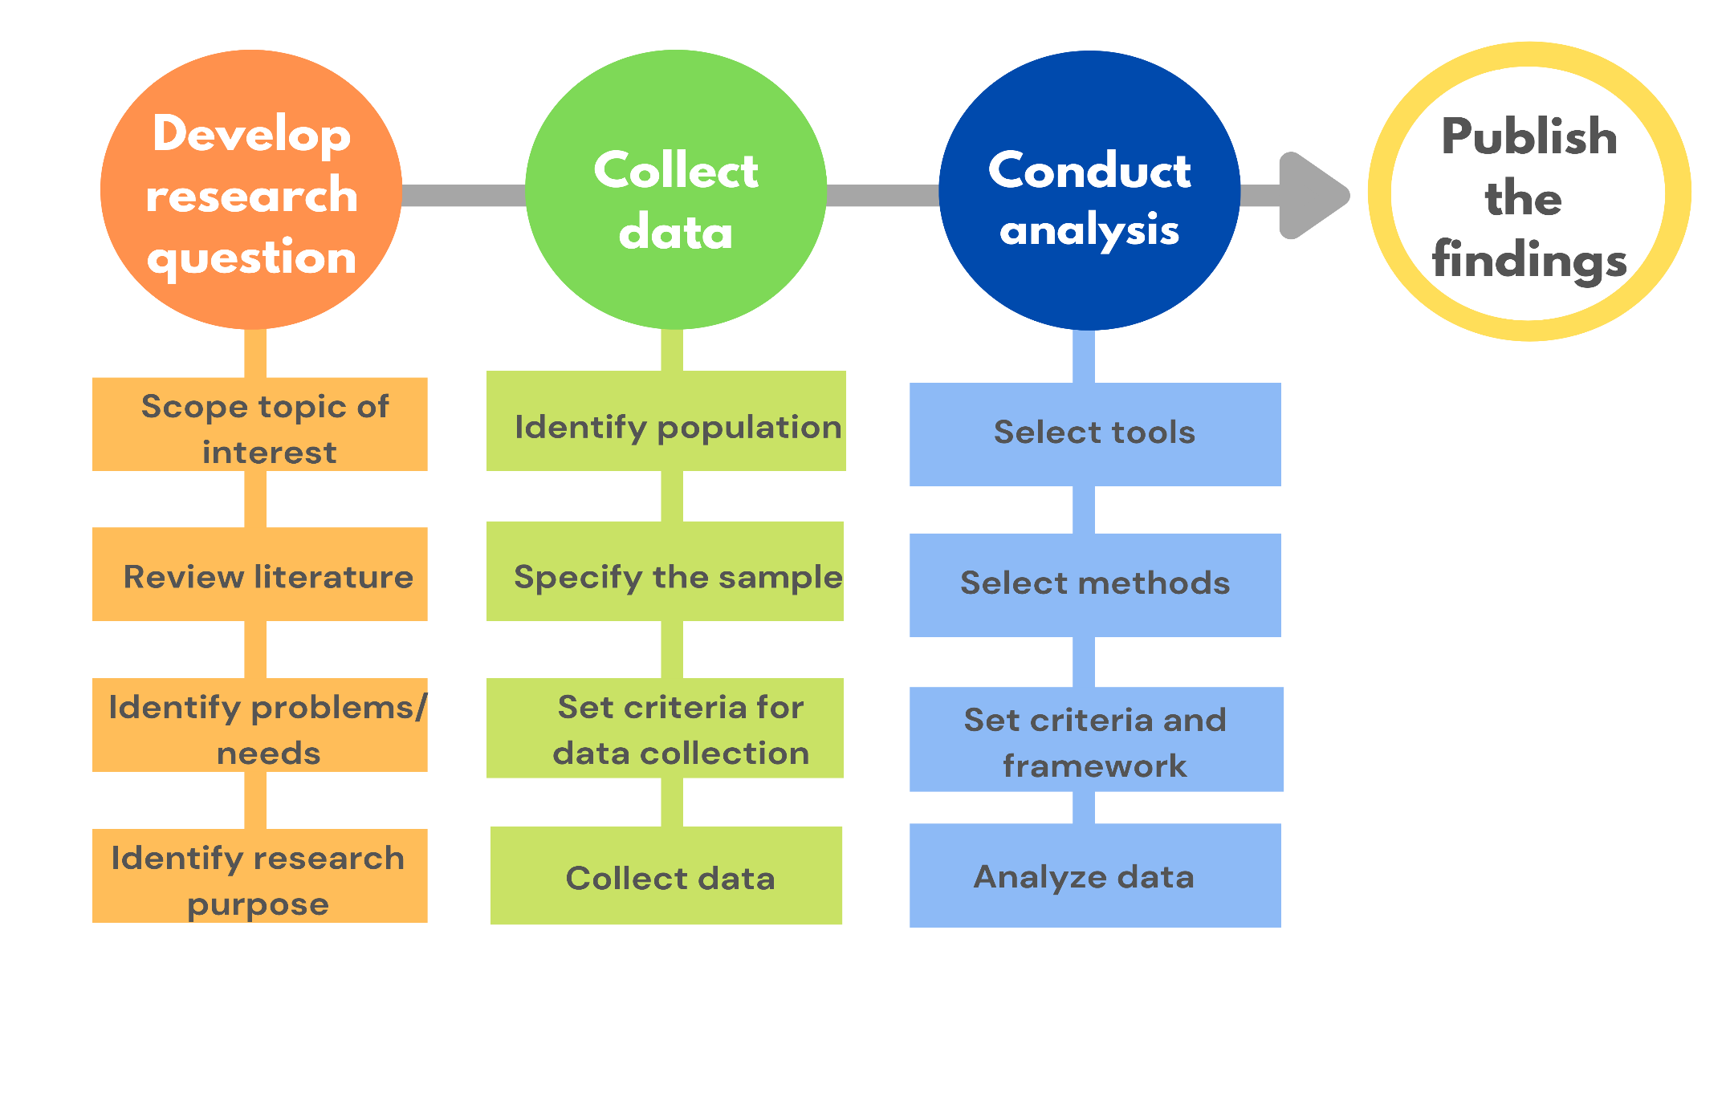
GENERAL RESEARCH PROCESS

Slide 3
STEP 1: SCOPE TOPIC OF INTEREST
Research requires commitment.
As a researcher, you need to make sure you are doing research that you not only gain some benefits but you also have some interest in doing it.
Notes:
Approach sometimes also called tradition of research.

Slide 4
STEP 2: REVIEW LITERATURE
Reviewing literature has two major purposes:
1. to build up the researcher's knowledge base of the topic under exploration for a deeper understanding
2. to ensure the significance of the research.
The researcher needs to make sure how the research will be able to contribute to the knowledge in the related field compared with the existing research literature.

Slide 5
STEP 3: IDENTIFY PROBLEM/ NEEDS
Based on your own understanding and interest of the topic, think about what issues can be explored? Why is it necessary to research this issue? What do we want to find out?
Sometimes, a research problem cannot be immediately identified. But, through reviewing the existing literature will start take its shape.
For example, South Africa has a high incidence of road death. Research already done shows that around 10,000 people are killed in road accidents each year. Now we need to find out what are the causes and impact of the high incidence of road deaths.
Notes:
Approach sometimes also called tradition of research.

Slide 6
STEP 4: IDENTIFY A FOCUS/PURPOSES
In this step, aims (goals) and objectives of the research are determined to define direction.
A clear aim will make it easier to develop objectives for the research, for example:
To investigate the causes of accidents in South Africa.
To measure the economic impacts of road-accidents on South Africa.
To assess the social and economic impact of road accidents on the South African population

Slide 7
STEP 5: OPERATIONALIZATION
What sort of information is needed to answer the questions?
Where will it be found (sources)?
What would be the best research methods to use?
Who is best suited to do this research?

Slide 8
STEP 6: COLLECT DATA
Three major elements in the research study need to be considered: population, sample (data), criteria for collection, and instruments.

Slide 9
STEP 6: COLLECT DATA
Data: It concerns what to study.
For experimental studies, the researcher needs to consider statistical sampling to make sure that sample is representative of the population.
For qualitative research, purposeful sampling is the major principle. The selection of individuals, groups, or cases depends on how the characteristics, or properties of the individuals, groups, or cases will best inform the researcher with the focus of what is under investigation.

Slide 10
STEP 6: DETERMINE METHODS
Instruments
For qualitative research, the issues are the sources of data, where the researcher can find the information and what methods the researcher can use to get the information.
Qualitative research usually focuses on the information gathered from the interviews, observations, or documents. The very distinctive feature about the qualitative research is that the researcher is part of the instrument.
The recognition of this researcher's subjective interpretation of the information yields the process of triangulation, which emphasizes use of multiple sources, methods, investigators, and theories to ensure the credibility of the research.

Slide 11
STEP 6: CRITERIA FOR COLLECTION
Procedures: A procedural planning of how to get entry to research participants or to the field, how to implement the experimental treatment or to schedule observations and interviews.

Slide 12
STEP 7: CONDUCT ANALYSIS
Three major steps before analyzing data are selecting tools, selecting methods of analysis and setting criteria and framework of analyzing

Slide 13
STEP 8: DISCUSS FINDINGS AND
DRAW CONCLUSION
Findings are often in table, graph, numeric or percentage form.
The discussion involves using words to describe the findings.
The discussion section is where the researcher gives opinions based on the findings of the research.
The researcher then draws conclusions and may make recommendations and point out implication based on the findings.

Slide 14
STEP 9: WRITE UP
Research report
Thesis/ dissertation
Research article/ research paper/ manuscript

Slide 15
RESEARCH PROCEDURE
Collect data
Analyze data
Review of literature
Determine aims of research
Determine research topic and focus
Interpret data for discussion and conclusion
Determine research design (Methodology and Tools)

Slide 16
RESEARCH PROCEDURE
Determine research topic and focus
Review of literature
Determine aims of research
Determine research design (Methodology and Tools)
Collect data
Analyze data
Interpret data for discussion and conclusion

