Slide 1


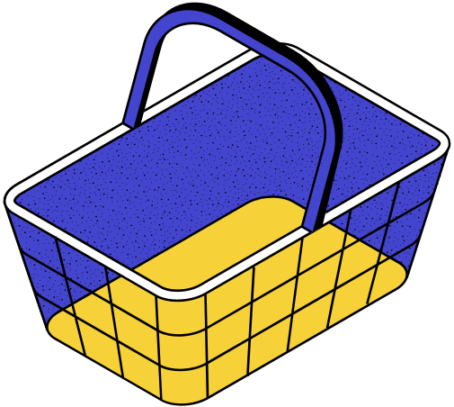
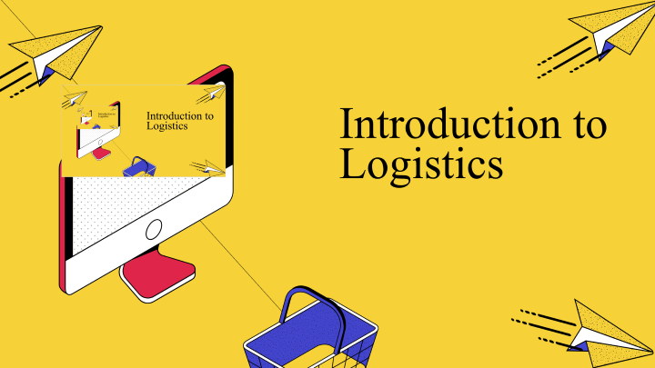
Introduction to Logistics

Slide 2



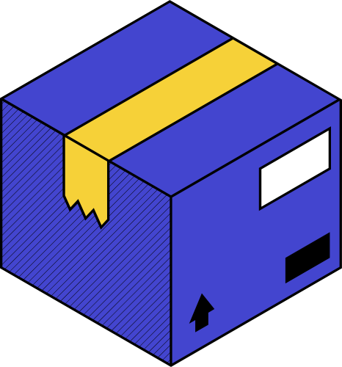
what is logistic
Logistics is generally the detailed organization and implementation of a complex operation. In a general business sense, logistics is the management of the flow of things between the point of origin and the point of consumption to meet the requirements of customers or corporations. The resources managed in logistics may include tangible goods such as materials, equipment, and supplies, as well as food and other consumable items.

Slide 3
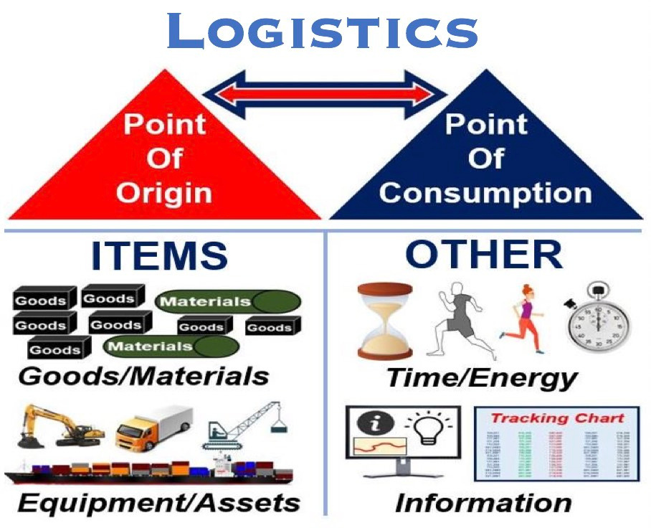
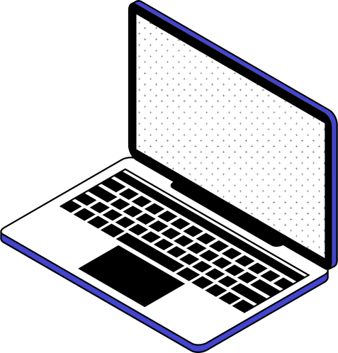

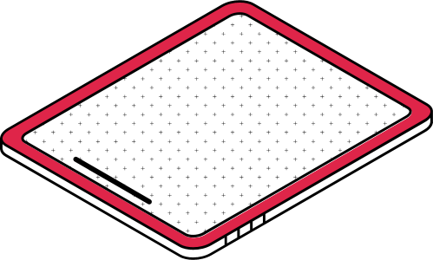
  Business logistics is all to do with getting the right item in the right amount at the right time at the right place for the right price in the right conditions to the right customer.

Slide 4
In business, logistics is the management of the flow of things between their point of origin and their final destination in order to meet the needs of companies and customers. It is a subset of supply chain management.
The resources managed in logistics include a wide range of items, including:
  Food
  People
  Animals
  Materials
  Time
  Information
  Vehicles, Boats and Airplanes
The logistics of physical things – things we can touch – generally involves the integration of material handling, information flow, production, packaging, transportation, inventory, warehousing and security.
Logistics in the world of business

Slide 5

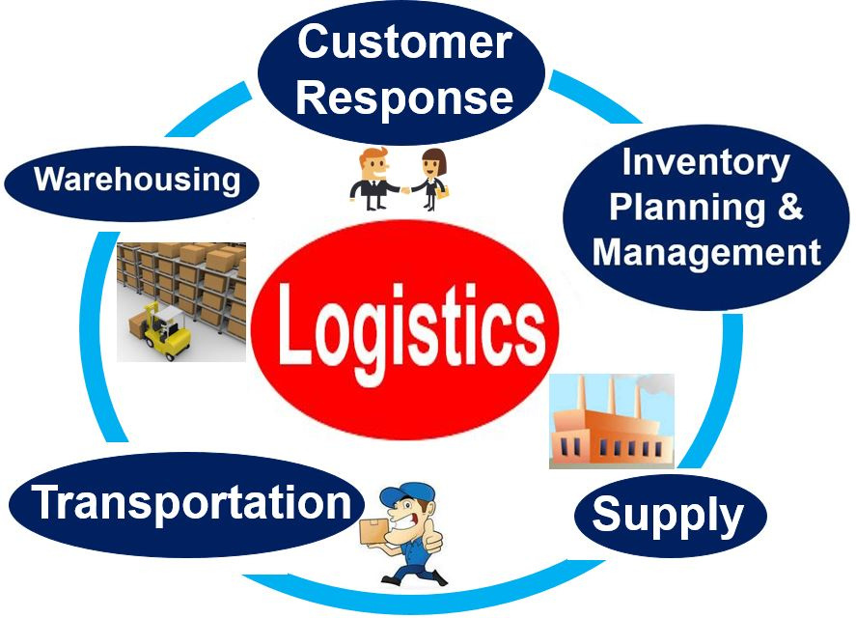

Logistics management means to plan, implement and control the effective forward-reverse movement of goods – plus sharing the related information between the point of origin and the point of consumption in order to meet customers’ needs.

Slide 6



Supply chain management VS Supply Chain

Slide 7

supply chain
A supply chain is a network between a company and its suppliers to produce and distribute a specific product to the final buyer. This network includes different activities, people, entities, information, and resources. The supply chain also represents the steps it takes to get the product or service from its original state to the customer.

Slide 8

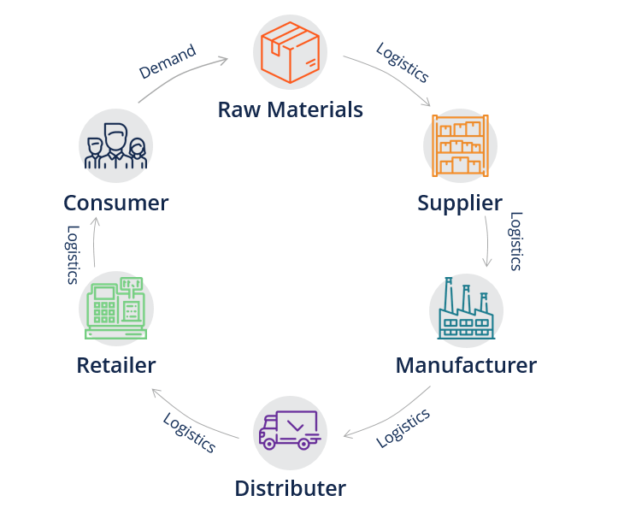
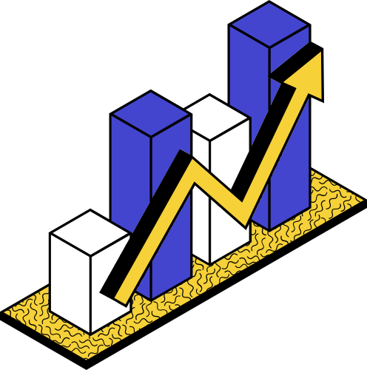
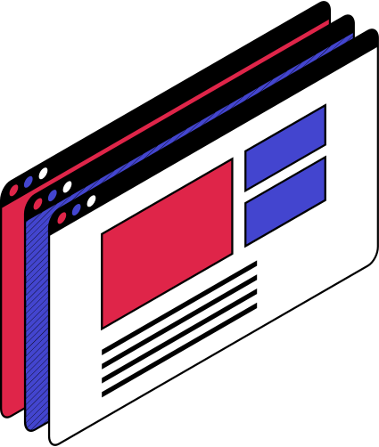
supply chain

Slide 9

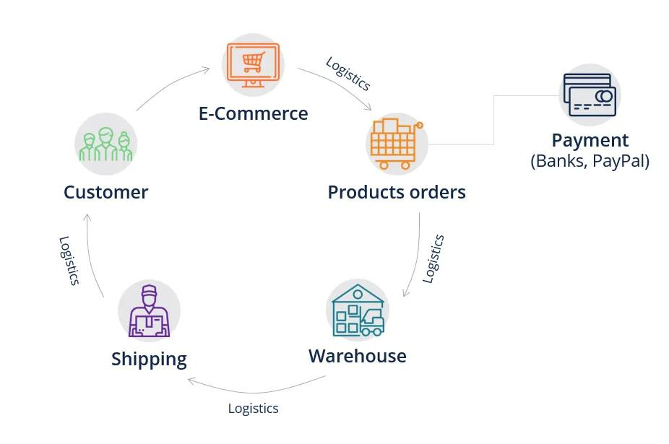
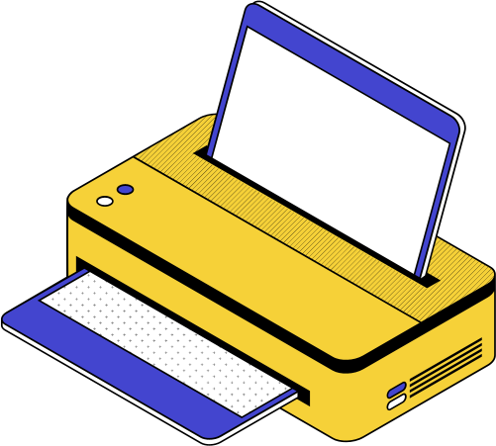
Supply Chain for an e-Commerce Company
this example, the e-commerce company operates a website, and that website sells various products. When a customer places an order for a product, the product order is being processed by technology such as a checkout cart, an order system, or a third-party product such as Shopify. The payment processors then come in and deal with payment transactions for the order, which actually opens up a new supply chain.

Slide 10
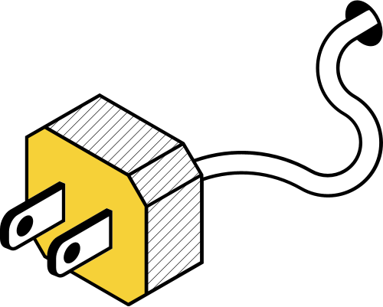


supply chain management
Supply chain management is the management of the flow of goods and services and includes all processes that transform raw materials into final products. It involves the active streamlining of a business's supply-side activities to maximize customer value and gain a competitive advantage in the marketplace.
SCM represents an effort by suppliers to develop and implement supply chains that are as efficient and economical as possible. Supply chains cover everything from production to product development to the information systems needed to direct these undertakings.

Slide 11
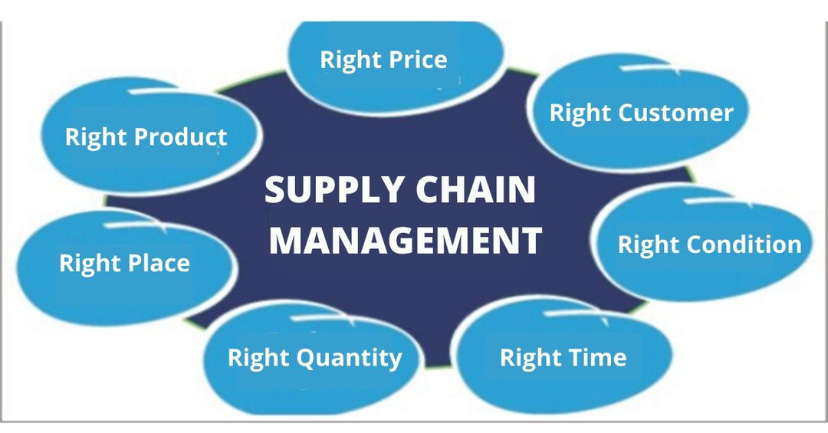
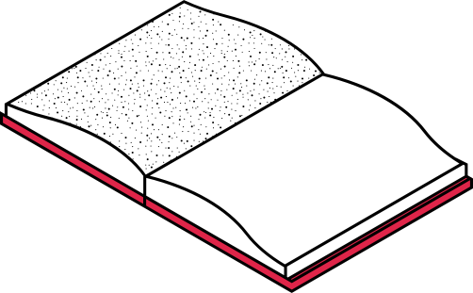
The Four Rs of SCM
•Reliability – the ability of as system to perform as expected over time
•Responsiveness – ability to respond in ever-shorter lead time with the greatest possible flexibility
•Resilience – ability to absorb shocks and continue to function even in the face of unexpected disruption
•Relationships – strategic sourcing based on the careful selection of suppliers and partnerships

Slide 12
References
1. https://marketbusinessnews.com/financial-glossary/logistics-definition-meaning/
2. https://corporatefinanceinstitute.com/resources/knowledge/strategy/supply-chain/
3. https://www.investopedia.com/terms/s/scm.asp
1

