Slide 1
Basic Principles of Research
Dr. Angvarrah Lieungnapar
Semester 1/2564

Slide 2
Course Description
Basic principles of research;
choosing research topic;
making research upon approval topic; presenting written and oral outcome

Slide 3
What is research?
“A systematic process of inquiry consisting of three elements or components: (1) a question, problem or hypothesis, (2) data, and (3) analysis and interpretation.”(Nunan 1992, 3)
“The systematic investigation and study of materials and sources in order to establish facts and reach new conclusions.”
“The systematic process of collecting and analyzing information to increase our understanding of the phenomenon under study. It is the function of the researcher to contribute to the understanding of the phenomenon and to communicate that understanding to others.

Slide 4
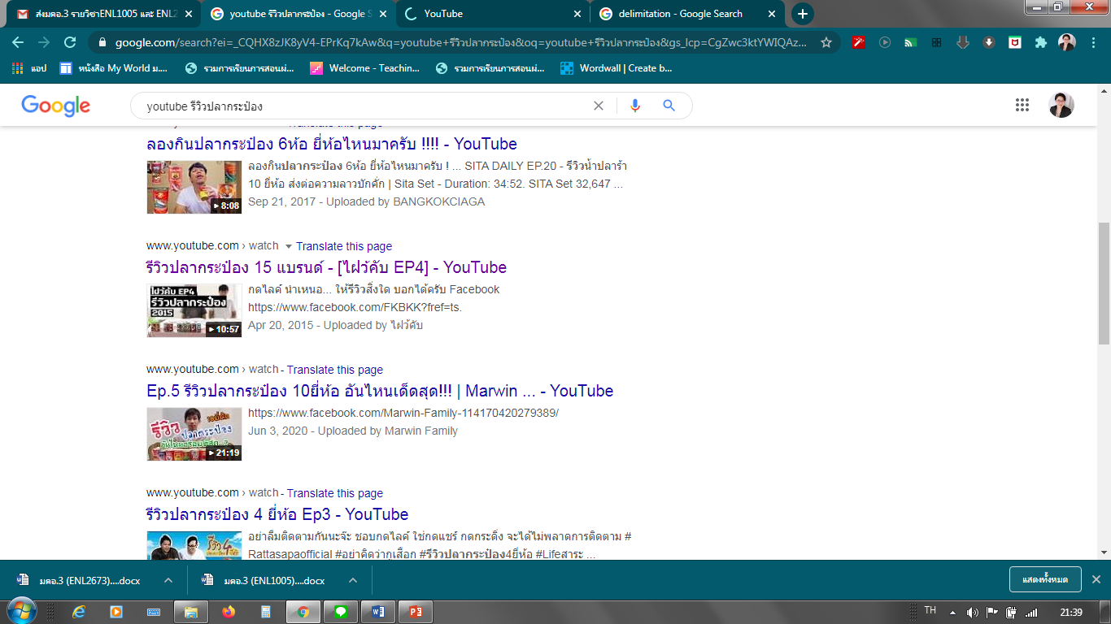
Case study
https://www.youtube.com/watch?v=Ap1N9tqTOog
https://www.youtube.com/watch?v=nDMuCMDXasE

Slide 5
Assignment
In group, show a case study that reflects ‘research as a systematic process’

Slide 6
What can help you do research?
Need to read lot
Collect good research articles for reading (review literature)

