Slide 1
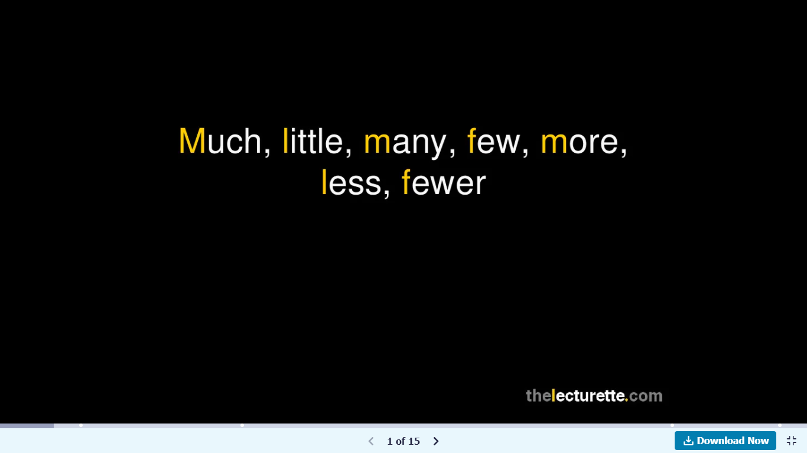
https://www.slideshare.net/pietvanderlaan/much-little-many-few-more-less-fewer

Slide 2
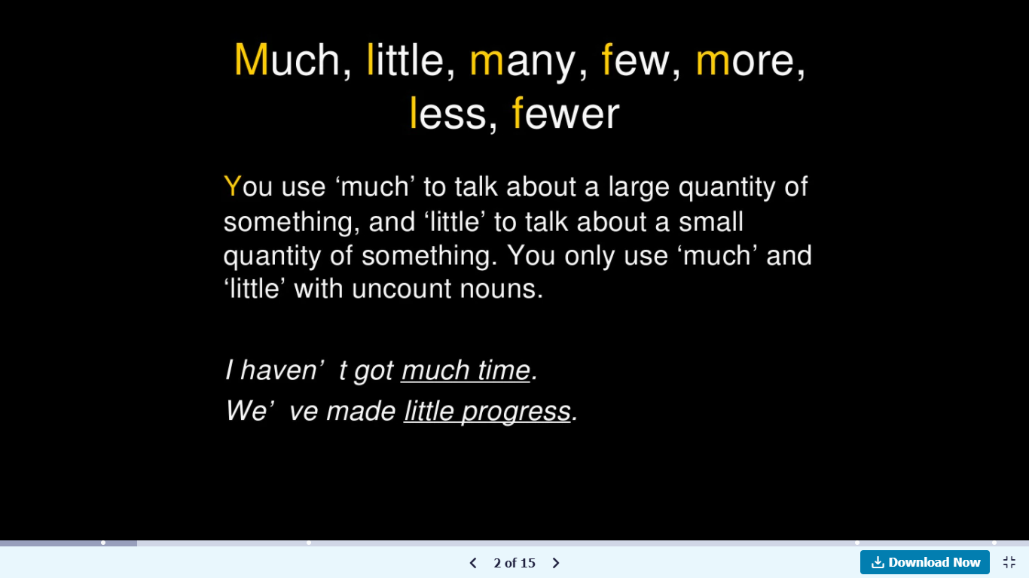
Much + uncountable N. (large quantity)
Little + uncountable N. (small quantity)

Slide 3
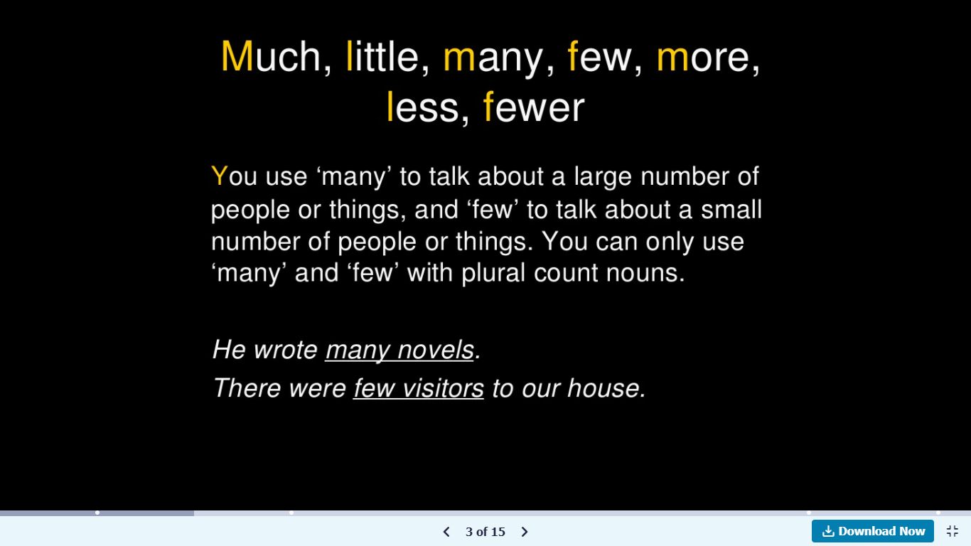
Many + plural countable N. (a large number of people/things)
Few + plural countable N. (a small number of people/things)

Slide 4
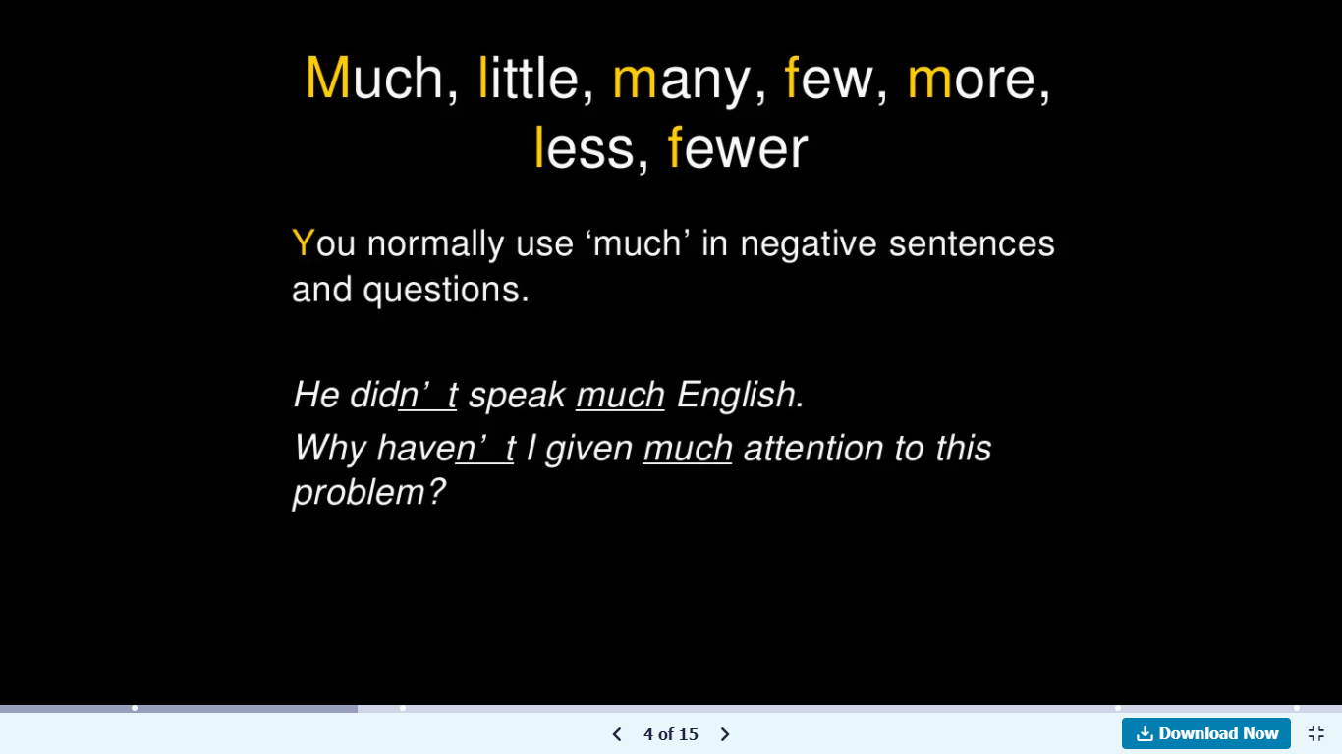

Slide 5
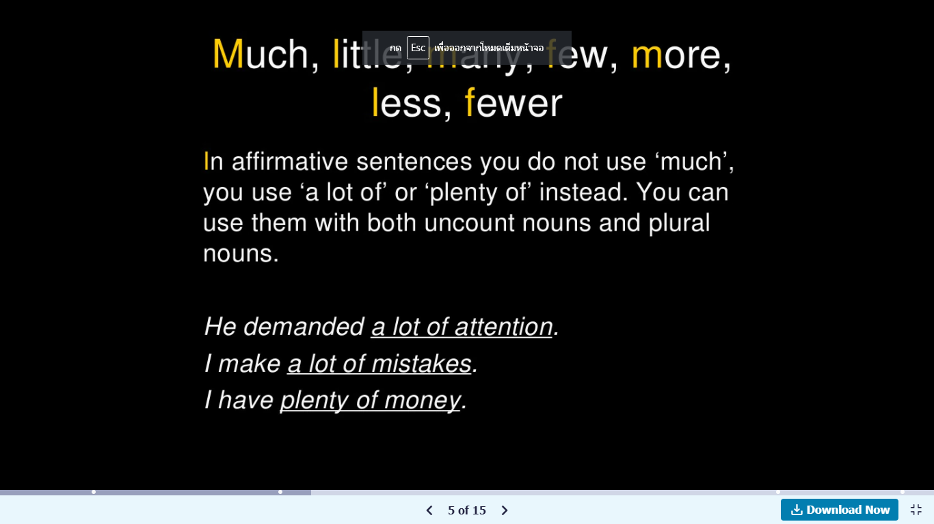
A lot of + uncountable/ plural countable N. (large quantity/number)
Plenty of + uncountable/ plural countable N. (large quantity/number)

Slide 6
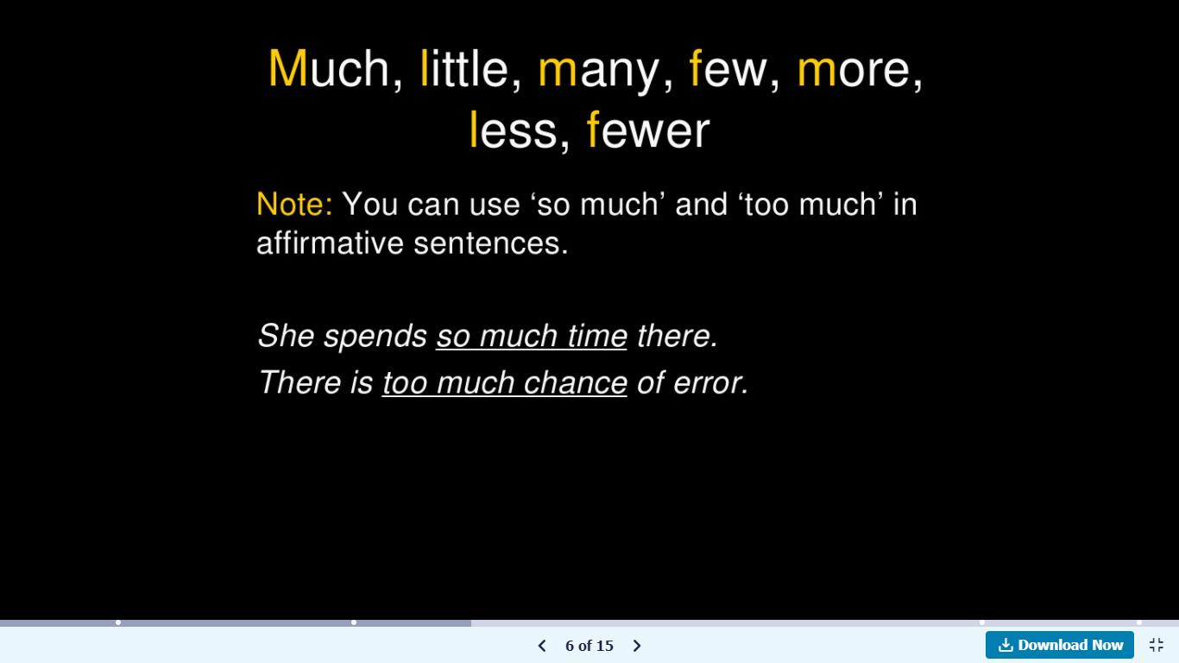

Slide 7
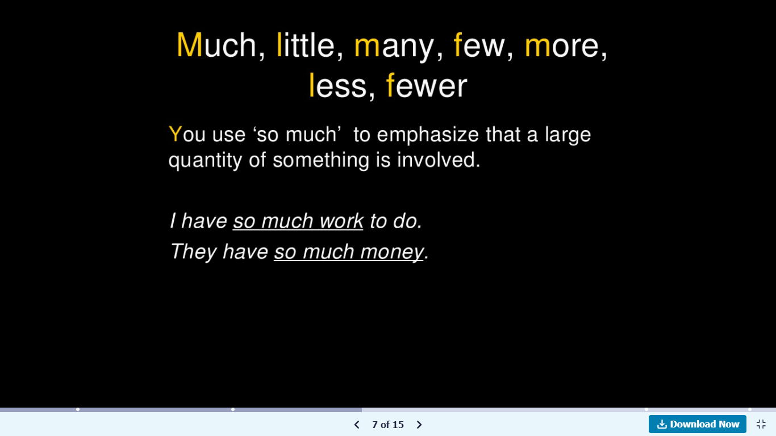

Slide 8
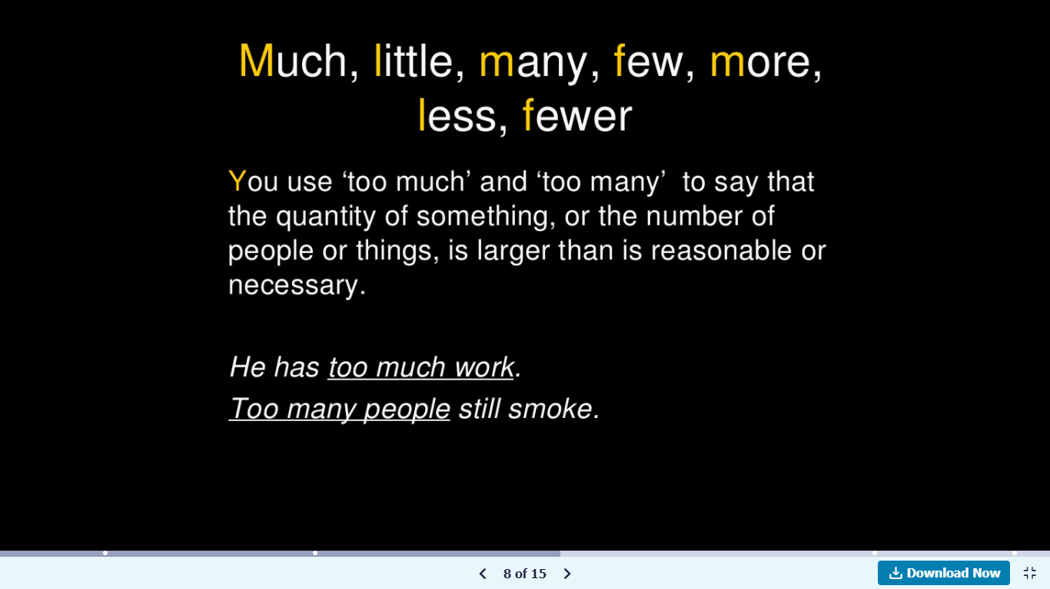

Slide 9
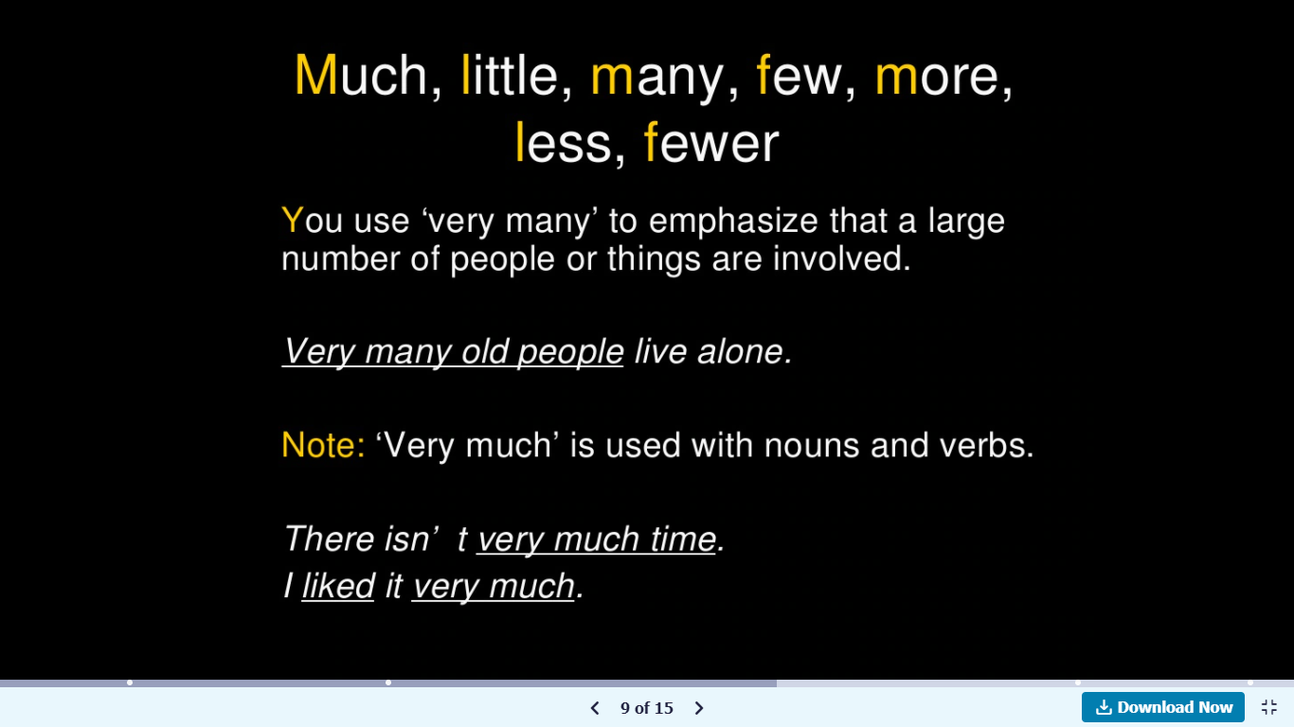

Slide 10
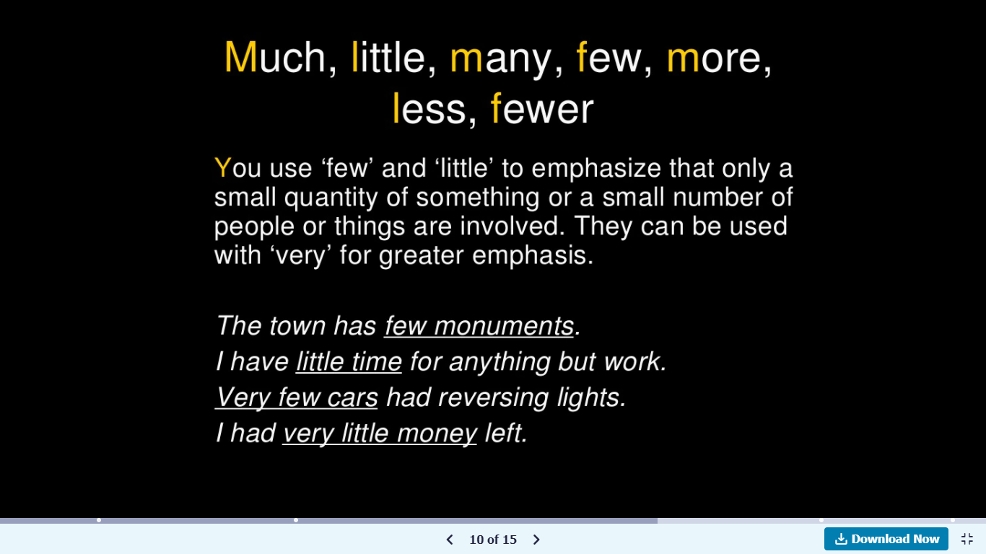

Slide 11
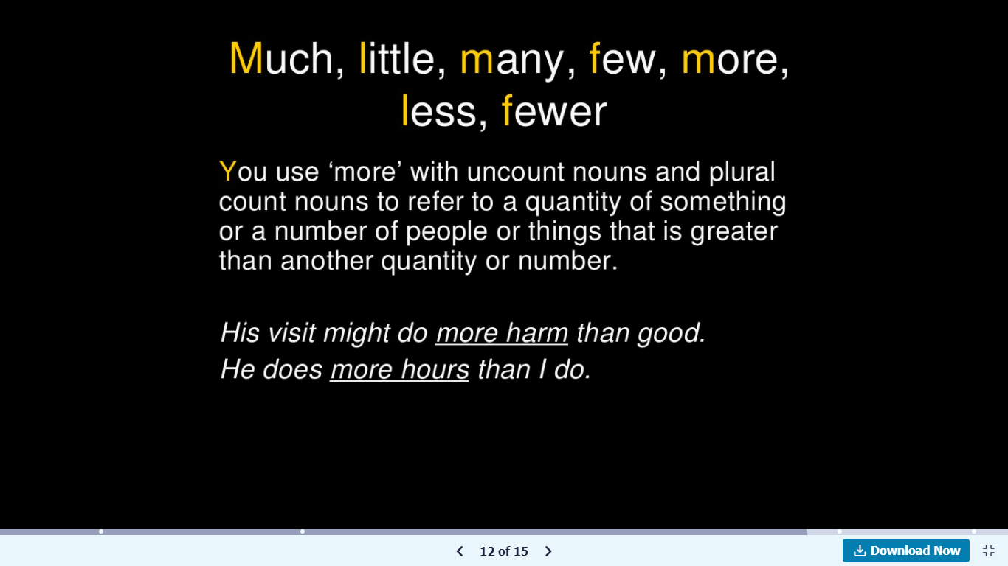
More + uncountable/ plural countable N. (greater than another quantity/number)

Slide 12
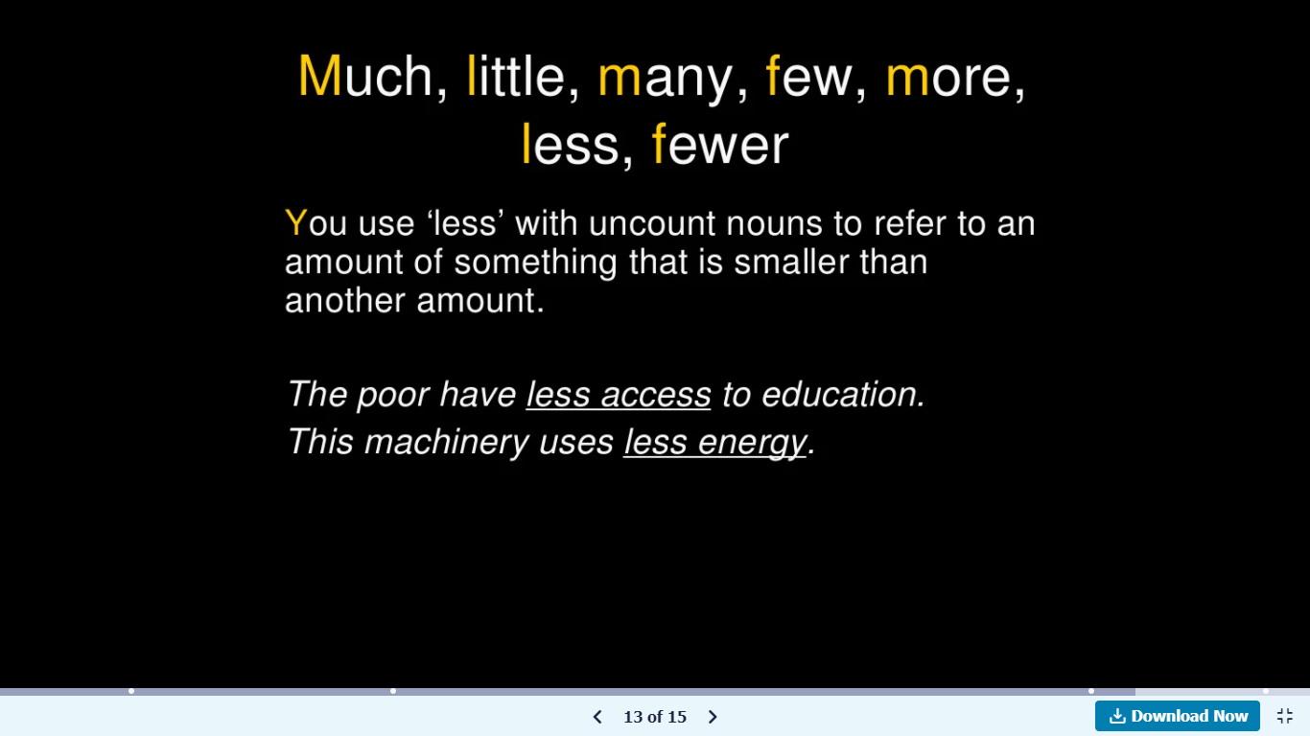
Less + uncountable N. (smaller than another amount)

Slide 13
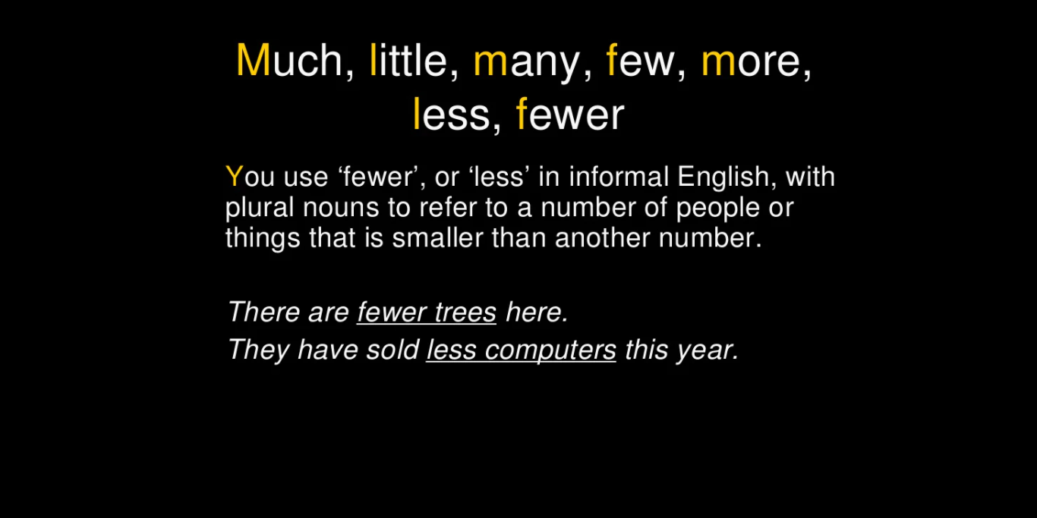
Fewer + plural countable N. (smaller than another number)

Slide 14
Summary
Much + uncountable N. (large quantity)
Little + uncountable N. (small quantity)
Many + plural countable N. (a large number of people/things)
Few + plural countable N. (a small number of people/things)
A lot of + uncountable/ plural countable N. (large quantity/number)
Plenty of + uncountable/ plural countable N. (large quantity/number)
More + uncountable/ plural countable N. (greater than another quantity/number)
Less + uncountable N. (smaller than another amount)
Fewer + plural countable N. (smaller than another number)

