Slide 1
Characteristics of Basic research
The main purpose is to understand and explain.
It aims in formulating and testing theoretical construct.
It takes the form of a theory that explains the phenomenon under investigation to give its contribution to knowledge. It
It is more descriptive in nature exploring what, why and how questions.
The results can describe natural or social phenomenon, such as its form, structure, activity, change over time, relationship to other phenomena

Slide 2
Methodology

Slide 3
Overall Methodology
Approach to research:
Quantitative research (research depends on numbers and statistical procedures)
Qualitative
Mixed method research
Notes:
Approach sometimes also called tradition of research.

Slide 4
What is qualitative data?
Qualitative data is non-statistical and is typically unstructured or semi-structured in nature. This data isn’t necessarily measured using hard numbers used to develop graphs and charts. Instead, it is categorized based on properties, attributes, labels, and other identifiers.
Qualitative data can be used to ask the question “why.” It is investigative and is often open-ended until further research is conducted. Generating this data from qualitative research is used for theorizations, interpretations, developing hypotheses, and initial understandings.

Slide 5
What is qualitative data?
Qualitative data can be generated through:
Texts and documents
Audio and video recordings
Images and symbols
Interview transcripts and focus groups
Observations and notes
Note: Identification numbers like an SSN or driver’s license are also considered qualitative data because they are categorical and unique to one person.

Slide 6
What is quantitative data?
Contrary to qualitative data, quantitative data is statistical and is typically structured in nature – meaning it is more rigid and defined. This type of data is measured using numbers and values, which makes it a more suitable candidate for data analysis.
Whereas qualitative is open for exploration, quantitative data is much more concise and close-ended. It can be used to ask the questions “how much” or “how many,” followed by conclusive information.

Slide 7
What is quantitative data?
Quantitative data can be generated through:
Tests
Experiments
Surveys
Market reports
Metrics

Slide 8
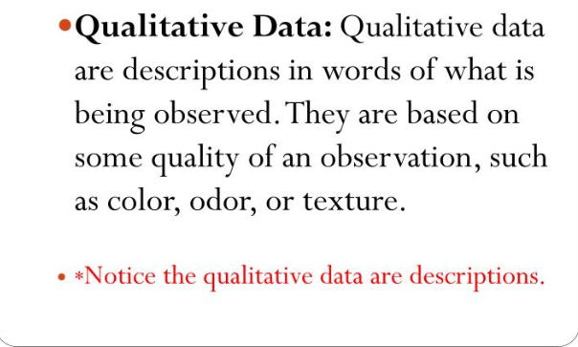

Slide 9
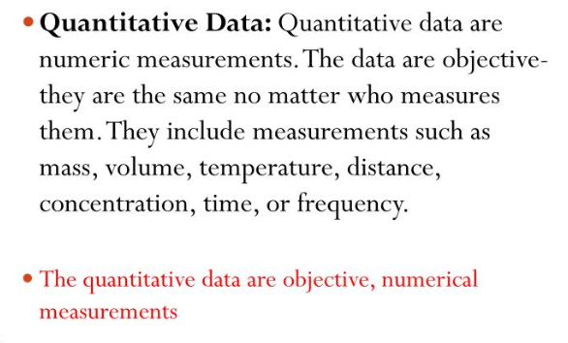

Slide 10
What is the difference between quantitative and qualitative data?
Quantitative data can be counted, measured, and expressed using numbers. Qualitative data is descriptive and conceptual. Qualitative data can be categorized based on traits and characteristics.

Slide 11
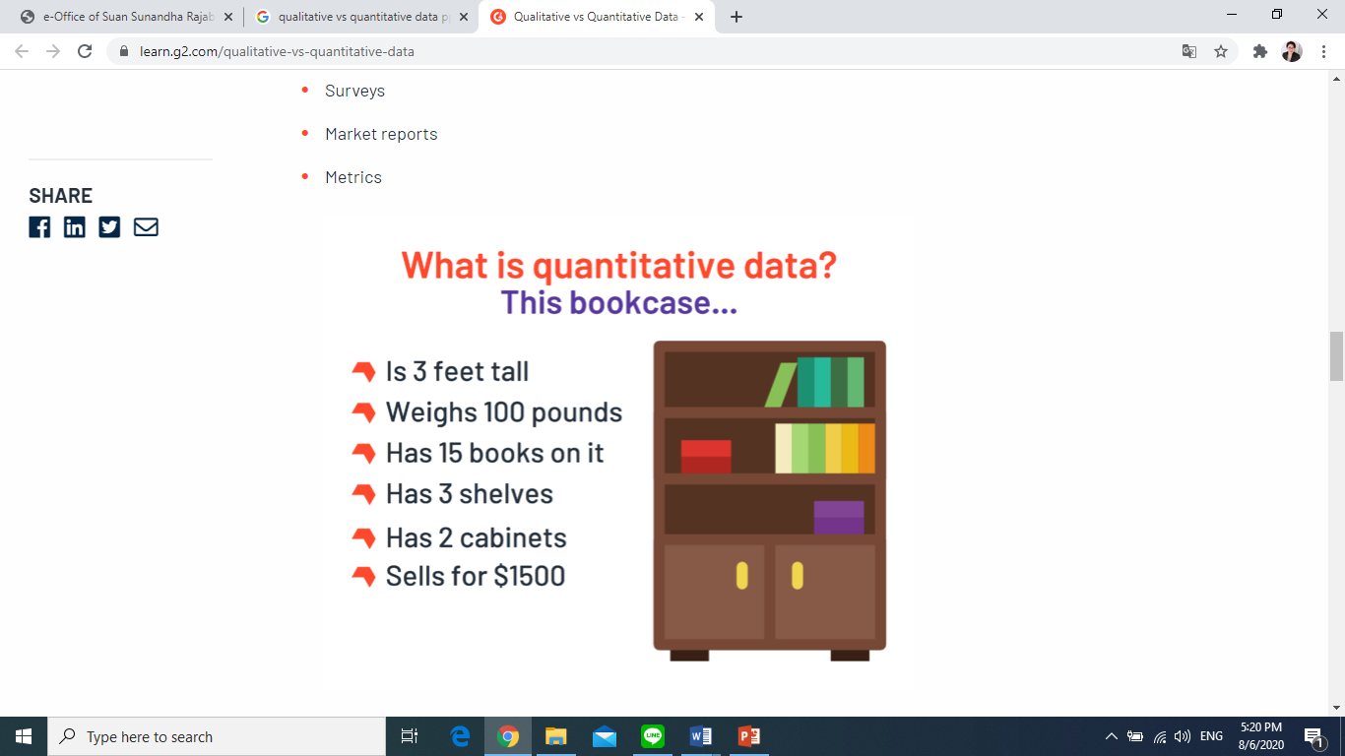
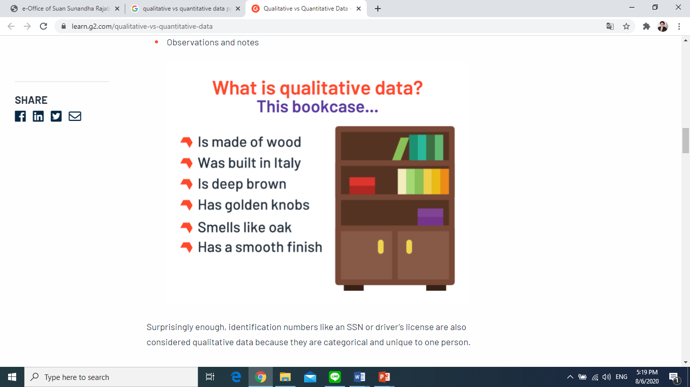

Slide 12
Qualitative vs Quantitative Data
Qualitative Data Overview: Deals with descriptions. Data can be observed but not measured. Colors, textures, smells, tastes, appearance, beauty, etc. Qualitative → Quality | Quantitative Data Overview: Deals with numbers. Data which can be measured. Length, height, area, volume, weight, speed, time, temperature, humidity, sound levels, cost, members, ages, etc. Quantitative → Quantity

Slide 13
Qualitative data: *red/green color, gold frame *smells old and musty *texture shows brush strokes of oil paint *peaceful scene of the country *masterful brush strokes | Quantitative data: *picture is 10" by 14” with frame 14" by 18” * weighs 8.5 pounds surface area of painting is 140 sq. in. *cost $300
Oil Painting

Slide 14

Qualitative data: *robust aroma *frothy appearance * strong taste *glass cup * expensive | Quantitative data: *12 ounces of latte *serving temperature 150⁰ F. *serving cup 7 inches in height *cost $4.95
Latte

Slide 15
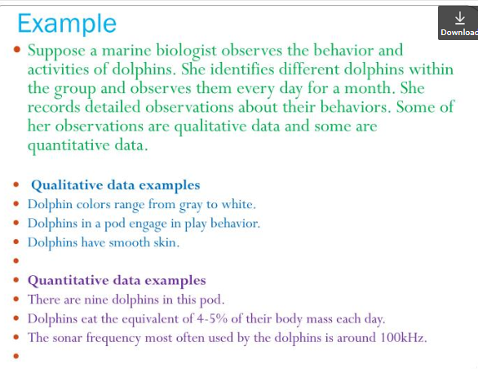

Slide 16
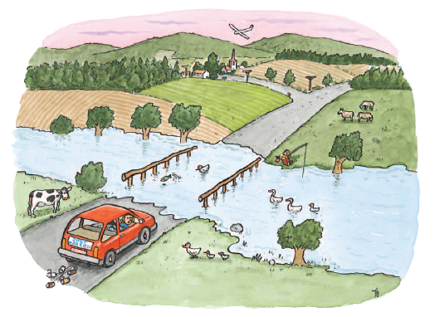
1. Make one qualitative observation about the picture above.
2. Make one quantitative observation about the picture above.

Slide 17
Fundamentals in research
Research should be able to meet the tests of:
Validity =>
Reliability =>
Success of measuring what was planned; strength of conclusion
Research is repeatable

Slide 18
Data Collection Procedure
Means of gathering data with certain procedures:
Observation (audio, video, note-taking)
Survey:
  questionnaire,
  interview (formal or informal)
Record
Tests
Learner diaries
Corpus

Slide 19
Data
  Learners (individuals, grades, groups: age, proficiency, etc.)
  Teachers
  All teaching material
  Teaching situation
  Texts
  ---> combinations possible or necessary

Slide 20
Population: any set of individuals (or objects) having some common observable characteristics.
Sample: the subset of a population which represents the characteristics of the population.
A sample consists of respondents or subjects
An informant: a person from whom a linguist obtains information about language, dialect, or culture.
A corpus is a collection of written or spoken material.

Slide 21
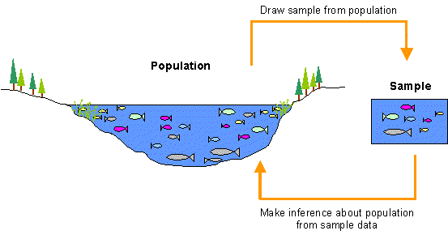

Slide 22
Practice

